Slide 1
Spark Machine Learning (1)

Slide 2
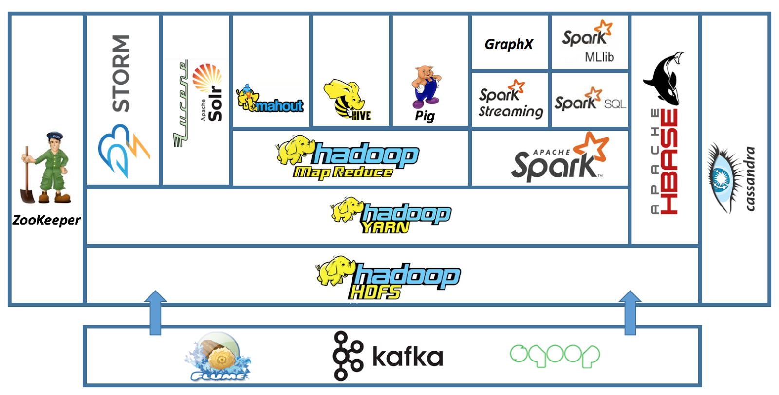

Slide 3
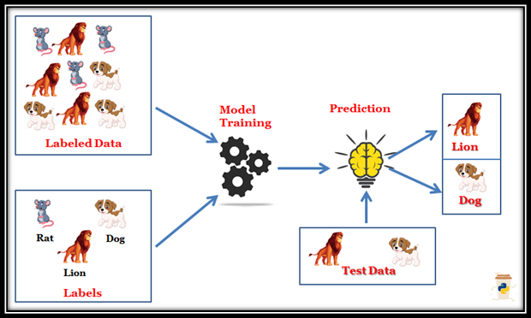
Supervised Learning
https://blog.finxter.com/supervised-and-unsupervised-machine-learning/

Slide 4
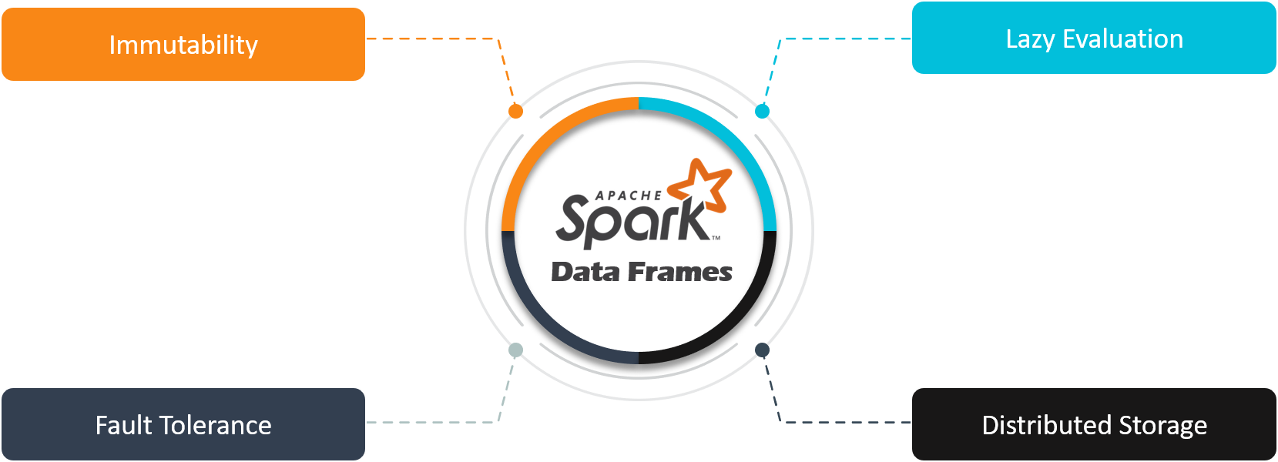
Spark DataFrame
https://www.edureka.co/blog/dataframes-in-spark/

Slide 5
RDD vs DataFrame
RDD
  A distributed collection of data elements spread across many machines in the cluster
  It can easily and efficiently process data which is structured as well as unstructured
  Data source API allows that an RDD could come from any data source e.g. text file, a database
DataFrame
  A DataFrame is a distributed collection of data organized into named columns
  It works only on structured and semi-structured data
  Data source API allows that an DataFrame could come from CSV, JSON, HDFS, HIVE table

Slide 6
Load Data
val data = spark.read.option("header","true").
option("inferSchema","true").
format("csv").
load("/tmp/mooc.csv")
code on this slides from https://towardsdatascience.com/training-your-first-classifier-with-spark-and-scala-893d7c6f7d88

Slide 7
Create the label column
val df = (data.select(data("certified").as("label"),
$"registered", $"viewed", $"explored",
$"final_cc_cname_DI", $"gender", $"nevents",
$"ndays_act", $"nplay_video", $"nchapters", $"nforum_posts"))

Slide 8
One-Hot Encoding the String columns
import org.apache.spark.ml.feature.{VectorAssembler, StringIndexer, OneHotEncoderEstimator}
// string indexing
val indexer1 = new StringIndexer().
setInputCol("final_cc_cname_DI").
setOutputCol("countryIndex").
setHandleInvalid("keep")
val indexed1 = indexer1.fit(df).transform(df)
val indexer2 = new StringIndexer().
setInputCol("gender").
setOutputCol("genderIndex").
setHandleInvalid("keep")
val indexed2 = indexer2.fit(indexed1).transform(indexed1)
// one hot encoding
val encoder = new OneHotEncoderEstimator().
setInputCols(Array("countryIndex", "genderIndex")).
setOutputCols(Array("countryVec", "genderVec"))
val encoded = encoder.fit(indexed2).transform(indexed2)

Slide 9
Impute Null Values
val nanEvents = encoded.groupBy("nevents").count().orderBy($"count".desc)
for (line <- nanEvents){
println(line)
}
// define medians
val neventsMedianArray = encoded.stat.approxQuantile("nevents", Array(0.5), 0)
val neventsMedian = neventsMedianArray(0)
val ndays_actMedianArray = encoded.stat.approxQuantile("ndays_act", Array(0.5), 0)
val ndays_actMedian = ndays_actMedianArray(0)
val nplay_videoMedianArray = encoded.stat.approxQuantile("nplay_video", Array(0.5), 0)
val nplay_videoMedian = nplay_videoMedianArray(0)
val nchaptersMedianArray = encoded.stat.approxQuantile("nchapters", Array(0.5), 0)
val nchaptersMedian = nchaptersMedianArray(0)
// replace
val filled = encoded.na.fill(Map(
"nevents" -> neventsMedian,
"ndays_act" -> ndays_actMedian,
"nplay_video" -> nplay_videoMedian,
"nchapters" -> nchaptersMedian))

Slide 10
Form the feature vector
// Set the input columns as the features we want to use
val assembler = (new VectorAssembler().setInputCols(Array(
"viewed", "explored", "nevents", "ndays_act", "nplay_video",
"nchapters", "nforum_posts", "countryVec", "genderVec")).
setOutputCol("features")
// Transform the DataFrame
val output = assembler.transform(filled).select($"label",$"features")

Slide 11
Split the label-features data into training and testing
// Splitting the data by create an array of the training and test data
val Array(training, test) = output.select("label","features").
randomSplit(Array(0.7, 0.3), seed = 12345)

