Slide 1
OpenStax Chapter 22
Permanent Magnets
  Always have a north and a south pole
  Youtube: Lecture 22: https://youtu.be/Y1MDZzaDwf4
  Lecture 23: https://youtu.be/oVcHw2cyu9o

Slide 2
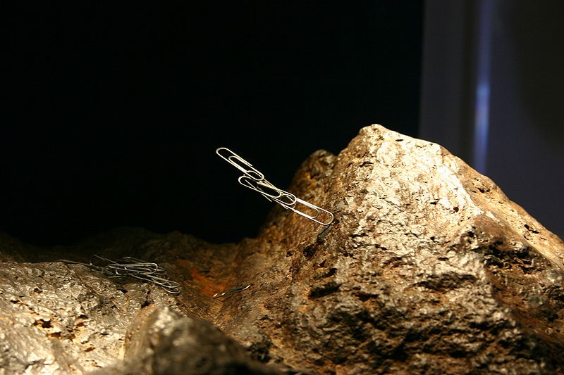

Lodestones and Compasses
Lodestones can interact with other materials in odd ways
Attract some metals like iron and nickel
http://en.wikipedia.org/wiki/File:Magnetite_Lodestone.jpg
By 1119 first compass was made with a lodestone
Free to rotate lodestone always points same way

Slide 3
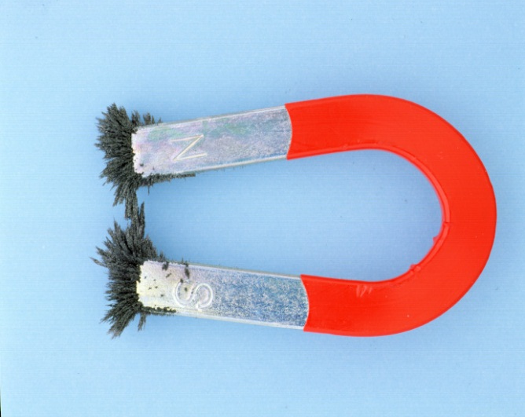
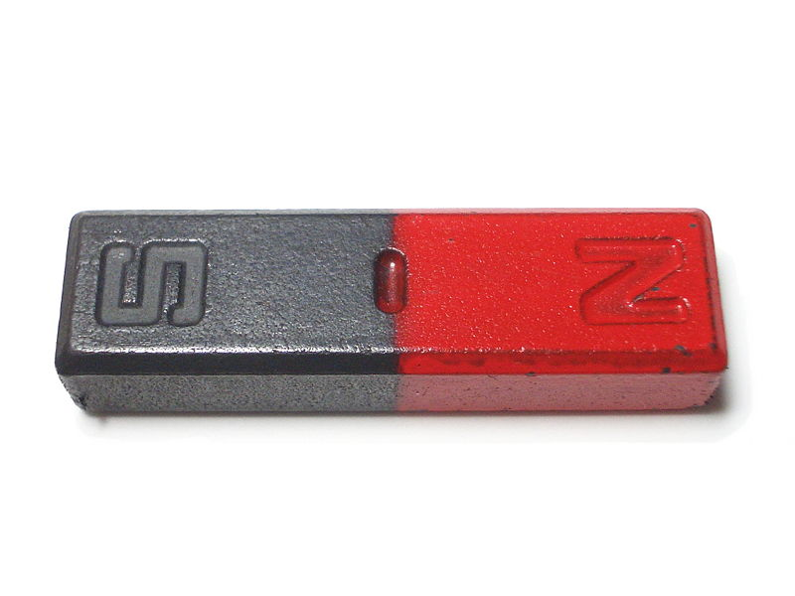
Permanent Magnets
Lodestones are permanent magnets
http://commons.wikimedia.org/wiki/File:Bar_magnet.jpg
http://www.mikecurtis.org.uk/ks2_magnets.htm
Permanent magnets:
can ATTRACT other permanent magnets (sometimes)
can REPEL other permanent magnets (sometimes)
ATTRACT some materials (like iron, nickel; sometimes)
Don’t interact with many materials (like wood, bone)

Slide 4

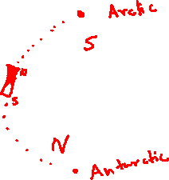
Magnetic Poles
N
S
N
S
Opposite Poles attract
N
S
S
N
Like Poles repel
Poles are like charges but with important differences
North “seeking” pole points to Earth’s geographic north
What type of magnetic pole is in the Arctic?
south magnetic pole

Slide 5
Magnets are Dipoles
Every magnet has both a North and a South pole
Electric Dipoles:
Both poles attract magnetic materials (like iron, nickel, and cobalt)
+
–
+ and – charge held together
Geometry of the magnet determines where the poles are and what happens between them
Look at a paperclip and bar magnet:
Clip is strongly attracted to ends
Clip is not attracted to center

Slide 6
Finding Magnets
We have three electrically neutral cylinders (they only interact through magnetic properties); each one has an “X” painted on it to tell the ends apart. When I and II are brought together as shown, they attract each other. When II and III are brought together as shown, they attract each other. For each of the scenarios, what will happen when I and III are brought together? (Assume all magnets are bar magnets.)
Scenarios
All three are magnets
A
I
II
I
Two are magnets
D
X
X
X
Only one is a magnet
C
??
A. They’ll attract
B. They’ll repel
C. They won’t interact
D. Can’t tell with given information
E. No way for this to work
X
X
II
III
III
X
If not all are magnets, what do you do to find out which are?
Flip object at a time; see what happens

Slide 7
Conceptual Problem with Magnets
In a certain configuration, object A and B are attracted to one another. In a certain configuration, object B and C are repelled by one another. What will happen when A and C are brought near one another? (All three objects are electrically neutral.)
I. A and C will definitely attract one another (or do nothing)
II. A and C will definitely repel one another (or do nothing)
III. A and C will sometimes attract one another and sometimes repel one another (or do nothing)
IV. A and C will never attract or repel one another
Only I is possible
Only II is possible
Only III is possible
Only IV only
Either I or III

Slide 8
Magnetic Fields
OpenStax 22.1 – 22.3
Magnetic Fields
  Are loops (leave north and enter south poles)
  Permanent magnets try to line up in field

Slide 9
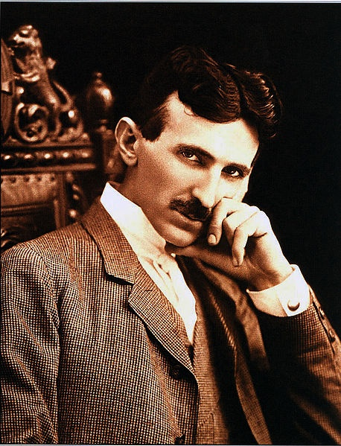
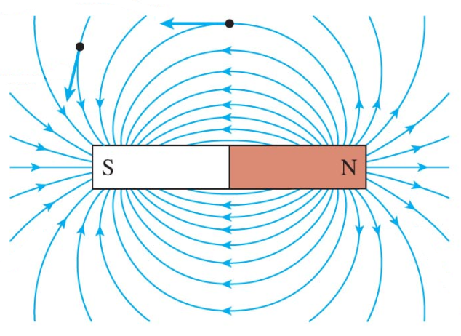

Magnetic Fields
Magnets alter space around them by creating fields
Symbol: $\vec{B}$ (magnetic field is a vector quantity)
SI Unit: Tesla (T)
50 μT
Earth’s Field:
Fridge Magnet:
Field leaves North Pole and
enters South Pole
5 mT
Like E-fields, can represent with field vectors or field lines
Magnetic field lines are really loops (continue inside magnet)
http://en.wikipedia.org/wiki/File:N.Tesla.JPG
© 2010 Pearson Education, Inc.

Slide 10
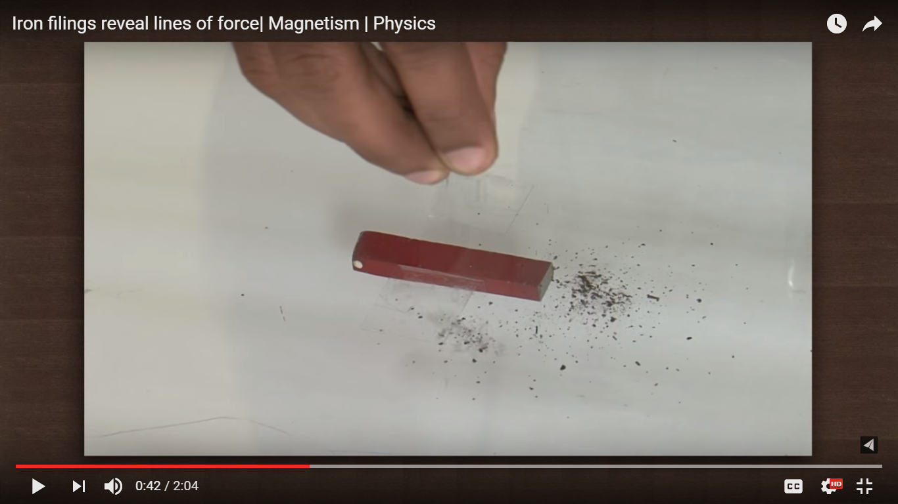
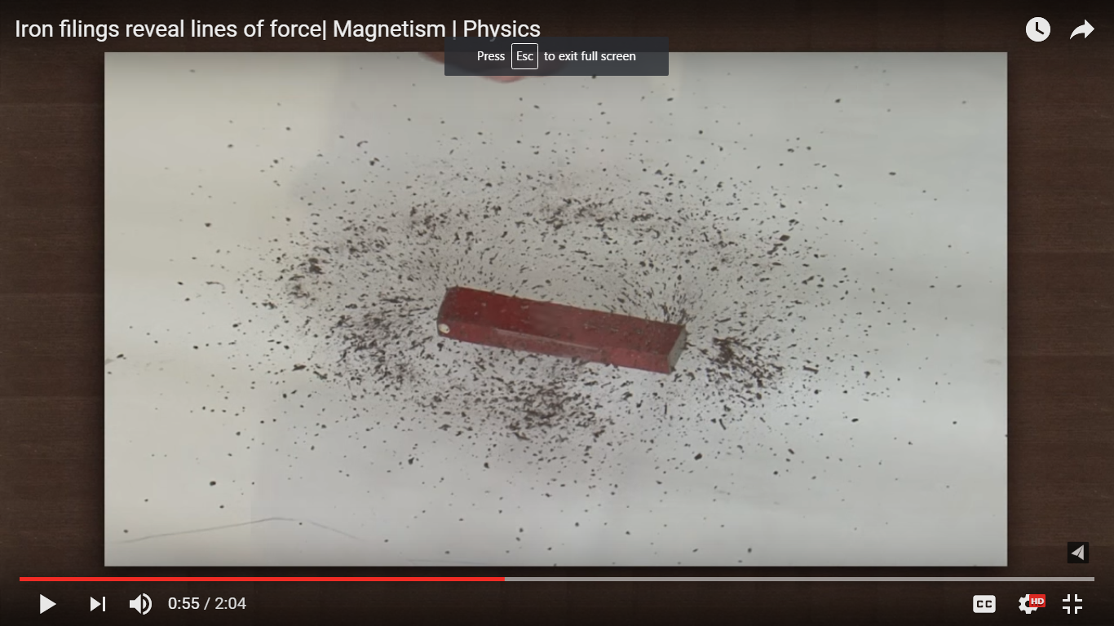
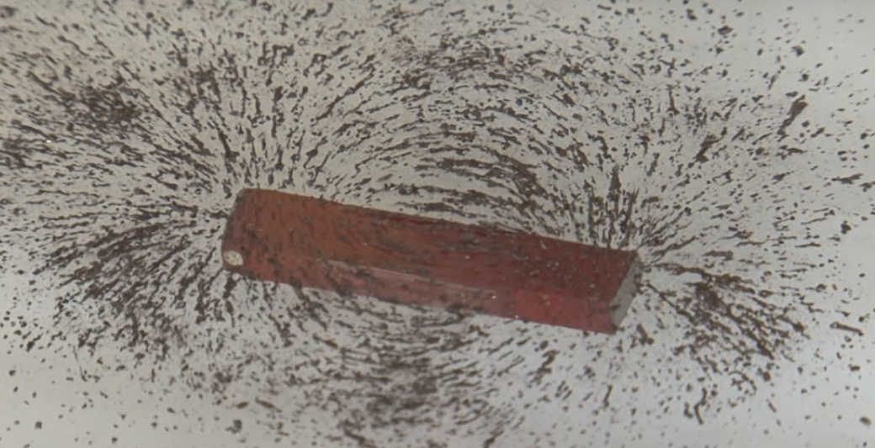
Finding Magnetic Field Lines
Tracing lines with iron filings:
https://www.youtube.com/watch?v=Xy6H0mr3KXw
Place magnet on paper and sprinkle iron filings
Shake paper lightly to allow iron filings to move on paper
Iron filings will form the pattern on the right
The pattern represents magnetic field lines
Zero field at middle of magnet

Slide 11
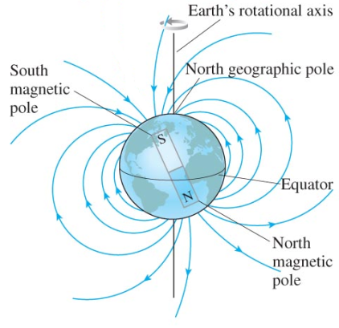
Bar Magnet in a Magnetic Field
Bar magnets try to line up with magnetic field
(compare with electric dipole [lecture 11-13])
N
S
N
S
This is why compasses work
Geographic North
© 2010 Pearson Education, Inc.

Slide 12
Magnetic Field of a Current
OpenStax 22.4 – 22.7, 22.9
Currents create magnetic fields
  Field wraps around current
  Field lines are always loops
Right-hand grip rule (24.4)

Slide 13
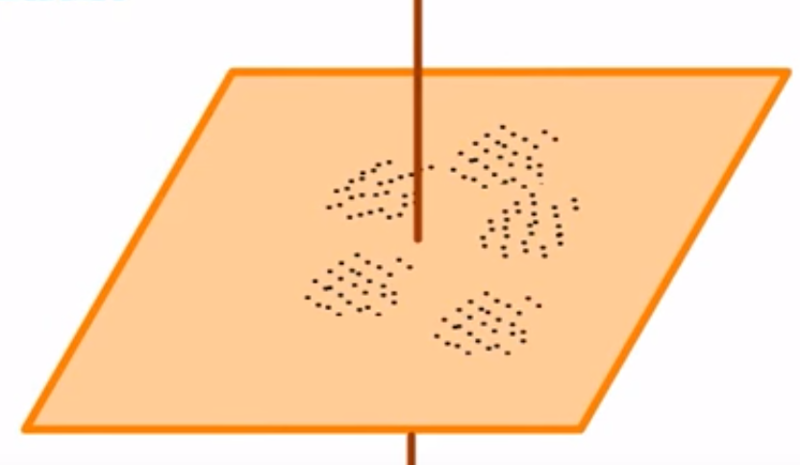


What Causes Magnetic Fields?
Permanent Magnets (why – we’ll come back to that)
Electric Currents:
(Direction of field can be found with iron filings or compass
https://www.youtube.com/watch?v=JInPz340iDQ)
Wire passes through a cardboard sheet sprinkled with iron filing
Turn on current (pointing down the wire in this diagram)
Iron filings form a circular pattern
i.e. magnetic field of a wire carrying a current is circular

Slide 14
Magnetic Field of a Wire
Is the direction of the field of a wire CW or CCW?
Current flowing out of page: CCW
Current flowing into page: CW
Field wraps around wire; therefore, 3D notation required:
Out of Page
(arrow pointing towards observer)
(point of arrow)
Into Page
(arrow pointing away from observer)
(feathers of arrow)

Slide 15
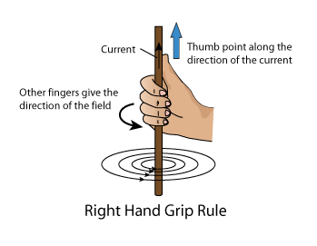
Right-hand Rule: Grip Rule
Used to find direction of magnetic field of a wire
I
Grip wire with right hand
Point thumb in direction of current
Curl of fingers represents direction of field

Slide 16
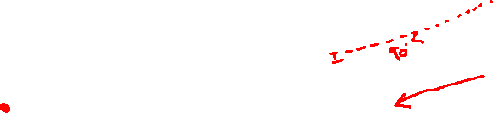
Finding Direction of B Field from Field Lines
Draw tangent to field lines at chosen point
Direction of tangent shows direction of B field at that point
B
I
r
r
B
Field is perpendicular to both current and radius
(i.e. field, current and radius are mutually perpendicular)

Slide 17
Example 1
1
Draw circular field lines extending up to points 1 and 2
Draw arrows on the circle pointing in the correct direction of field (i.e. using right-hand grip rule)
Draw tangents at points 1 and 2
I
2

Slide 18
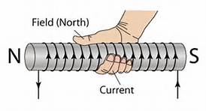
Example 2
3
Field at point 3 is pointing out of the page
I
Field at point 4 is pointing into the page
4

Slide 19
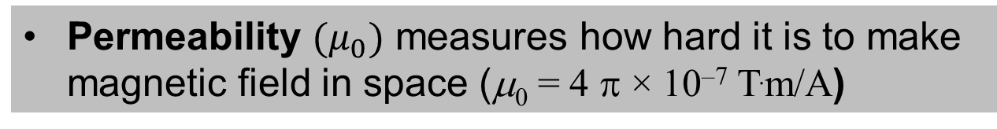
Magnitude of Field of a Wire
Magnitude of magnetic field (B) depends on:
  Current (I) (higher I => larger B)
  Distance from wire (r) (larger r => smaller B)
Strength of Mag. Field at a distance from a long wire
Permeability of space
Current passing through wire
Perpendicular Distance from wire
Permeability $(μ_{0})$ measures how hard it is to make magnetic field in space (μ₀ = 4 π × 10^{–7} T.m/A)

Slide 20

Combining B Fields
Find B field contribution of each source
Combine all B fields by vector summation
(i.e. head-to-tail or summing x,y components)
B₁
I₁
I₂
I₃
/
B₃
/
B₂
B₁
$$\vec{B_{net}}= \vec{B_{1}} +\vec{B_{2}} +\vec{B_{3}}$$
$$B_{net,x}=B_{1,x} +B_{2,x} +B_{3,x}$$
$$B_{net,y}=B_{1,y} +B_{2,y} +B_{3,y}$$
=
=
B₂
B₃
B_{net}

Slide 21
Finding Direction of Field with Multiple Wires Present: Example 1
The two wires shown have the same current flowing through them and are located at the corners of a square. What is the direction of the magnetic field at the square’s center?
a.
b.
c.
d.
e. Magnetic field is zero there
Direction of ?

Slide 22
Finding Magnitude of Field with Multiple Wires Present [1]
If the two wires each carry 2.0 A of current, and the square has sides that are 15 cm long. What is the magnitude of the field at the center?
2.7 × 10^{–6} T
3.8 × 10^{–6} T
5.4 × 10^{–6} T
7.5 × 10^{–6} T
1.0 × 10^{–5} T
r
Magnitude?
Find magnitude of field from one wire $\left(B= \frac{μ_{0}I}{2πr}\right)$
Need distance from center of square to corner

Slide 23

Finding Magnitude of Field with Multiple Wires Present [2]
If the two wires each carry 2.0 A of current, and the square has sides that are 15 cm long. What is the magnitude of the field at the center?
2.7 × 10^{–6} T
3.8 × 10^{–6} T
5.4 × 10^{–6} T
7.5 × 10^{–6} T
1.0 × 10^{–5} T
r = 0.106 m
r
$${45}^{°}$$
Magnitude?
Magnitude
(one wire)
B_{1_wire} = 3.8 μT
x-component
(one wire)
B_{1_wire;x} = B_{1_wire} cos(45°) = 2.7 μT
magnitude (both wires)
B_{2_wires;x} = 2 B_{1_wire;x} = 5.4 μT

Slide 24
Finding Direction of Field with Multiple Wires Present: Example 2
The two wires shown have the same current flowing through them and are located at the corners of a square. What is the direction of the magnetic field at the square’s center?
a.
b.
c.
d.
e. Magnetic field is zero there
Direction of ?

Slide 25
Finding Magnitude of Field with Multiple Wires Present [1]
If the two wires each carry 2.0 A of current, and the square has sides that are 15 cm long. What is the magnitude of the field at the center?
2.7 × 10^{–6} T
3.8 × 10^{–6} T
5.4 × 10^{–6} T
7.5 × 10^{–6} T
1.0 × 10^{–5} T
r
Magnitude of?
Find magnitude of field from one wire (say the right one)
Need distance from center of square to corner

Slide 26
Finding Magnitude of Field with Multiple Wires Present [2]
If the two wires each carry 2.0 A of current, and the square has sides that are 15 cm long. What is the magnitude of the field at the center?
2.7 × 10^{–6} T
3.8 × 10^{–6} T
5.4 × 10^{–6} T
7.5 × 10^{–6} T
1.0 × 10^{–5} T
r
r = 0.106 m
Magnitude of?
Magnitude
(right wire)
B_{right} = 3.8 μT
y-component
(right wire)
B_{right;y} = B_{right} sin(45°) = 2.7 μT
magnitude (both wires)
B_{both} = 2 B_{right;y} = 5.3 μT

Slide 27
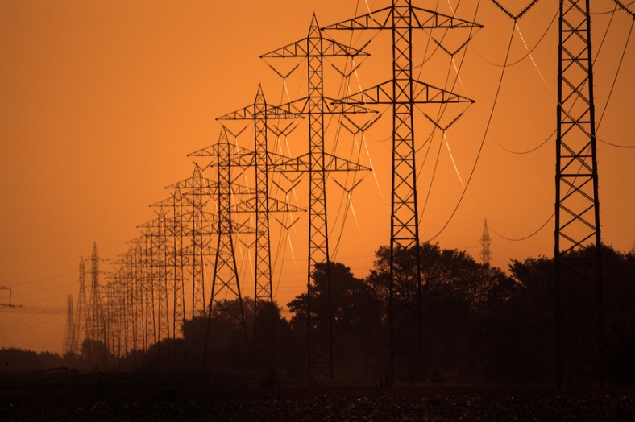
Magnetic Field Created By Power Lines [1]
Your new apartment is great, but it’s under a high tension power line, and you’re worried about the magnetic field created by the wires. The tower has two wires 4 m apart, each carries a current of 340 A, and your bed is 15 m below their mid point. The wire on the west side of the tower carries current north and the wire on the east side of the tower, carries a current south (these are the geographic directions). At your bed what is the …
(geographic) direction of the lines’ field?
magnitude of the lines’ field?
a. East
b. West
c. Up
d. Down
e. Magnetic field is zero
a. 2.38 × 10^{–6} T
b. 1.80 × 10^{–5} T
c. 1.19 × 10^{–6} T
d. 8.99 × 10^{–6} T
e. 8.00 × 10^{–6} T

Slide 28
Magnetic Field Created By Power Lines [2]
What is the (geographic) direction of the lines’ field?
(North: into page, South: out of page):
a. East
b. West
c. Up
d. Down
e. Magnetic field is zero
2
x
1
θ
r
y
Alternate Interior angles
Finding θ & r (x = 2 m; y = 15 m):
ϕ
Complements
θ
θ
ϕ
Complements

Slide 29
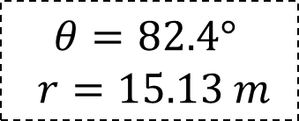

Magnetic Field Created By Power Lines [3]
What is the magnitude of the lines’ field?
2
x
1
a. 2.38 × 10^{–6} T
b. 1.80 × 10^{–5} T
c. 1.19 × 10^{–6} T
d. 8.99 × 10^{–6} T
e. 8.00 × 10^{–6} T
r
$$θ=82.4°$$
$$r=15.13 m$$
y
Magnitude (one wire)
θ
θ
y-component (one wire)
$B_{1,y}+B_{2,y}$
magnitude (both wires)

Slide 30
Magnetic Field Created By Power Lines
+ Earth’s Magnetic Field
What is the magnitude of the net magnetic field caused by the tower’s field (1.19 μT) and the earth’s field (which is 50 μT, north)?
a. 48.813 μT
b. 49.99 μT
c. 51.187 μT
d. 50.01 μT
e. 50.60 μT
Side View:
Earth’s Field (north)
Tower’s Field
(down)
Net Field

Slide 31
Current Loop and Magnetic Dipole Moment
OpenStax 22.8

Slide 32
Current Carrying Loop
Imagine a loop of wire with a current I and radius R
(Top view)
I
(Side view)
What is the direction of magnetic field inside the loop?
I
- For CCW current: out of page
- For CW current: into page
Field at center (with one loop):
With N loops:

Slide 33
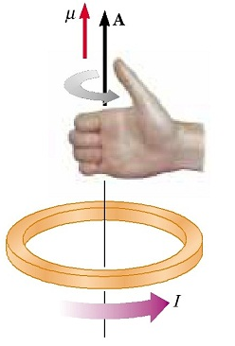
Right-hand Rule: Loop Rule
Used to find direction of magnetic field of a current loop
Curl fingers in direction of current
Direction of thumb is the direction of field

Slide 34
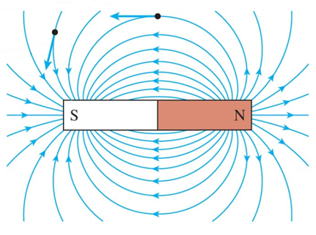
Magnetic Dipole Moment [1]
A current loop behaves like a magnet
Magnetic field points from N to S [slide 9]
The current loop produces a magnetic dipole moment ($μ$) in the direction of the field

Slide 35
Magnetic Dipole Moment [2]
Magnetic Dipole Moment $\left(μ\right)$
[NOT the same as $μ_{0}$ (permeability of free space)]
Perpendicular to loop
Points in the same direction as B
Used for calculating torque, energy, etc.
In the presence of an external B ($B_{ext}$):
If $μ$ is parallel to $B_{ext}$: energy is minimum
If $μ$ is opposite to $B_{ext}$: energy is maximum
$$μ$$
Number of Loops
Area of Loops
Mag. Moment of Loop
Current passing through wire

Slide 36
Torque on Magnetic Moment
[compare with slide 11]
Imagine a loop of wire in an external magnetic field
$μ$of loop
I
External Field
Loop tries to align its $μ$ with the external field
(so that energy becomes minimum)
Torque is generated as loop rotates
(Electric motors work using this principle)

Slide 37
Example: Magnetic Field at Center
Find the magnitudes of the magnetic field at the center for the following setup. Each wire carries the same current and the loops are single loops (N = 1):
Inner Loop’s Field:
2a
I
a
Out of Page
Outer Loop’s Field:
center of two loops (inner with radius a, outer with radius 2a, currents in opposite directions)
Into Page
Total Field:
Out of Page

Slide 38
Rank the Magnetic Fields
Rank the magnitudes of the magnetic fields at the points for the following setups, each wire carries the same current and the loops are single loops (N = 1):
B > C > A > D
I
I
I
2a
a
I
a
I
a
2a
A
a from long wire
<
B
center of loop with radius a
>
C
center of two loops (inner with radius a, outer with radius 2a, currents in opposite directions)
D
Midway between two long wires 2a apart (currents in same direction)

Slide 39
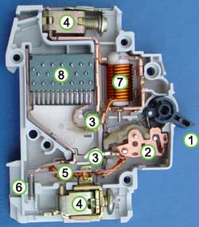
Circuit Breakers
Switch that opens automatically when current is too big
Reusable (unlike a fuse)
Often use loops of wire:
I_{safe}
I_{not} _{safe}
http://commons.wikimedia.org/wiki/File:Circuitbreaker.jpg
Bigger current means bigger magnetic field
Bigger current means bigger magnetic field
Iron Switch
Switch becomes more magnetized
Pulled open by magnetic force

Slide 40
Magnetic Material
OpenStax 22.2

Slide 41
Electron Magnetic Moments
(Source of Permanent Magnets)
Electrons intrinsically have a “magnetic moment”
Analogy: electrons aren’t stationary (and current is just moving charge so …)
e–
Electrons have magnetic properties
In atoms, paired electrons cancel out
e–
+
e–
= 0
With unpaired electrons, atom can have a magnetic moment
In non-magnetic object: random distribution
A
A
A
A
A
A
A
A
A

Slide 42
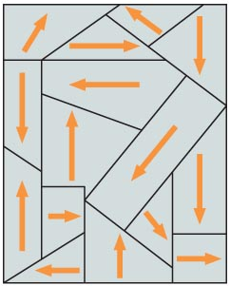
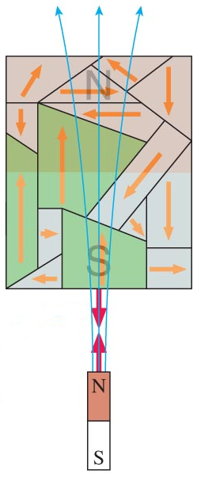
Magnetizing Ferromagnetic Material examples: Fe, Co, Ni
In a non-magnet, “domains” are formed
© 2010 Pearson Education, Inc.
In each domain, magnetic moments line up
Applying external magnetic field (bring a magnet nearby) to ferromagnetic material:
Domains start to line up
As more domains line up the material gets more magnetized
© 2010 Pearson Education, Inc.

Slide 43
Permanent Magnets and Poles
In a permanent magnet, atom’s magnetic moments line up
A
A
A
A
A
A
A
A
N
S
A
A
A
A
A
A
A
A
Poles come from the fact that field from magnetic moments is aimed to leave one side (N) and enter other (S)
Cut the magnet into two pieces
A
A
A
A
A
A
A
A
N
S
N
S
A
A
A
A
A
A
A
A
and you now have two pieces on which the $μ$’s line up:

Slide 44
Magnetic Force
OpenStax 22.7
Magnetic force on a charged particle is perpendicular to velocity and field
Magnitude depends on charge, speed, field, angle
Circular path of particle in magnetic field
  Radius depends on mass, charge, speed, and magnetic field
  Can be used to identify particles

Slide 45
Magnetic Field and Charged Particles
Currents generate magnetic fields
Currents exert forces on perm. mag.s through magnetic fields
Newton’s Third Law:
(every action has an equal and opposite reaction)
permanent magnets exert forces on currents through magnetic fields
If a charge moves through a magnetic field what will happen?
Field will exert a force on the charge
(and charge will exert force on field creator)
i.e. a charged particle moving through a magnetic field experiences magnetic force

Slide 46
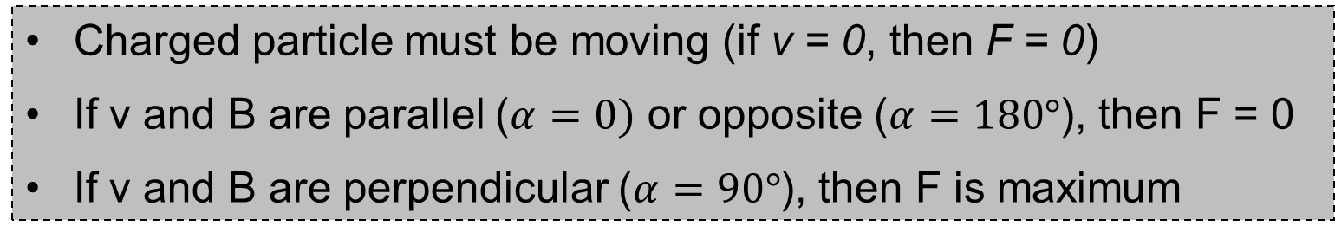
Magnitude of Magnetic Force
Force from field on charge q (N)
Angle between and .
0° ≤ α ≤ 180°
Charge (C)
Speed of charge (m/s)
Magnetic field (T)
Charged particle must be moving (if v = 0, then F = 0)
If v and B are parallel ($α=0)$ or opposite ($α=180°$), then F = 0
If v and B are perpendicular ($α=90°$), then F is maximum

Slide 47
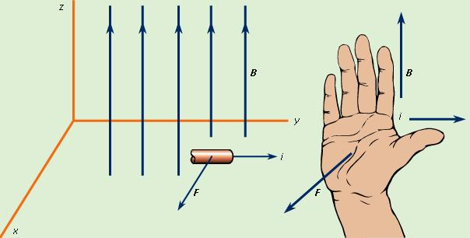
Right-hand Rule: Cross Product
Used to find direction of magnetic force
B
v
+q
F
Point thumb in direction of velocity (v) (or current I)
Point fingers in direction of magnetic field (B)
Palm faces in direction of force (F) if charge is +ve
(direction of F is reversed if charge is –ve)

Slide 48
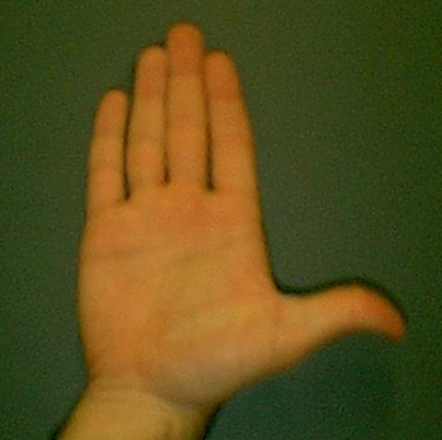
Summary of Right Hand Rule
(for cross product)
Fingers in direction of magnetic field
Thumb points in direction of current or velocity
Note: For a negative particle, direction of force is opposite to the face of palm
Face of palm points in the direction of the force
(on a Positive particle)

Slide 49
Getting the Direction of Force on Charged Particles [1]
Proton

Slide 50
Getting the Direction of Force on Charged Particles [2]
Electron
Note: Direction of F is reversed for –ve charge

Slide 51
Getting the Direction of Force on Charged Particles [3]
Ca²⁺

Slide 52
Getting the Direction of Force on Charged Particles [4]
Cl–

Slide 53
Summary
Proton
Electron
(out of page)
(into page)
Ca²⁺
Cl–
(into of page)

Slide 54
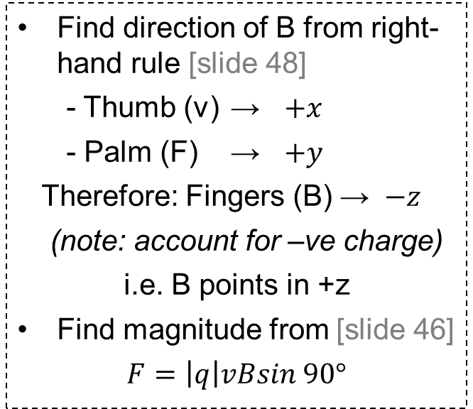
Example: Find Field from Force
An electron momentarily has a velocity (v) which is 400 km/s and in the +x direction. If the force on it from a magnetic force (F) is 5.35 × 10^{–19} N in the +y, which of the following is possibly the magnetic field (B)?
8.36 × 10^{–6} T in +z
8.36 × 10^{–6} T in –z
8.36 × 10^{–3} T in +z
8.36 × 10^{–3} T in –z
1.34 × 10^{–24} T in +z
Find direction of B from right-hand rule [slide 48]
- Thumb (v) → $+x$
- Palm (F) → $+y$
Therefore: Fingers (B) → $−z$
(note: account for –ve charge)
i.e. B points in +z
Find magnitude from [slide 46]
$$F=\left|q\right|vBsin 90°$$
y
x
Note: Direction of B is reversed for –ve charge
z

