Slide 1
Hands on HDFS

Slide 2
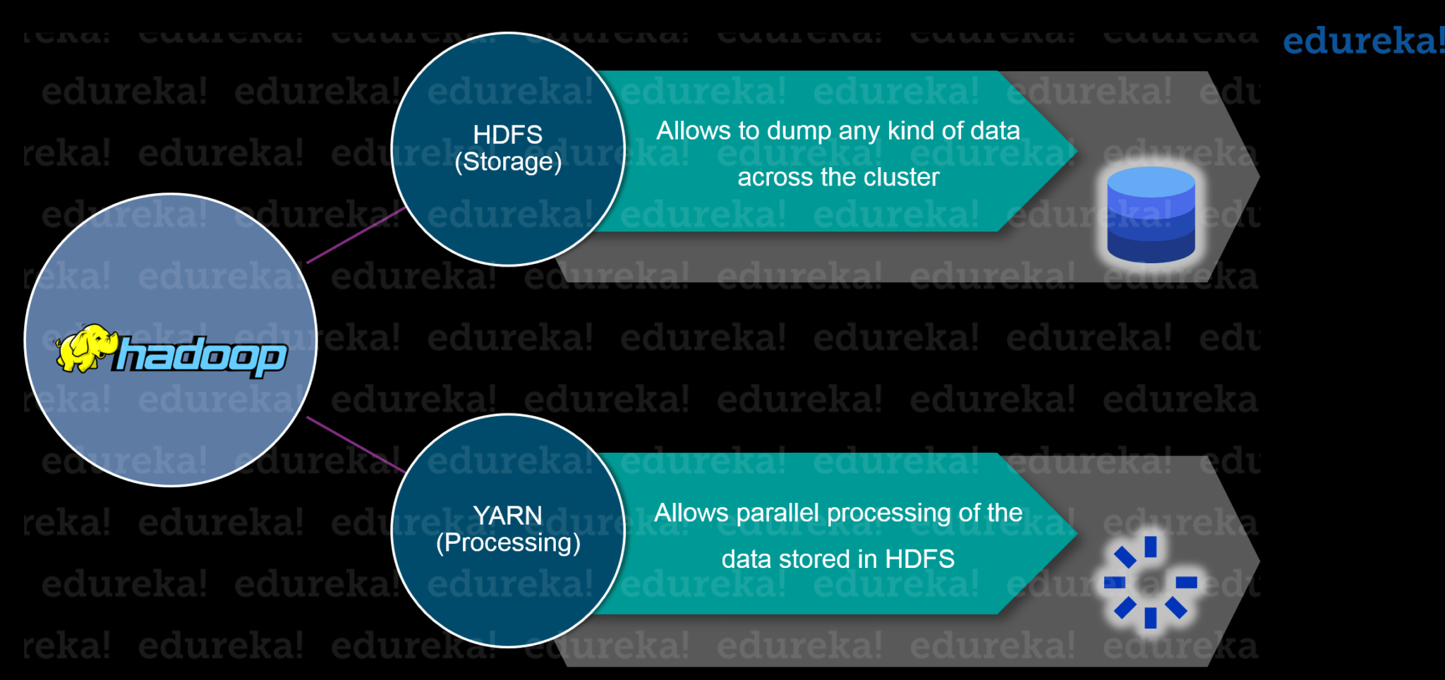
Recall Hadoop Achitecture

Slide 3
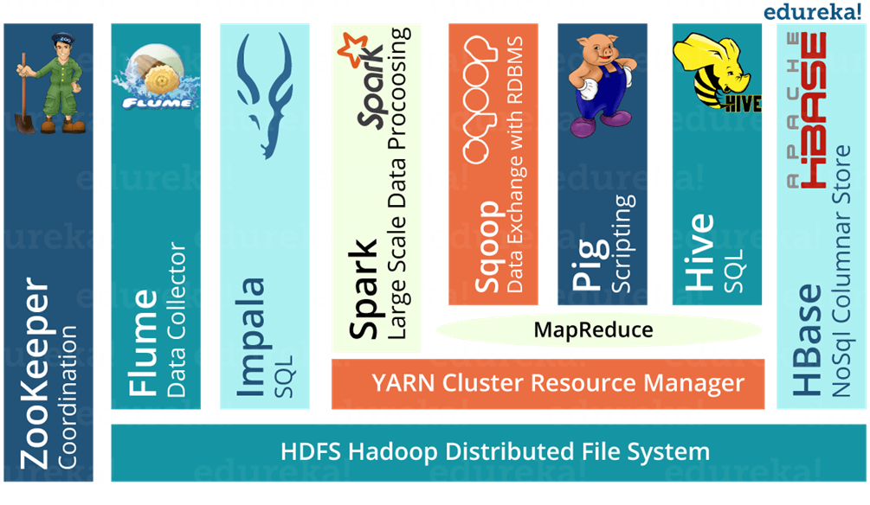

Slide 4
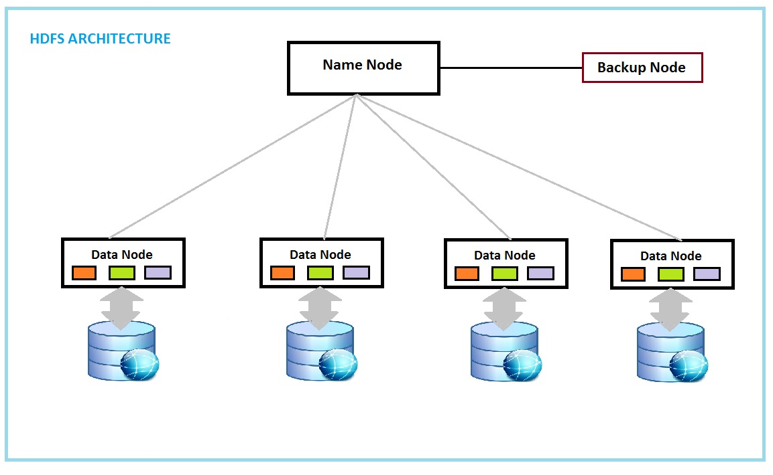
Recall HDFS
HDFS is a scalable, fault-tolerant, distributed storage system
HDFS has demonstrated production scalability of up to 200 PB of storage and a single cluster of 4500 servers, supporting close to a billion files and blocks.

Slide 5
Hands on HDFS

Slide 6
Close VM with “Save State”

Slide 7
Launch VM

Slide 8
Go to this website, and use maria_dev/maria_dev to login

Slide 10
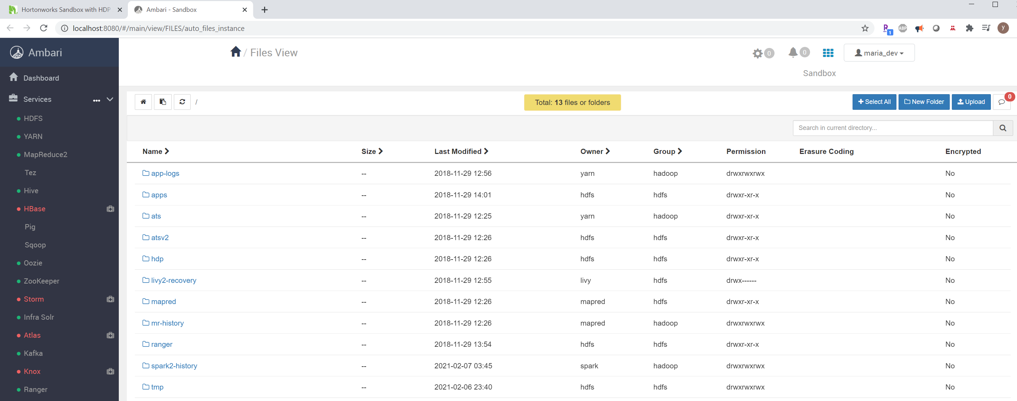
This presents the HDFS view

Slide 11
Create a new folder in “tmp” called “data”

Slide 12
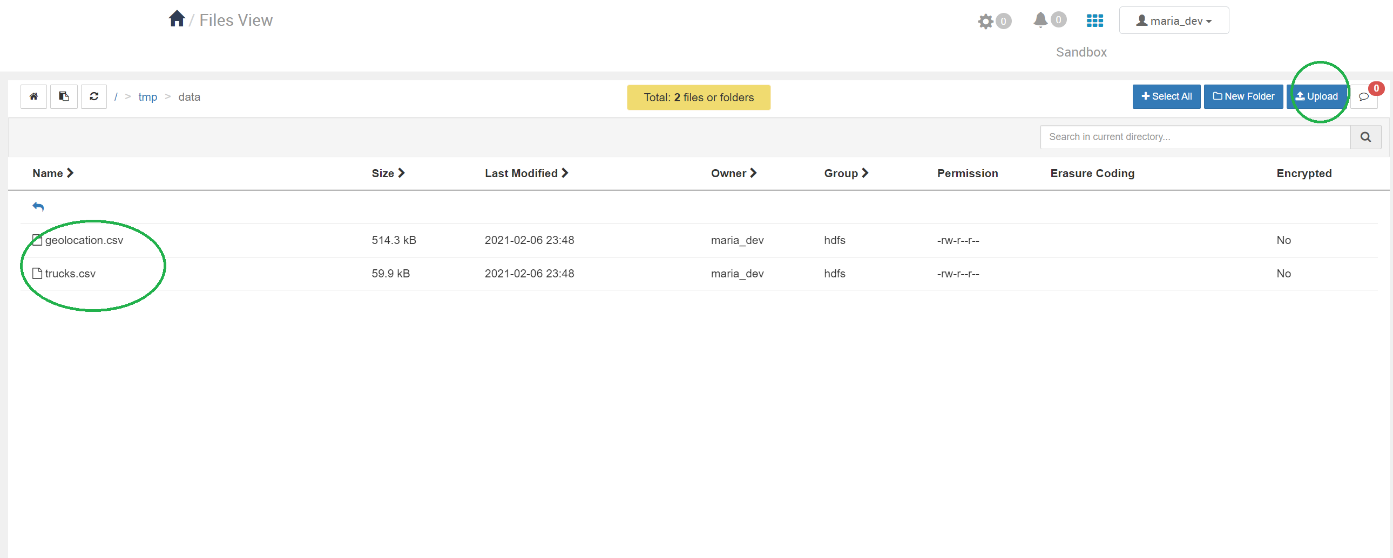
Upload two csv files from your local computer to HDFS (in the folder of “data”)

Slide 13
File operations

Slide 14
Change permission of a file or directory

Slide 15
View HDFS from Terminal
Go to this url with credential: root/your passwd

Slide 16
Issue command “Hadoop fs -ls /” to list all the directories and files under the root /

Slide 17
List the directories and files under “/tmp”

Slide 18
List the directories and files under “/tmp/data”

