Slide 1
MapReduce Hands-On

Slide 2
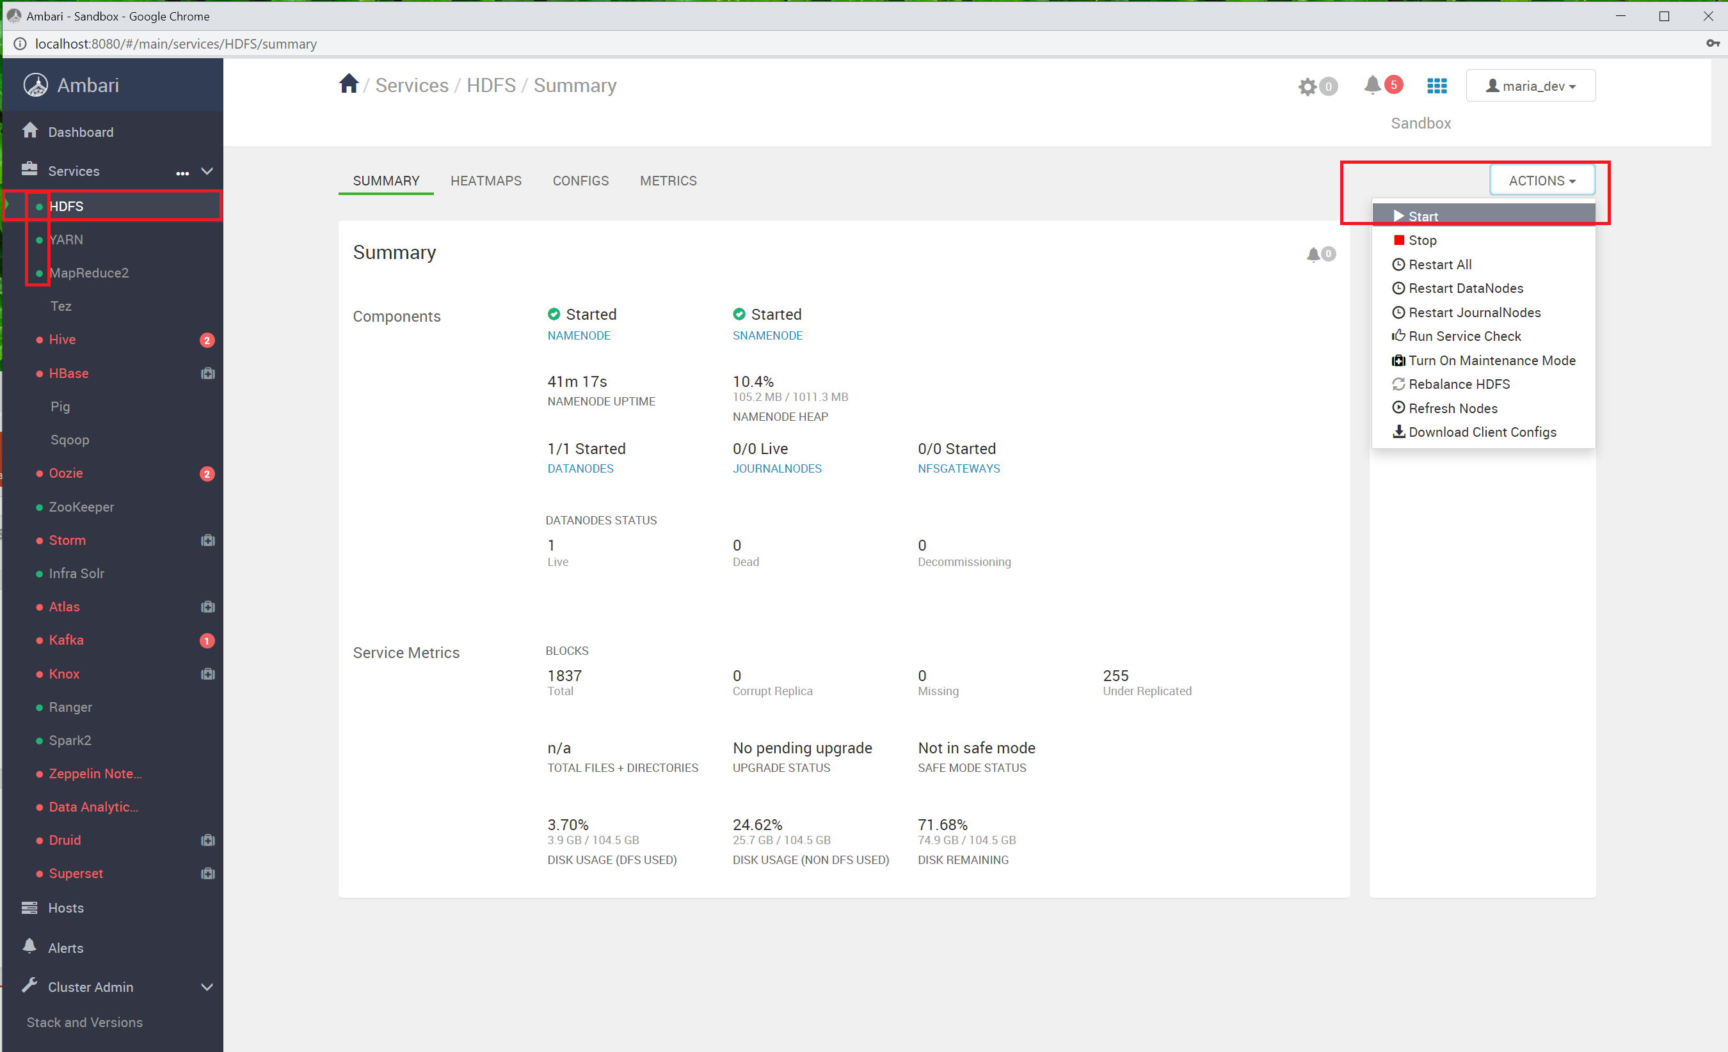
Make Sure HDFS, YARN, MapReduce2 Services Running
If not, start the service one by one in the order: HDFS, YARN, MapReduce2

Slide 3
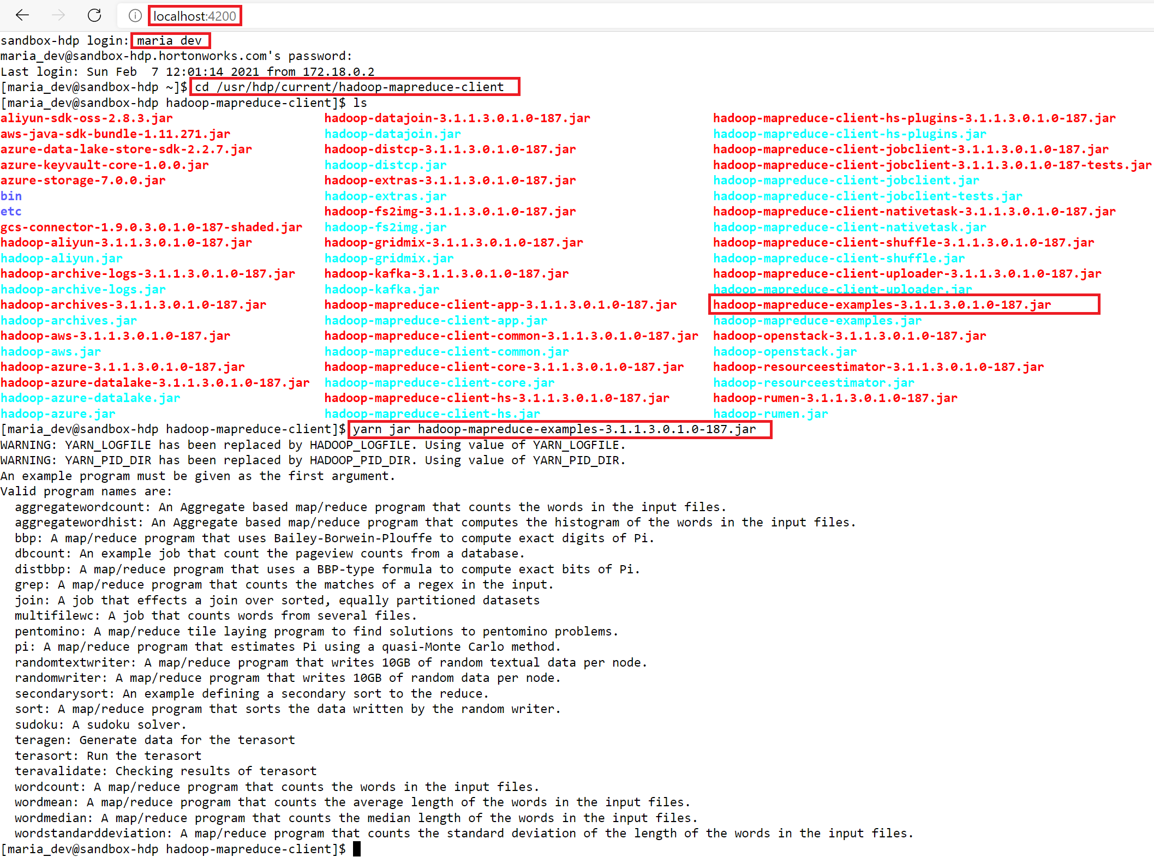
List Example MapReduce Applications

Slide 4
Run the Pi Example (MapReduce Example)

Slide 5
Monitor MapReduce Running Jobs

Slide 6
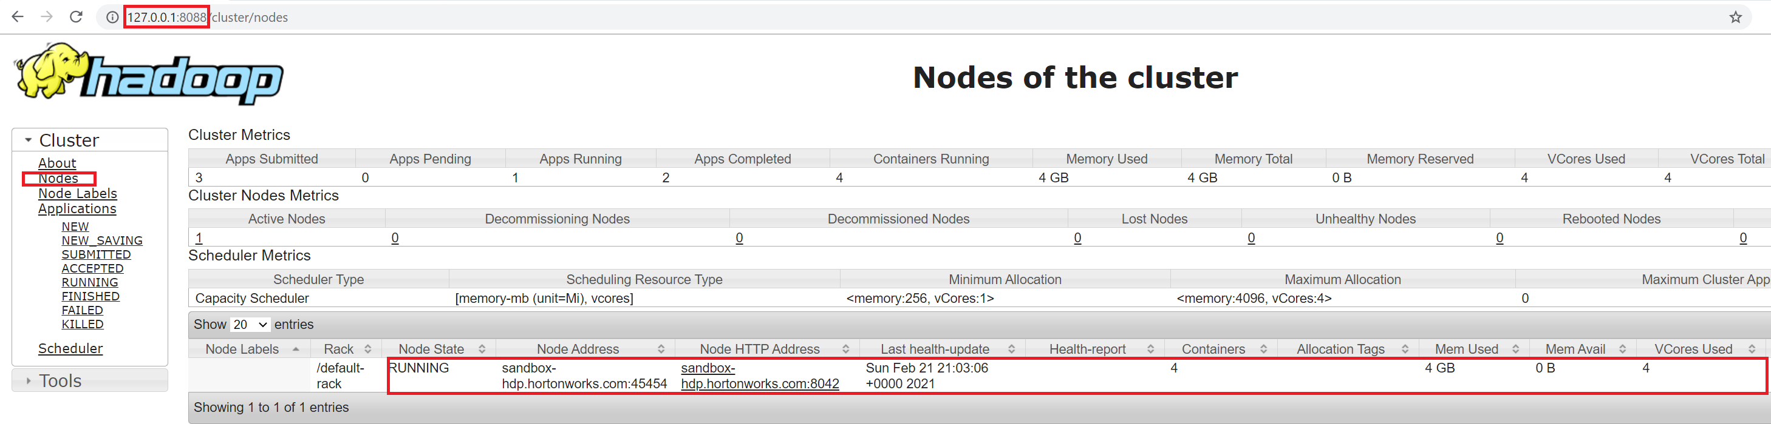
Monitor Notes of Cluster

Slide 7
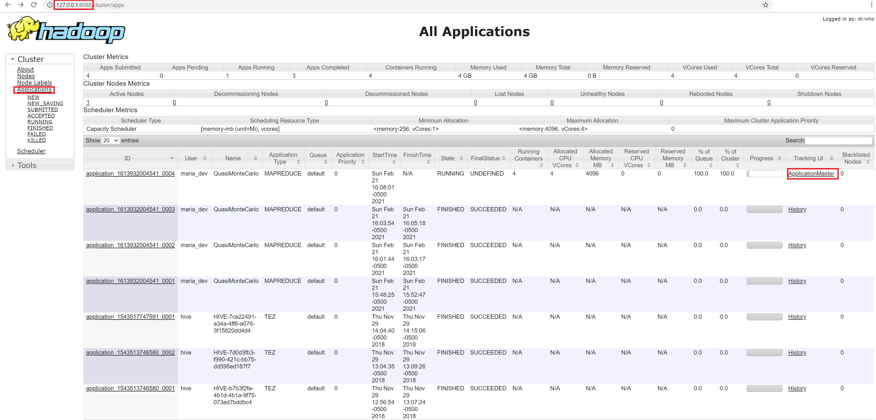
Monitor A Particular Job

Slide 8
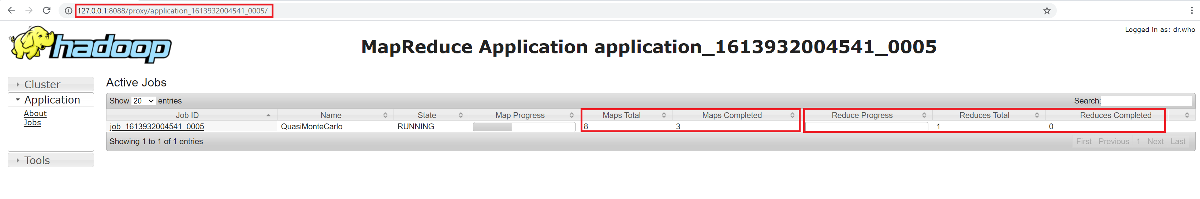

Slide 9
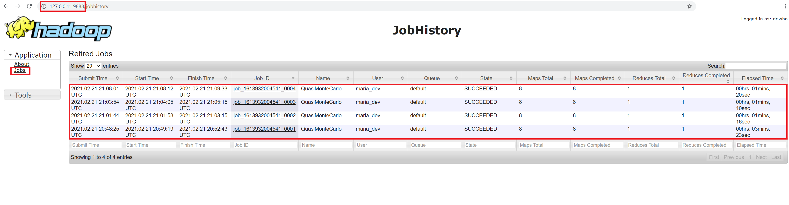
Monitor Job History

Slide 10
Run Another MapReduce Example - terasort
Use the above command to create a directory “terasort” in your home directory on HDFS

Slide 11
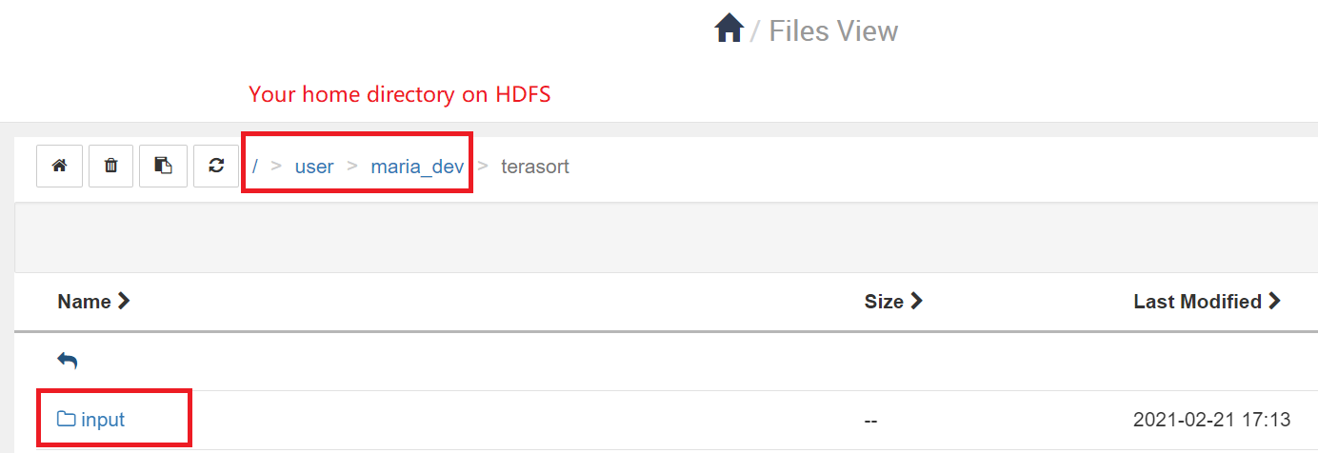
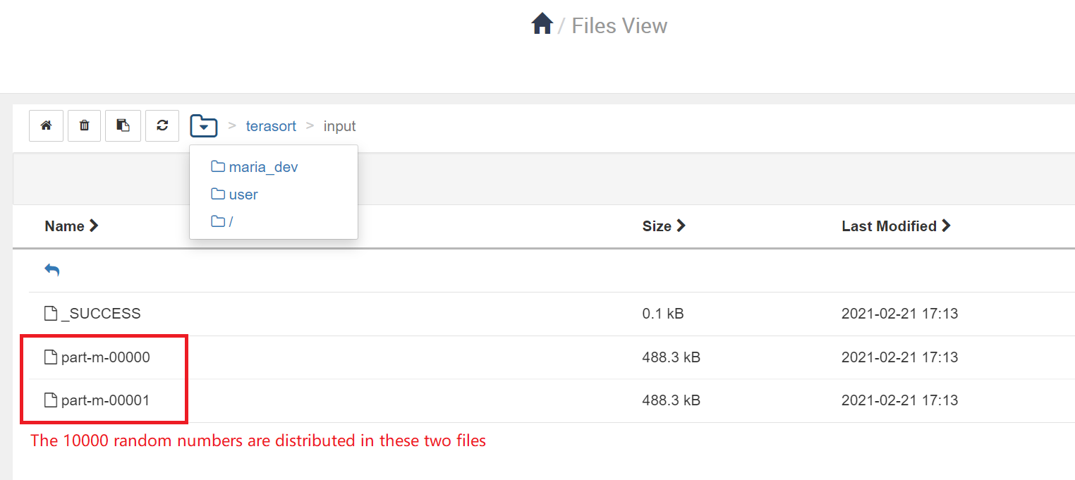
Run a MapReduce job to generate 10000 random binary numbers for sorting later on. The generated random numbers will be put under terasort/input directory, as specified by this command.

Slide 12
Some Important URLs for VirtualBox
127.0.0.1:8080 - Hadoop Server Dashboard
127.0.0.1:4200 – SSH to Hadoop Server
127.0.0.1:8088 – Monitor Jobs and Cluster Status
127.0.0.1:19888 – MapReduce Job History UI
127.0.0.1:19888/logs – MapReduce Job History logs

Slide 13
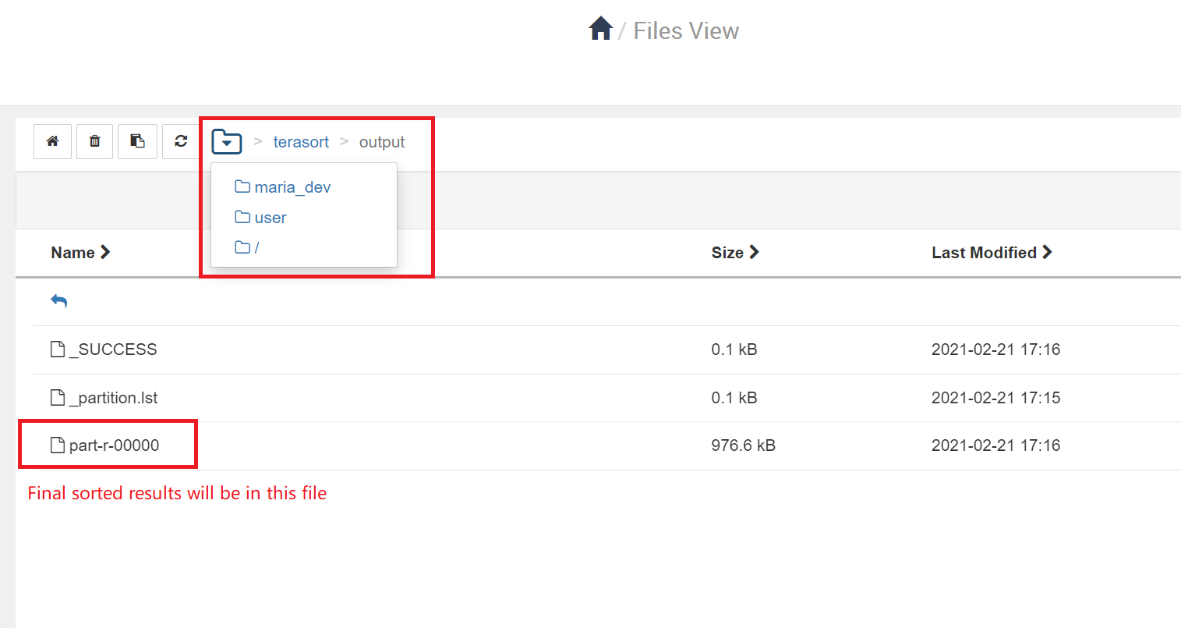
Use the above command to run MapReduce application terasort to sort all 10000 random binary numbers. The result will be put in output folder terasort/output. Please know the output directory must not exist before you execute this command.
This command will create the new directory output under terasort directory and put the sorted results in output folder

