Slide 1

Ch.07 – Logic Gates

Slide 2
Logic Gates
Logic gates are the building blocks of digital electronics
It is an electronic device that performs a Boolean operations (a logical operation) on its binary inputs (logical value 0/1) and produces a single binary output (logical 0/1)
The fundamental logic gates include
      - NOT gate
      - AND gate
      - NAND gate
      - OR gate
      - NOR gate
      - Exclusive OR (aka XOR) gate
      - Exclusive NOR (aka XNOR) gate
      Each of these gates performs a specific logical operation on its input signals

Slide 3
Logic Gates
Most logic gates are made from MOSFETs (metal–oxide–semiconductor field-effect transistors)
Microprocessors, which may contain more than 100 million logic gates
The output signal of one gate can be wired to the inputs of one or several other gates, and so on. Systems with varying degrees of complexity can be built without great concern of the designer for the internal workings of the gates, provided the limitations of each integrated circuit are considered.

Slide 4

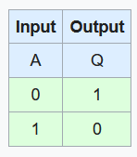
NOT logic gate
Also known as a logical inverter
The circle on the output side is used in digital logic diagrams to indicate a logic inversion between the external and the internal logic state
Equation of a NOT gate: (output) X= Ā (Ā is read as A-complement)
  here A is the input signal and X is the output signal of NOT gate
Remember the logic convention
  - Positive True Logic (PTL) (high voltage level = 1; low voltage = 0)
  - Negative True Logic (NTL) (high voltage level = 0; low voltage = 1)
  Truth Table is a table that lists all the inputs and outputs of a logic gate
Notes:
https://en.wikipedia.org/wiki/Logic_gate

Slide 5
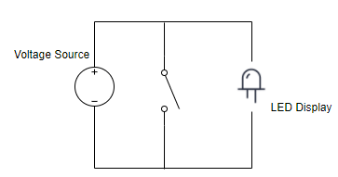
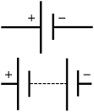
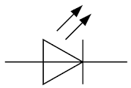
Equivalent circuit of a NOT logic gate
LED glows when switch is in an OPEN state
LED will not glow when switch is in CLOSED state
Useful in
- generating waveforms
- in temperature control circuits

Slide 6

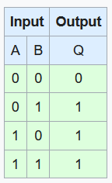
OR gate
The output of an OR gate = 1 if any of its inputs is 0
The output of an OR gate = 0 if both of its inputs is 0
It can have more than 2 inputs and only one output
If either A or B is 1, then Q is 1
OR gate finds the maximum between input logic levels

Slide 7
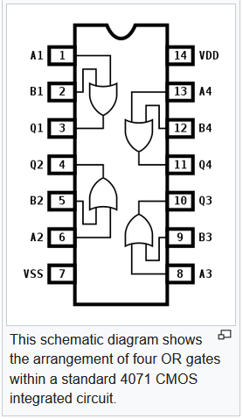

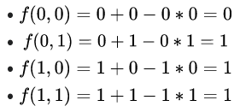
…
OR gate
Equation of a OR gate
Used in alarm systems and intrusion detection equipment
Used in industrial plants for performing protective operations
Notes:
https://en.wikipedia.org/wiki/OR_gate

Slide 8

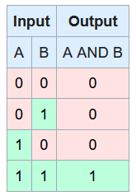
AND gate
The output of AND gate is 1 only if all the inputs to the AND gate are 1
If any one of the inputs is 0 to the AND gate, the output is 0
AND gate can have more than 2 inputs
Truth table for AND gate is shown here

Slide 9

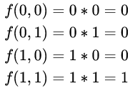
AND gate
Equation for AND gate
AND gate helps for allowing or not allowing the data through a channel
Used in digital measuring devices
Freezer warning buzzer devices

Slide 10

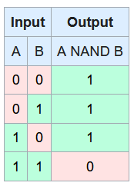
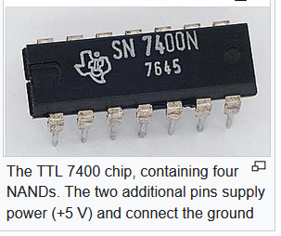
NAND gate
Produces an output =0 only if all its inputs = 1
Its output is complement (negates/opposite) to that of an AND gate
A LOW (0) output results only if all the inputs to the gate are HIGH (1)
If any input is LOW (0), then a HIGH (1) output result is obtained

Slide 11

NAND gate
Equation
NAND gate is equivalent to inverters followed by an OR gate

Slide 12

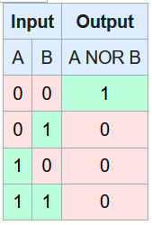
NOR gate
A HIGH output (1) results if both the inputs to the gate are LOW (0)
If one or both input is HIGH (1), a LOW output (0) results
NOR is the result of the negation of the OR operator
It can also be seen as the inverse of an AND gate

Slide 13

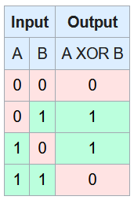
XOR gate
Produces a true (= logic state 1 or HIGH) output when the number of true inputs is odd
A true output results if one, and only one, of the inputs to the gate is true
If both inputs are false (0/LOW) or both are true, a false output is produced
XOR represents the inequality function, i.e., the output is true if the inputs are not alike otherwise the output is false
Notes:
https://en.wikipedia.org/wiki/XOR_gate

Slide 14

XOR gate
Equation

Slide 15
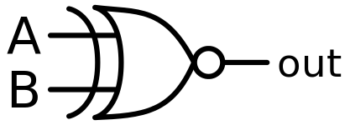
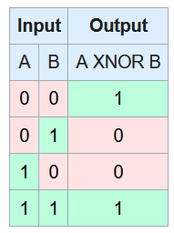

XNOR gate
A high output (1) results if both of the inputs to the gate are the same.
If one but not both inputs are high (1), a low output (0) results.
Equation

Slide 16
…
111

Slide 17
…
111

