Slide 1
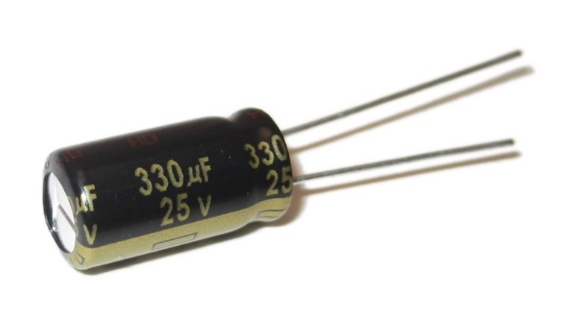
Capacitors
OpenStax 19.5
Youtube: https://youtu.be/09Ao97ncHF8

Slide 2
Capacitors
ΔV_{C} = ΔV_{bat}
Two metal plates separated by a gap
Can store charge
When a potential difference is applied, the plates become oppositely charged
Q
–Q
+
+
+
+++++++
–
–
–
–––––––
e
+
–
ΔV_{bat}
+
-

Slide 3
Induced Charge
+
+
+
-
Charge one plate (+ or -)
Charged plate produces an electric field
Charge in induced on opposite plate by electrons moving away/towards
There is no charge flow between plates
Charge is induced by one plate on another

Slide 4
Parallel Plate Capacitors
Electric Field
Consist of two charged plates (which have opposite charges)
+Q
+ + + + + + + + + + +
- - - - - - - - - - -
–Q
Electric field is uniform (constant everywhere between the plates)
Depends on charge on each plate and area
Permittivity of free space: ε₀ = 8.85 × 10⁻¹² C²/N m²

Slide 5

Parallel Plate Capacitor
Potential Difference
++++++++++++++++++
––––––––––––––––––
Also, we know:
Therefore:
+Q
–Q
Suppose: $C=\frac{ε_{0}A}{d}$ => $Q=C ΔV_{C}$

Slide 6
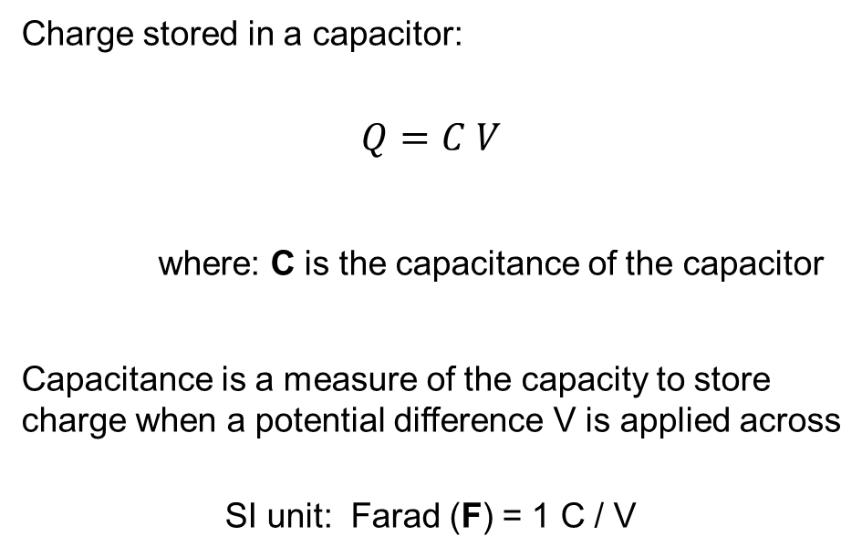
Capacitance
Charge stored in a capacitor:
$$Q=C V$$
where: C is the capacitance of the capacitor
Capacitance is a measure of the capacity to store charge when a potential difference V is applied across
SI unit: Farad (F) = 1 C / V

Slide 7
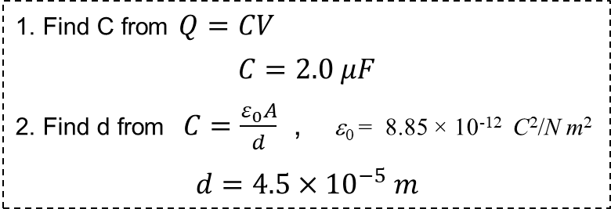
Analyzing a Capacitor
When a potential difference of 1.5 V is applied across a parallel plate capacitor, it has a charge of 3.0 μC. If the plates have an area of 10.2 m², what is their separation?
To get a higher capacitance – play with geometry
1. Find C from $Q=CV$
$C=2.0 μF$
2. Find d from $C=\frac{ε_{0}A}{d}$ , ε₀ = 8.85 × 10⁻¹² C²/N m²
$$d=4.5×{10}^{−5} m$$
(This capacitance value is reasonable, but the plates are gigantic!)
or put material between the plates (i.e. dielectric)

Slide 8
Energy Stored in Capacitors
OpenStax 19.7
They also store potential energy
  Depends on Q, C, and ΔV_{C} (can look at any two)

Slide 9
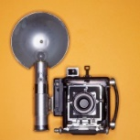
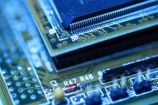
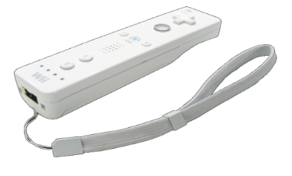
Places Capacitors are Used
Nature:
Virtually all electronic devices
Nerve Cells:
Storing Energy for Quick Release:
10^{–11} F
Camera Flash
10^{–5} to 10^{–4} F
Defibrillator
10^{–5} F
Other:
Computer RAM
10^{–15} F
Some touch screens
Motion sensors
10^{–8} to 10^{–6} F
http://en.wikipedia.org/wiki/File:Wiimote.png

Slide 10
Storing Energy
Since charges are separated, there is a potential energy associated with capacitors
Change in potential energy for a charge is:
ΔU_{elec} = q ΔV
Potential difference changes as Capacitor charges
Initial: 0 V
in between
Final: ΔV_{C}
+
+
+
–
–
–
+++++++
–––––––
Initially, charges move through smaller potential difference

Slide 11
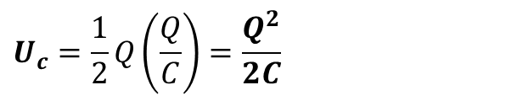
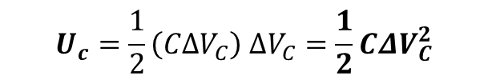
Potential Energy of Capacitor
Energy stored when charge is Q and potential difference is ΔV_{C}
Since Q = C ΔV_{C} :
$$U_{c}=\frac{1}{2}\left(CΔV_{C}\right) ΔV_{C}=\frac{1}{2}CΔV_{C}^{2}$$
$$U_{c}=\frac{1}{2}Q\left(\frac{Q}{C}\right)=\frac{Q^{2}}{2C}$$
To change energy stored in capacitor, change any parameter:
capacitance
These require doing work on the capacitor
charge
potential

Slide 12
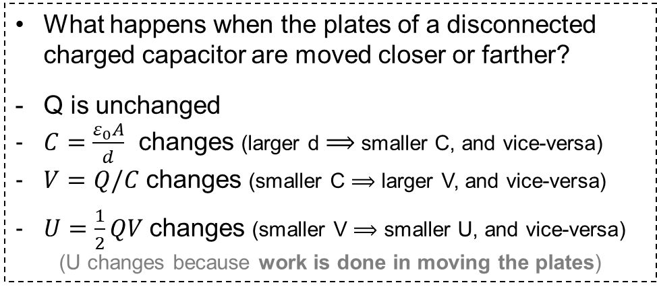
Disconnecting a Capacitor
What happens when a capacitor is charged and then disconnected?
The capacitor retains the charge
(the stored charge cannot be lost)
What happens when the plates of a disconnected charged capacitor are moved closer or farther?
Q is unchanged
$C=\frac{ε_{0}A}{d}$ changes (larger d $⟹$ smaller C, and vice-versa)
$V=Q/C$ changes (smaller C $⟹$ larger V, and vice-versa)
$U=\frac{1}{2}QV$ changes (smaller V $⟹$ smaller U, and vice-versa)
(U changes because work is done in moving the plates)

Slide 13
Series and Parallel Capacitors
Identify same way as series and parallel resistors
Series
No junctions between
Have same charge stored
Both sides connected by wire
Parallel
Have same potential difference
Instead of considering current, look at charge stored
Charges only reach or leave plates due to current

Slide 14
Parallel Capacitors
(same V across all capacitors connected in parallel)
C₁
C_{eq}
+Q₁
–Q₁
+Q_{tot}
–Q_{tot}
ΔV
Redraw
C₂
ΔV
+Q₂
–Q₂
i) Q_{tot} = Q₁ + Q₂ = C₁ ΔV + C₂ ΔV = ΔV (C₁ + C₂)
ii) Q_{tot} = C_{eq} ΔV
Capacitors in Parallel: C_{eq} = C₁ + C₂

Slide 15
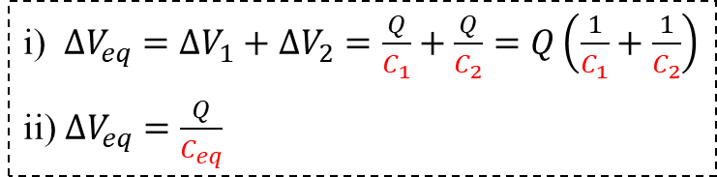
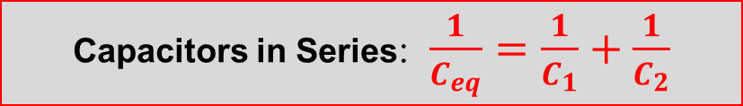
Series Capacitors
(same I and Q across all capacitors connected in series)
C₁
C₂
C_{eq}
+Q
–Q
+Q
–Q
Redraw
+Q
–Q
ΔV₁
ΔV₂
ΔV_{eq}
i) $ΔV_{eq}=ΔV_{1}+ΔV_{2}=\frac{Q}{C_{1}}+\frac{Q}{C_{2}}=Q\left(\frac{1}{C_{1}}+\frac{1}{C_{2}}\right)$
ii) $ΔV_{eq}=\frac{Q}{C_{eq}}$
Capacitors in Series: $\frac{1}{C_{eq}}=\frac{1}{C_{1}}+\frac{1}{C_{2}}$

Slide 16
In General for N Capacitors
Parallel
Adding more capacitors increases capacitance
Series
Adding more capacitors decreases capacitance

Slide 17
Analyzing Combination of Capacitors [1]
What is the charge stored on the circled capacitor?
7 μF
5 μF
3.9 μC
12 μC
18 μC
30 μC
75 μC
(Highlighted capacitors are in parallel)
3 μF
10 μF
C_{eq_1} = 7 + 3 μF = 10 μF
Redraw circuit with C_{eq_1}
3.0 V

Slide 18
Analyzing Combination of Capacitors [2]
What is the charge stored on the circled capacitor?
5 μF
3.9 μC
12 μC
18 μC
30 μC
75 μC
10 μF
Highlighted capacitors are in parallel
10 μF
C_{eq_2} = 5 + 10 μF = 15 μF
Redraw circuit with C_{eq_2}
3.0 V

Slide 19
Analyzing Combination of Capacitors [3]
What is the charge stored on the circled capacitor?
3.9 μC
12 μC
18 μC
30 μC
75 μC
10 μF
15 μF
Remaining Capacitors are in series
C_{eq_3} = (1/10 + 1/15)⁻¹ μF = 6 μF
3.0 V
Redraw circuit with C_{eq_3}

Slide 20
Analyzing Combination of Capacitors [4]
What is the charge stored on the circled capacitor?
3.9 μC
12 μC
18 μC
30 μC
75 μC
6 μF
Find charge stored on final C_{eq_3}
Use main capacitor equation
3.0 V
Go to next most simplified circuit

Slide 21
Analyzing Combination of Capacitors [5]
What is the charge stored on the circled capacitor?
3.9 μC
12 μC
18 μC
30 μC
75 μC
(part of this C_{eq})
Capacitors are in series
10 μF
15 μF
Each stores Q = 18 μC
Find potential across right capacitor
=> ΔV_{C} = 1.2 V
Go to next most simplified circuit
3.0 V

Slide 22
Analyzing Combination of Capacitors [6]
What is the charge stored on the circled capacitor?
3.9 μC
12 μC
18 μC
30 μC
75 μC
5 μF
Highlighted capacitors are in parallel
10 μF
10 μF
Each has ΔV_{C} = 1.2 V
For circled:
Q = (10 μF)(1.2 V) = ?
3.0 V

Slide 23
RC Circuits
OpenStax 21.6
RC Circuit Equations
  Exponential Growth (capacitor’s Q, ΔV_{C} while charging)
  Exponential Decay (capacitor’s Q, ΔV_{C} while discharging; I for both charging and discharging)
  ONLY FOR SERIES CIRCUITS
Capacitor
  Uncharged: acts like wire
  Charged: acts like open circuit
  Always obeys rules for series & parallel elements

Slide 24
Current Through a Capacitor
Charges do not flow through a capacitor (because plates are separated)
But, charge on one plate induces a charge on the other plate [slide 3]
Therefore, a capacitor still allows a current to flow
I

Slide 25
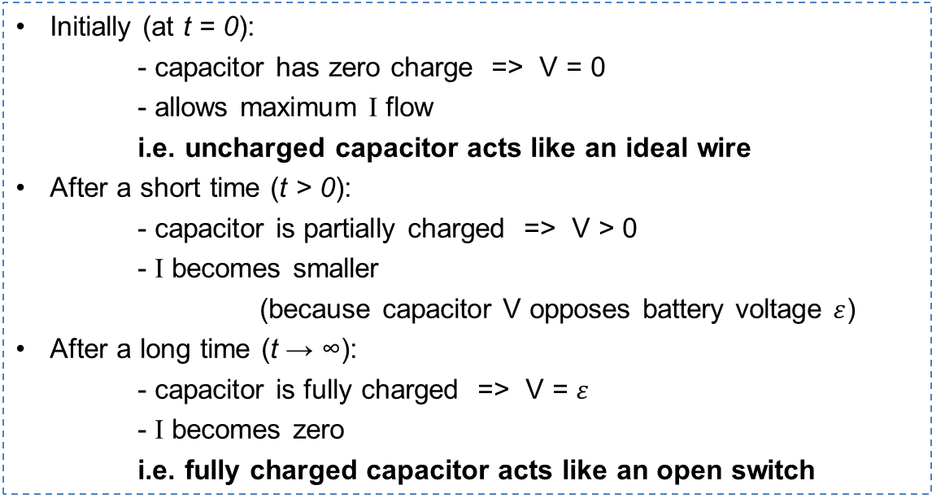
Charging a Capacitor
(As a capacitor is charged, it develops a V)
Initially (at t = 0):
- capacitor has zero charge => V = 0
- allows maximum I flow
i.e. uncharged capacitor acts like an ideal wire
After a short time (t > 0):
- capacitor is partially charged => V > 0
- I becomes smaller
(because capacitor V opposes battery voltage $ε$)
After a long time (t → ∞):
- capacitor is fully charged => V = $ε$
- I becomes zero
i.e. fully charged capacitor acts like an open switch

Slide 26
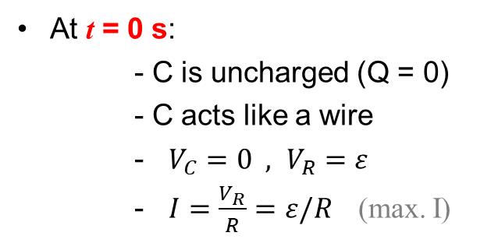
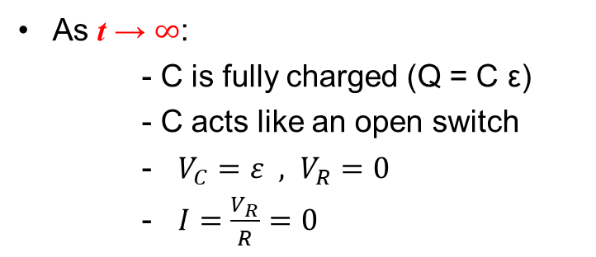
Charging Capacitor in RC Circuit
(resistor-capacitor circuit)
At t = 0 s:
- C is uncharged (Q = 0)
- C acts like a wire
- $V_{C}=0 , V_{R}=ε$
- $I=\frac{V_{R}}{R}=ε/R$ (max. I)
I
R
ε
C
–Q
+Q
As t → $∞$:
- C is fully charged (Q = C ε)
- C acts like an open switch
- $V_{C}=ε , V_{R}=0$
- $I=\frac{V_{R}}{R}=0$
What happens when C is partially charged?

Slide 27
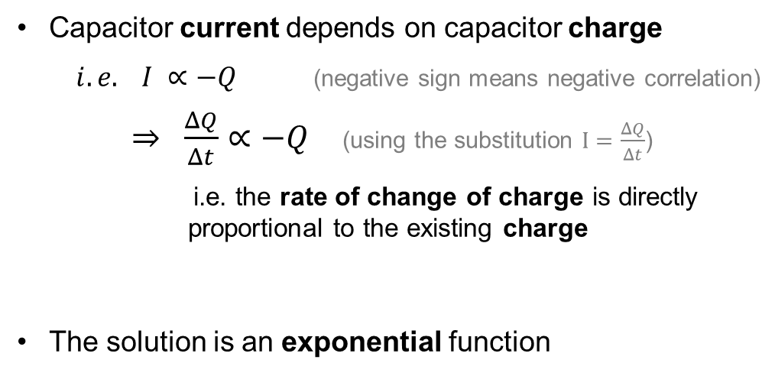
Charging Capacitor in RC Circuit
(resistor-capacitor circuit)
What happens when C is partially charged?
Capacitor current depends on capacitor charge
$i.e. I ∝−Q$ (negative sign means negative correlation)
$⇒ \frac{ΔQ}{Δt}∝−Q$ (using the substitution $I=\frac{ΔQ}{Δt}$)
i.e. the rate of change of charge is directly proportional to the existing charge
The solution is an exponential function

Slide 28
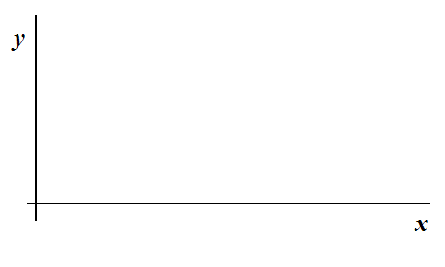
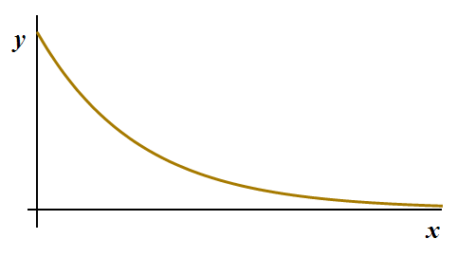
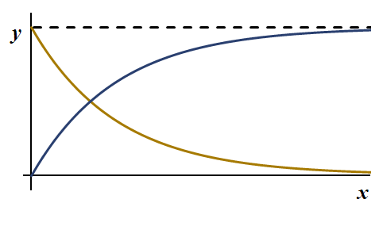
Exponential Equation Review
“Exponential Decay”:
Describes things that gradually decrease
e = 2.718…
At x = 0, y =
a
0
At x = ∞, y =
In modified form can be used to describe things that gradually grow to a certain value
a determines the max value
a, b determine the slope
At x = 0, y =
0
a
At x = ∞, y =

Slide 29
Equations for Charging Capacitor
(starts charging at t = 0)
Potential Difference across Capacitor
Current
Starts
0
Ι₀ = ε / R
Ends
ε
0
Equation
Potential difference across capacitor at time t
Current in circuit
at time t
τ = R C
emf
(final pot. diff. across capacitor)
Initial Current
(also max. current)

Slide 30

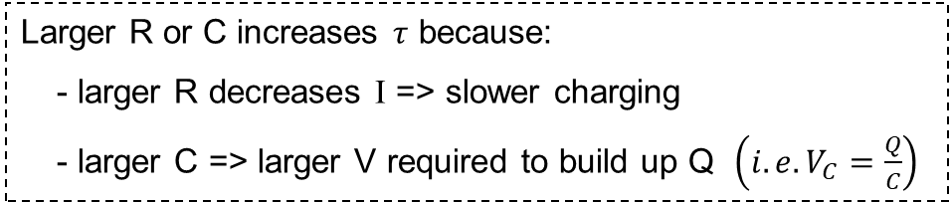
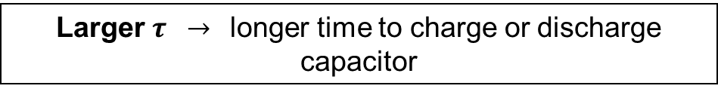
Time Constant ($τ)$
(product of equivalent resistance and capacitance in series)
τ = R C
Unit: s
(with R in Ω and C in F, will have units of seconds)
Measures how long it takes to charge (or discharge) a capacitor
Larger $τ →$longer time to charge or discharge capacitor
Larger R or C increases $τ$ because:
- larger R decreases I => slower charging
- larger C => larger V required to build up Q $\left(i.e. V_{C}=\frac{Q}{C}\right)$

Slide 31
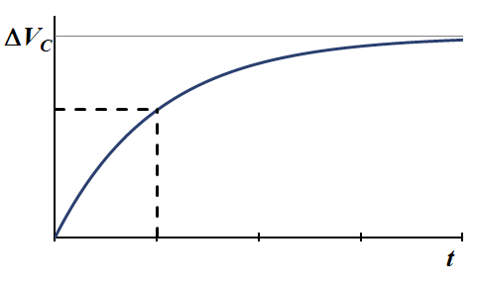
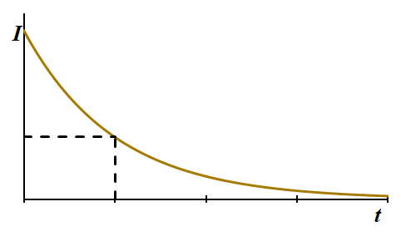







Time Constant ($τ)$
[slide 29]
When t = $τ$:
$$ΔV_{C}=ε(1−e^{−1})$$
$$I=I_{0}e^{−1}$$
e^{–1} = 0.3678…. $≈$ 0.37
$$⇒ ΔV_{C}=ε(0.63)$$
$$⇒ I=I_{0}(0.37)$$
For Charging:
At t = τ
ΔV_{C} ~ 63% of final
I ~ 37% of initial

Slide 32
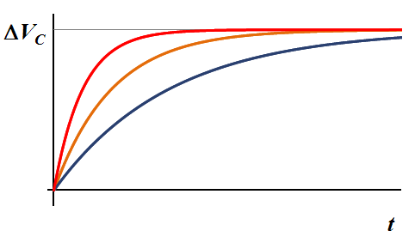
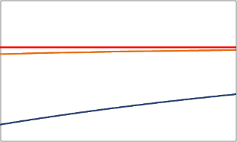
Using Graphs of Charging Circuits
Three RC circuits are made with identical batteries and resistors. The potential measured across the capacitors during charging is shown below. Rank the capacitances.
C₁ = C₂ = C₃
C₁ > C₂ > C₃
C₃ > C₂ > C₁
C₁ = C₂ > C₃
C₃ > C₁ = C₂
1
2
3
(zoomed in)
τ = R C
Higher capacitance (i.e. larger $τ$) will result in longer time to charge
Higher resistance (i.e. larger $τ$) will too (smaller initial current)

Slide 33
Using Graphs of Charging Circuits
Three RC circuits are made with different batteries but identical resistors. The potential measured across the capacitors during charging is shown below. Rank the capacitances.
C₂ > C₃ > C₁
C₁ > C₂ > C₃
C₁ > C₃ > C₂
C₂ = C₃ > C₁
C₃ > C₂ = C₁
1
2
3

Slide 34
What the graphs would look like if…
Batteries were identical
(using same capacitors as in the previous slide)
Capacitors were identical
(using same batteries as in the previous slide)
2
1
3
1
2
3
 | Battery emf
Circuit 1 | ε₁
Circuit 2 | (2/3) ε₁
Circuit 3 | (1/3) ε₁

Slide 35
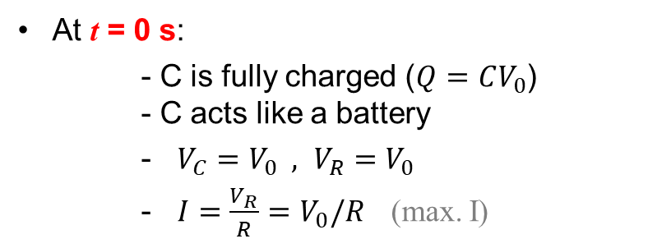
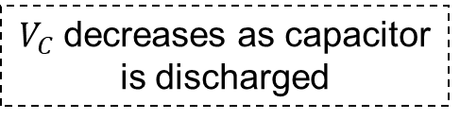
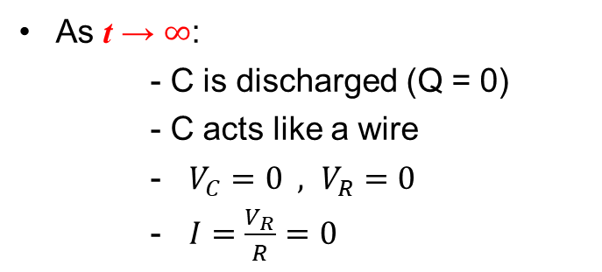

Discharging Capacitor in RC Circuit
(only resistor and capacitor, no battery)
[compare with slide 26]
At t = 0 s:
- C is fully charged ($Q=CV_{0}$) - C acts like a battery
- $V_{C}=V_{0} , V_{R}=V_{0}$
- $I=\frac{V_{R}}{R}=V_{0}/R$ (max. I)
I
R
C
+Q
-Q
As t → $∞$:
- C is discharged (Q = 0)
- C acts like a wire
- $V_{C}=0 , V_{R}=0$
- $I=\frac{V_{R}}{R}=0$
$$V_{0}$$
$V_{C}$ decreases as capacitor is discharged

Slide 36
Equations for Discharging Capacitor
(starts discharging at t = 0)
[compare with slide 29]
τ = R C
Potential Difference across Capacitor
Current
Starts
(ΔV_{C} )₀
I₀ = (ΔV_{C} )₀ / R
Ends
0
0
Equation
Potential difference across capacitor at time t
Current in circuit
at time t
Initial Current
Initial pot. diff. across capacitor

Slide 37
Uses for RC Circuits
Timing electrical systems
Car flashers, windshield wipers, etc.
Propagation of signals
Nerve signals
Quick delivery of charge
Want current for specific amount of time
Camera flashes, defibrillators

Slide 38


Analyzing Camera Flash [1]
A camera flash consists of a 100 nF capacitor which is charged by four 1.5 V batteries and discharged through a 300 Ω resistor. When discharging, how long does it take the current to drop to 1% of its initial value?
3.34 × 10^{–15} s
1.38 × 10^{–4} s
1.54 × 10^{–4} s
1.38 × 10⁵ s
1.54 × 10⁵ s
Current in RC is:
We are looking for: I = $\frac{1}{100}$ I₀
About a day (too long)
i.e. find t when $I = 0.01I_{0}$
First, find τ:
τ = R C
τ = R C = (300 Ω)(100 × 10^{–9} F) = 3 × 10^{–5} s
This is the time to 37% of initial current [slide 31] (time to 1% must be longer)

Slide 39
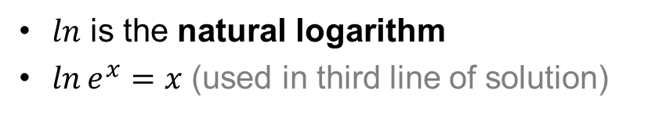
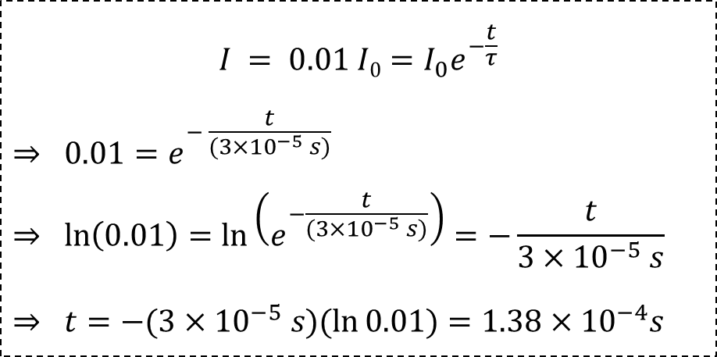
Analyzing Camera Flash [2]
A camera flash consists of a 100 nF capacitor which is charged by four 1.5 V batteries and discharged through a 300 Ω resistor. When discharging, how long does it take the current to drop to 1% of its initial value?
$$I = 0.01 I0=I_{0}e^{−\frac{t}{τ}}$$
$$⇒ 0.01=e^{− \frac{t}{(3×{10}^{−5} s)}}$$
$$⇒ \ln\left(0.01\right)=\ln\left(e^{−\frac{t}{(3×{10}^{−5} s)}}\right)=−\frac{t}{3×{10}^{−5} s}$$
$$⇒ t=−(3×{10}^{−5} s)(\ln{0.01)=1.38×{10}^{−4}s}$$
τ = R C = 3 × 10^{–5} s
3.34 × 10^{–15} s
1.38 × 10^{–4} s
1.54 × 10^{–4} s
1.38 × 10⁵ s
1.54 × 10⁵ s
$ln$ is the natural logarithm
$\ln{e^{x}=x}$ (used in third line of solution)

Slide 40
Caution About RC Circuit Equations
The equations on the previous slides are for when resistor and capacitor are in series
They work for this circuit
ε
But not this one:
Reminder: Two guidelines used to analyze Capacitor:
Acts Like
Uncharged
ΔV_{C}
= 0
Short (ideal wire)
Fully Charged
Ι
= 0
Open switch
(broken wire)
ε

Slide 41
Non-Series RC Circuit
The switch has been open for a long time. At t = 0 s, the switch is closed.
At t = 0 s, the circuit acts like:
B
3.0 Ω
As t → ∞, the circuit acts like:
A
3.0 Ω
A
B
1.0 Ω
1.0 Ω
10 μF
ε = 1.5 V
ε = 1.5 V
1.0 Ω
3.0 Ω
3.0 Ω
D
1.0 Ω
C
ε = 1.5 V
ε = 1.5 V
ε = 1.5 V

Slide 42
Example 1: Non-Series RC Circuit [1]
Once the capacitor is fully charged, what is the charge stored on the capacitor?
3.0 Ω
15 μC
3.8 μC
11 μC
60 μC
20 μC
Will use:
Need ΔV_{C}
10 μF
1.0 Ω
Capacitor and 3 Ω are in parallel
ε = 1.5 V
Have same potential difference
Fully charged C acts like broken wire

Slide 43
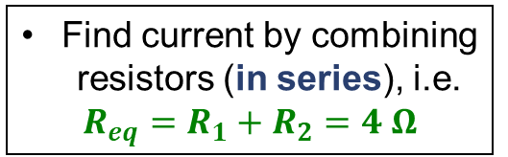
Example 1: Non-Series RC Circuit [2]
Once the capacitor is fully charged, what is the charge stored on the capacitor?
3.0 Ω
15 μC
3.8 μC
11 μC
60 μC
20 μC
Find ΔV_{R} with Ohm’s Law
C acts like broken wire
ΔV_{R} = I R
1.0 Ω
Find current by combining resistors (in series), i.e.
$$R_{eq}=R_{1}+R_{2}=4 Ω$$
ε = 1.5 V

Slide 44
Example 1: Non-Series RC Circuit [3]
Once the capacitor is fully charged, what is the charge stored on the capacitor?
Redraw circuit with R_{eq}
15 μC
3.8 μC
11 μC
60 μC
20 μC
4.0 Ω
Find total current
I = ΔV_{Req} / R
ε = 1.5 V
=> I = (1.5 V) / (4.0 Ω) = 0.38 A

Slide 45
Example 1: Non-Series RC Circuit [4]
Once the capacitor is fully charged, what is the charge stored on the capacitor?
3.0 Ω
15 μC
3.8 μC
11 μC
60 μC
20 μC
C acts like broken wire
1.0 Ω
Find ΔV_{R} with Ohm’s Law
ΔV_{R} = I R
ε = 1.5 V
ΔV_{R} = (0.38 A) (3.0 Ω) = 1.1 V = V_{C}

Slide 46
Example 1: Non-Series RC Circuit [5]
Once the capacitor is fully charged, what is the charge stored on the capacitor?
3.0 Ω
15 μC
3.8 μC
11 μC
60 μC
20 μC
10 μF
Will use:
1.0 Ω
ΔV_{C} = 1.1 V
Q = (10 μF) (1.1 V)
= ?
ε = 1.5 V

Slide 47
Example 2: Non-Series RC Circuit [1]
3.0 Ω
The switch has been open for a long time. Immediately after it is closed, what is the current through the 1 Ω resistor?
0.38 A
0.50 A
2.0 A
1.5 A
0 A
10 μF
1.0 Ω
Reminder: Uncharged capacitor acts like wire
ε = 1.5 V
Redraw Circuit

Slide 48
Example 2: Non-Series RC Circuit [2]
The switch has been open for a long time. Immediately after it is closed, what is the current through the 1 Ω resistor?
3.0 Ω
0.38 A
0.50 A
2.0 A
1.5 A
0 A
Right after switch closed:
3 Ω is shorted
1.0 Ω
ε = 1.5 V
Can redraw circuit with just 1.0 Ω resistor and emf

Slide 49
Example 2: Non-Series RC Circuit [3]
The switch has been open for a long time. Immediately after it is closed, what is the current through the 1 Ω resistor?
0.38 A
0.50 A
2.0 A
1.5 A
0 A
1.0 Ω
ε = 1.5 V
Use Ohm’s Law:
R = 1.0 Ω, ΔV_{R} = ε = 1.5
I = ?

Slide 50
Summary
RC Circuit Equations
  Exponential Growth (capacitor’s Q, ΔV_{C} while charging)
  Exponential Decay (capacitor’s Q, ΔV_{C} while discharging; I for both charging and discharging)
  ONLY FOR SERIES CIRCUITS
Capacitor
  Uncharged: acts like wire
  Charged: acts like open circuit
  Always obeys rules for series & parallel elements

