Slide 1
Chapter 13
Introduction to Human Geography (2018)
University of North Georgia Press
ENVIRONMENT & RESOURCES
Lecture Notes by Dorrell, Henderson, Lindley, & Connor.

Slide 2
Chapter 13: Environment & Resources
STUDENT LEARNING OUTCOMES
By the end of this section, the student will be able to:
Understand: the problems associated with the demand for nonrenewable energy resources and the available supply.
Explain: the issues associated with the pollution of air, land, and water.
Describe: the types of renewable and alternative energy resources and global initiatives to leverage these resources.
Connect: preservation efforts worldwide to anthropogenic pressures on the environment.
Introduction to Human Geography (2018). Dorrell, Henderson, Lindley, & Connor. University of North Georgia Press.

Slide 3
Chapter 13: Environment & Resources
CHAPTER OUTLINE
13.1 Introduction
13.2 Nonrenewable Energy Resources
13.3 Renewable Energy Sources
13.4 Pollution
13.5 Preservation of Natural Resources
Introduction to Human Geography (2018). Dorrell, Henderson, Lindley, & Connor. University of North Georgia Press.

Slide 4
13.1 Introduction
Resources and the environment – useful as capstone subject for course
Resource use and its ramifications related to:
  Population
  Migration
  Economics (industry and agriculture)
  Culture
  Levels of development
  Human settlements
Notes:
Source: https://genographic.nationalgeographic.com/human-journey/

Slide 5
13.2 Nonrenewable Energy Resources
Nonrenewables – resources in finite supply
Fossil fuels – derived from ancient plant and animal matter – include coal, oil and natural gas
Proven reserves of fossil fuels – deposits that can be recovered with some certainty
  Largest coal reserves – U.S., Russia, and China
  Largest oil reserves – Middle East (Saudi Arabia), Canada
  Largest natural gas reserves – Russia and Iran
Potential reserves – may exist but not definitively verified (example: Green River Formation in the U.S.
Notes:
Source: https://genographic.nationalgeographic.com/human-journey/

Slide 6
13.2 Nonrenewable Energy Resources
Production – extraction of fossil fuels from the Earth through mining and drilling – related to population, proven reserves and other factors
Coal production – China, the U.S. and India world leaders
Oil production – current leaders include Saudi Arabia, Russia, and the U.S.
Natural gas production – most global production in the U.S. and Russia
Notes:
Source: https://genographic.nationalgeographic.com/human-journey/

Slide 7
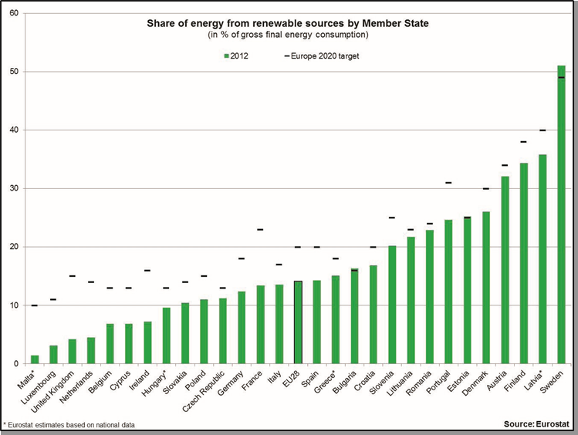
13.3 Renewable Energy Sources
Renewable resources – in infinite supply
Major types – solar, wind, hydroelectric, biofuels and geothermal
Strong emphasis on renewable energy in Europe (80 percent of new energy projects in renewable energy)
China investing heavily in wind and solar
Figure 13.1 | Renewable energy for selected countries in Europe
Notes:
Source: https://genographic.nationalgeographic.com/human-journey/

Slide 8
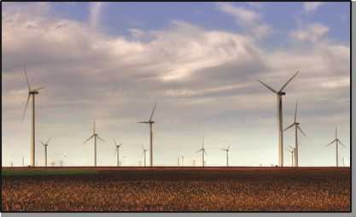
13.3 Renewable Energy Sources
Renewable resources in the U.S. – historically, hydroelectric power
More recent developments in wind power – Kansas, Texas, and other states
U.S. has some of the largest solar farms in world (including concentrated solar power)
Strong emphasis on electric cars, especially states like California (reduces fossil fuel emissions in urban areas)
Figure 13.2 | The Smoky Hills Wind Farm in Kansas
Notes:
Source: https://genographic.nationalgeographic.com/human-journey/

Slide 9
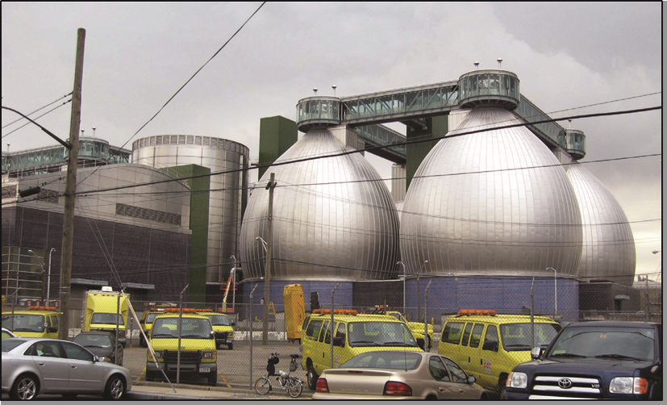
13.3 Renewable Energy Sources
Biofuels – produce energy from living matter (such as corn, sugar cane, etc.)
The U.S. and Brazil – world leaders in biofuel production
Ethanol production – food versus fuel controversy
Methane – extracted from digesters in wastewater treatment process to produce electricity
Figure 13.3 | Egg-shaped “digesters” at the Newton Creek Wastewater Treatment Plant
Notes:
Source: https://genographic.nationalgeographic.com/human-journey/

Slide 10
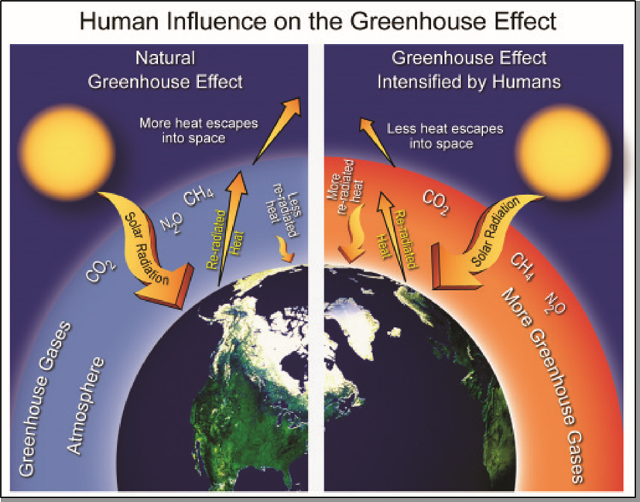
13.4 Pollution
Fossil fuel burning – produces air pollution
Carbon dioxide – greenhouse gas emitted when fossil fuels burned
Greenhouse effect – trapping of longwave radiation (heat) by greenhouse gases in lower atmosphere – gases absorb and reradiate longwave radiation
Anthropogenic greenhouse gas production linked in some degree to climate change
Figure 13.4 | Natural and anthropogenically-forced greenhouse effect
Notes:
Source: https://genographic.nationalgeographic.com/human-journey/

Slide 11
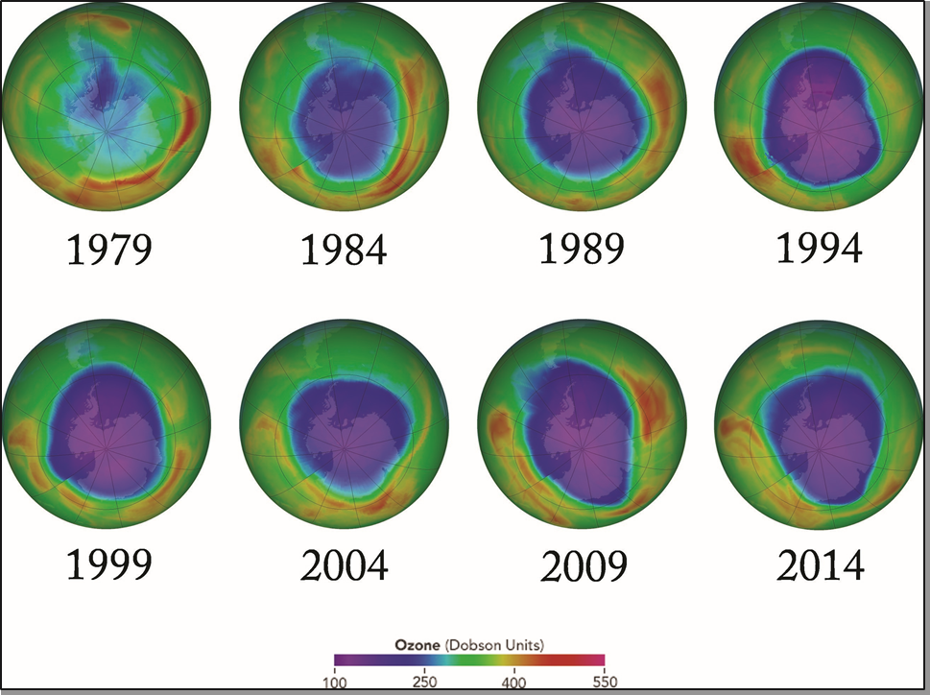
13.4 Pollution
The ozone layer – stratospheric ozone protects the Earth from harmful ultraviolet radiation (causes sunburn, skin cancer)
Chlorofluorocarbons (CFCs) – produced by refrigeration equipment and aerosols
CFCs break down ozone layer – international efforts to reduce CFC use (Montreal Protocol, beginning in 1987)
Figure 13.5 | Ozone depletion around Antarctica from 1979 to 2014
Notes:
Source: https://genographic.nationalgeographic.com/human-journey/

Slide 12
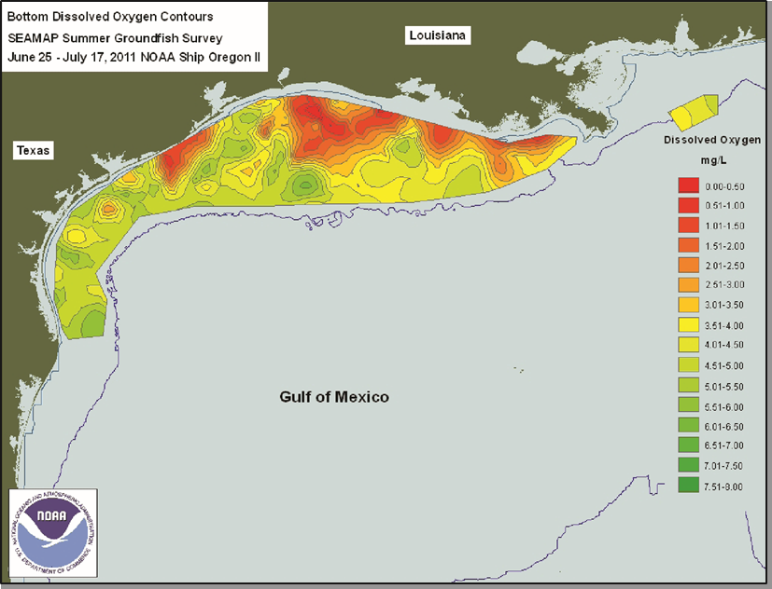
13.4 Pollution
Water pollution – from industrial chemicals, untreated sewage, agricultural fields, and other sources
Eutrophication – process where water bodies become oxygen deficient – nutrients from agricultural runoff, in particular, cause algal blooms – decay of algae consumes oxygen
Dead zones with dearth of oxygen prevalent – Gulf of Mexico and Baltic Sea
Figure 13.6 | The 2010 Dead Zone in the Gulf of Mexico
Notes:
Source: https://genographic.nationalgeographic.com/human-journey/

Slide 13
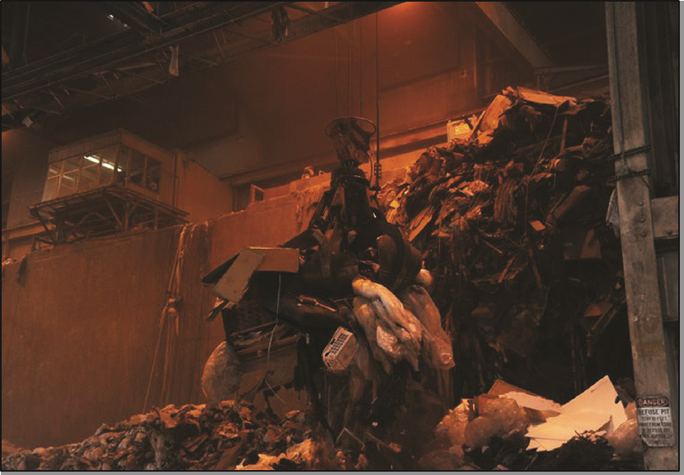
13.4 Pollution
Solid waste disposal and control – methods include solid waste landfills, incineration, and recycling
Landfills – solid waste is buried to reduce odors, pest proliferation, and hide unsightly trash
Incineration – trash is burned, often to produce electricity, especially in developed countries (examples: waste to energy plants in New York and Florida)
Figure 13.7 | The “Claw” moving plant waste and rubbish to incinerator
Notes:
Source: https://genographic.nationalgeographic.com/human-journey/

Slide 14
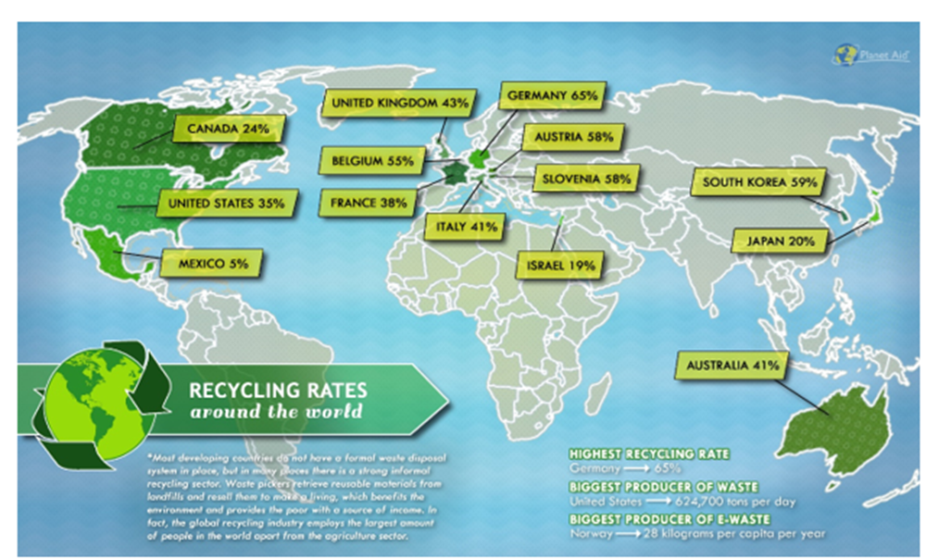
13.4 Pollution
Recycling – particularly for paper, glass, plastics and metals
United States – colleges and universities participate in Recylemania
Germany – recycles about 65 percent of municipal waste
South Korea – almost 60 percent recycling rate
Global recycling rates
Notes:
Source: https://genographic.nationalgeographic.com/human-journey/

Slide 15
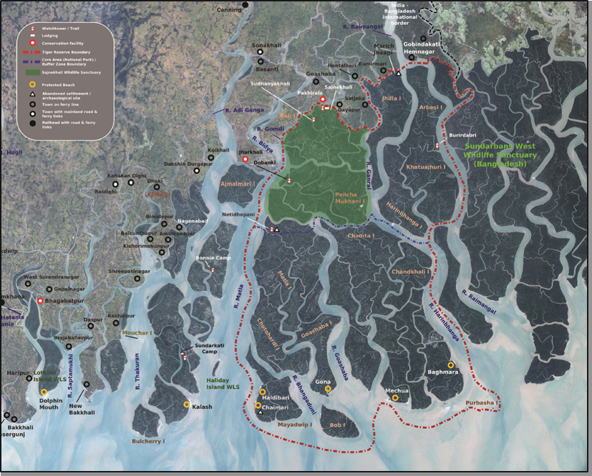

13.5 Preservation of Natural Resources
Conservation of natural resources – involves sustainability through replanting trees and limiting use
Preservation – protect natural areas – do not use the resources, but keep them in a “natural” state
National parks - important element of preservation efforts globally
  United States – a world leader in national parks
  Parks protect endangered species, such as the Bengal tiger
Figure 13.9 Bengal tiger
Figure 13.8 | Sundarban National Park, India
Notes:
Source: https://genographic.nationalgeographic.com/human-journey/

Slide 16
13.X Documentary Film List for Environment & Resources
Burned: Are Trees the New Coal? (2017).
  https://ggc.kanopy.com/video/burned
Atmospheric Chemistry (2016).
  https://ggc.kanopy.com/video/atmospheric-chemistry
Solar Power and Electricity (2016).
  https://ggc.kanopy.com/video/solar-power-and-electricity
The Cost of Oil (2009).
  https://ggc.kanopy.com/video/cost-oil
Clean Energy: Wind Power (2011).
  https://ggc.kanopy.com/video/green-careers-clean-energy-wind-power
The Green Economy: Hydroelectric Power (2014).
  https://ggc.kanopy.com/video/green-economy-hydroelectric-power
The Green Economy: Waste to Energy (2014).
  https://ggc.kanopy.com/video/green-economy-waste-energy
Sanitary Landfill (2009).
  https://ggc.kanopy.com/video/curiosity-quest-goes-green-sanitary-landfill
Recycling (2010).
  https://ggc.kanopy.com/video/green-careers-recycling

Slide 17
Chapter 13 END
Introduction to Human Geography (2018)
University of North Georgia Press
Environment & resources
Lecture Notes by Dorrell, Henderson, Lindley, & Connor.

