Slide 1
Circuits (contd.)
OpenStax Chapter 21.1
Youtube: https://youtu.be/FhfI4B6UmiM

Slide 2








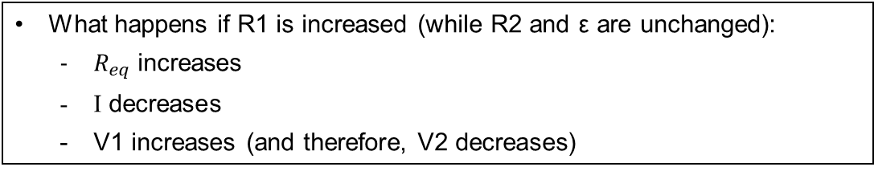


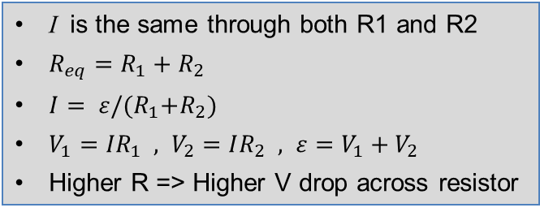



Resistors in Series [lecture 16-17 slide 37]
$$V_{1}$$
$$I$$
I is the same through both R1 and R2
$R_{eq}=R_{1}+R_{2}$
$I= ε/{(R}_{1}+R_{2})$
$V_{1}={IR}_{1} , V_{2}=IR_{2} , ε=V_{1}+V_{2}$
Higher R => Higher V drop across resistor
$$R_{1}$$
$$ε$$
$$R_{2}$$
$$V_{2}$$
$$I$$
What happens if R1 is increased (while R2 and ε are unchanged):
  $R_{eq}$ increases
  I decreases
  V1 increases (and therefore, V2 decreases)
Potential at Different Locations:
$$0 V$$
$$ε$$
$$ε−V_{1}$$
$$ε−V_{1}−V_{2}=0$$
$$R_{1}$$
$$R_{2}$$

Slide 3

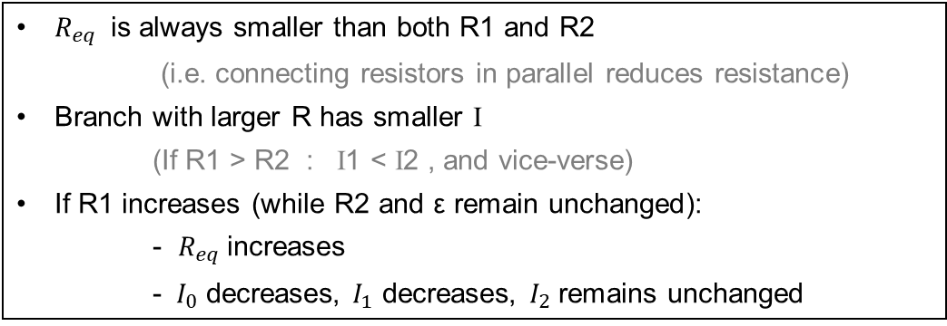


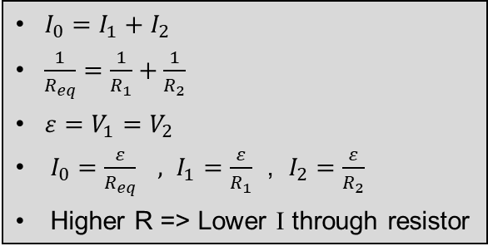






Resistors in Parallel [lecture 16-17 slide 39]
$$I_{0}$$
$I_{0}=I_{1}+I_{2}$
$\frac{1}{R_{eq}}=\frac{1}{R_{1}}+\frac{1}{R_{2}}$
$ε=V_{1}=V_{2}$
$I_{0}=\frac{ε}{R_{eq}} , I_{1}=\frac{ε}{R_{1}}$ , $I_{2}=\frac{ε}{R_{2}}$
Higher R => Lower I through resistor
$$ε$$
$$V_{2}$$
$$R_{1}$$
$$R_{2}$$
$$V_{1}$$
$$I_{2}$$
$$I_{1}$$
$$I_{0}$$
$R_{eq}$ is always smaller than both R1 and R2
(i.e. connecting resistors in parallel reduces resistance)
Branch with larger R has smaller I
(If R1 > R2 : I1 < I2 , and vice-verse)
If R1 increases (while R2 and ε remain unchanged):
- $R_{eq}$ increases
  - $I_{0}$ decreases, $I_{1}$ decreases, $I_{2}$ remains unchanged

Slide 4


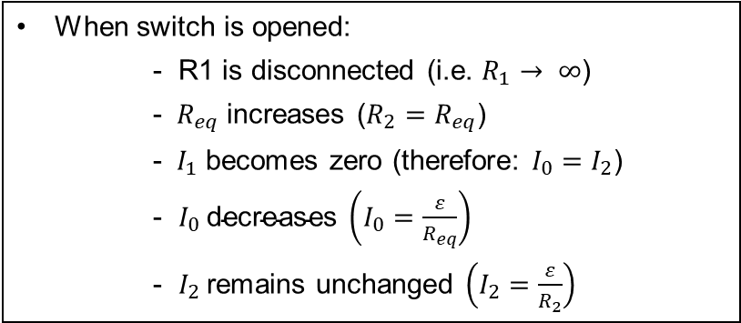









Resistors in Parallel (contd.)
Closed switch
Open switch
$$I_{0}$$
$$I_{1}$$
$$I_{2}$$
$$I_{0}$$
$$I_{2}$$
$$R_{1}$$
$$R_{2}$$
$$R_{1}$$
$$R_{2}$$
$$I_{0}$$
$$I_{0}$$
When switch is opened:
- R1 is disconnected (i.e. $R_{1}→ ∞$)
- $R_{eq}$ increases ($R_{2}=R_{eq}$)
- $I_{1}$ becomes zero (therefore: $I_{0}=I_{2}$)
- $I_{0} \text{decreases} \left(I_{0}=\frac{ε}{R_{eq}}\right)$
- $I_{2}$ remains unchanged $\left(I_{2}=\frac{ε}{R_{2}}\right)$

Slide 5
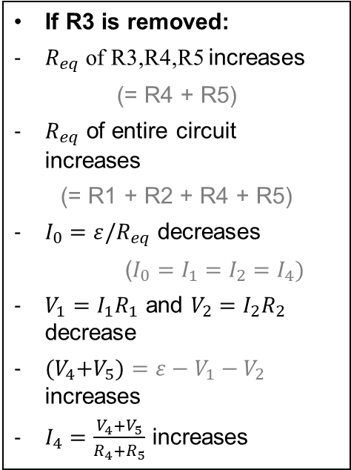



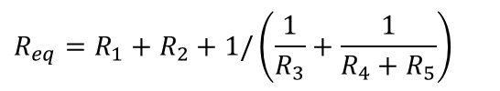




Resistors in Parallel and Series
R4
R5
$$I_{2}$$
$$I_{4}$$
If R3 is removed:
$R_{eq}$ of R3,R4,R5 increases
(= R4 + R5)
$R_{eq}$ of entire circuit increases
(= R1 + R2 + R4 + R5)
$I_{0}=ε/R_{eq}$ decreases
($I_{0}=I_{1}=I_{2}=I_{4})$
$V_{1}=I_{1}R_{1}$ and $V_{2}=I_{2}R_{2}$ decrease
${(V}_{4}+V_{5})=ε−V_{1}−V_{2}$ increases
$I_{4}=\frac{V_{4}+V_{5}}{R_{4}+R_{5}}$ increases
R3
$$I_{1}$$
R2
$$I_{3}$$
R1
ε
$$I_{0}$$
$$R_{eq}=R_{1}+R_{2}+1/\left(\frac{1}{R_{3}}+\frac{1}{R_{4}+R_{5}}\right)$$
$$I_{0}=I_{1} =I_{2} , I_{3}+I_{4}=I_{0}$$
$$I_{0}=ε/R_{eq}$$

Slide 6
Conceptual Analysis for Current
Rank the currents through these four identical resistors:
A = B = C = D
A > B > C = D
C > B > D > A
A > B > C > D
A > C = D > B
C
B
C & D in series (i.e. same current)
I_{left}
I_{right}
D
From junction rule: I_{left} + I_{right} = I_{total}
A
I_{total}
Right & Left Branches are in parallel (have same ΔV_{branch}), but different R_{eq}
use Ohm’s Law
&
I_{B} > I_{D} , I_{C}

Slide 7
Remove Resistor in Parallel
What happens to a circuit if you remove a resistor that was in parallel with other elements?
Current still passes through the other branches
Do the currents on the other branches change?
No
Does the total current change?
Decreases

Slide 8
Wire in Parallel with Resistor
(“Short Circuit”)
What is the current through the circled resistor?
(note: wire has zero resistance)
A
B
What is the potential difference across it?
(must be the same as between A and B)
0 V
For an ideal wire this is:
Ohm’s Law:
Current in circled resistor must be 0 A
What happened to current in other resistor?
Increased

Slide 9
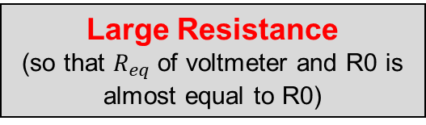
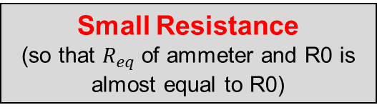
Resistances of Voltmeters and Ammeters
(lecture 16-17, slides 50,51)
Voltmeter: needs to be connected in parallel with resistor
(so that it has the same V across it as does the resistor)
V
Should voltmeter itself have large or small resistance?
Large Resistance
(so that $R_{eq}$ of voltmeter and R0 is almost equal to R0)
R0
Ammeter: needs to be connected in series with resistor
(so that it has the same I through it as does the resistor)
Should ammeter itself have large or small resistance?
Small Resistance
(so that $R_{eq}$ of ammeter and R0 is almost equal to R0)
A
R0

Slide 10
Energy and Power in Circuits
OpenStax Chapter 20.4

Slide 11
Battery’s Energy Transfer
Moves particles to higher potential energy
Electric Potential Energy and Potential are related:
ΔU = q ΔV
For a battery (with ΔV = ε) this is:
+
–
ΔU_{batt} = q ε
Energy Transfer Occurring:
E_{chem} U_{elec}
What happens when a resistor is included?

Slide 12
Resistor’s Energy Transfer
Moves particles to a lower potential energy
Resistor
ΔU_{r} = q ΔV_{r}
For this circuit:
|ΔV_{r}| = |ε|
+
–
Total Energy Transfer
E_{chem} U_{elec}
E_{chem} U_{elec} K_{ions} E_{therm}
Battery
Resistor

Slide 13
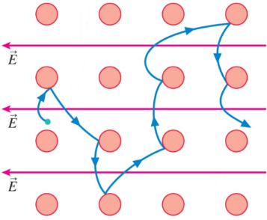
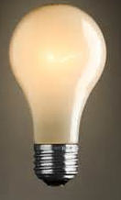
Why Wires (and Resistors) Heat Up
Temperature is measure of kinetic energy of atomic particles making up an object
As electrons move through wire, they hit ions… (lecture 16-17 slide 8)
… making ions vibrate more
(i.e. ions gain kinetic energy)
© 2010 Pearson Education, Inc.
Therefore: temperature of wire increases
(This is why incandescent light bulbs heat up and light)
Side Effect: Resistance also increases
(because electrons are more likely to hit ions now)

Slide 14
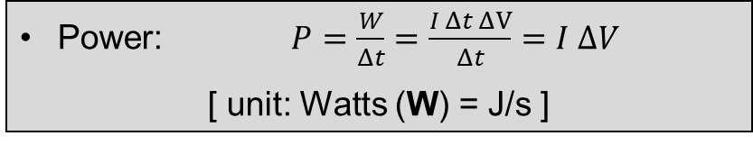
Electric Energy and Power
Work done: W = q ΔV (lecture 14-15 slide 13)
q = I Δt (lecture 16-17 slide 3)
Combining: W = I Δt ΔV
In a circuit, a battery continuously does work on the charges to keep them moving.
Therefore, instead of the total amount of work done, the rate of work done (i.e. power) is of more importance.
Power: $P=\frac{W}{Δt}=\frac{I Δt ΔV}{Δt}=I ΔV$
[ unit: Watts (W) = J/s ]

Slide 15

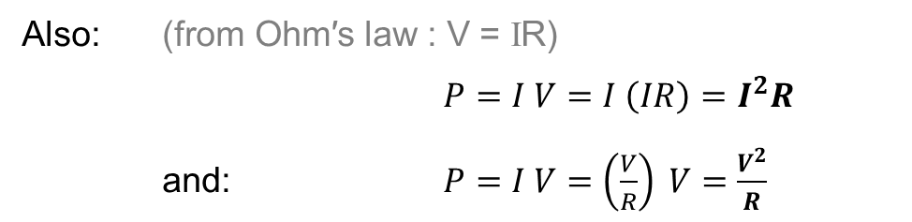
Electric Energy and Power (contd.)
Power: $P=IV$
Also: $\text{(}\text{from} \text{Ohm}\text{′}\text{s} \text{law}\text{ : }\text{V}\text{ = }\text{I}\text{R}\text{)}$
$P=I V=I \left(IR\right)=I^{2}R$
and: $P=I V=\left(\frac{V}{R}\right) V=\frac{V^{2}}{R}$
The greater the power output, the hotter/brighter/faster an element performs.
The power output of a circuit element (e.g. resistor), depends on I, V, R associated with it.
Therefore: changes in I, V, R affect power outputs of circuit elements

Slide 16


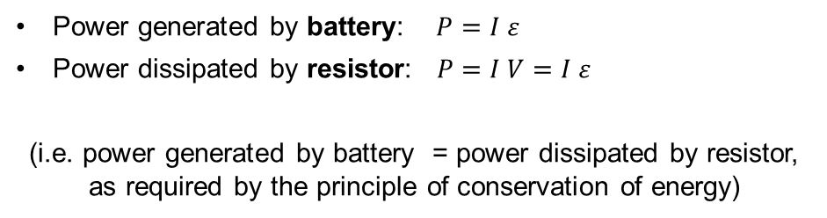



Power: Single Resistor
Power: $P=IV=I^{2}R=V^{2}/R$
$$I$$
$$ε$$
$$V=ε$$
$$R$$
Power generated by battery: $P=I ε$
Power dissipated by resistor:$P=I V=I ε$
(i.e. power generated by battery = power dissipated by resistor, as required by the principle of conservation of energy)

Slide 17





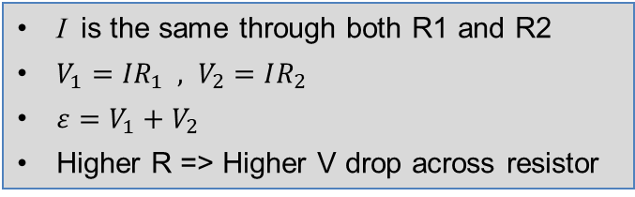

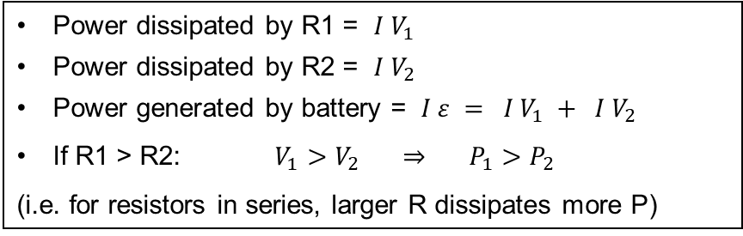


Power: Resistors in Series
Power: $P=IV=I^{2}R=V^{2}/R$
$$V_{1}$$
$$I$$
I is the same through both R1 and R2
$V_{1}={IR}_{1} , V_{2}=IR_{2}$
$ε=V_{1}+V_{2}$
Higher R => Higher V drop across resistor
$$R_{1}$$
$$ε$$
$$R_{2}$$
$$V_{2}$$
$$I$$
Power dissipated by R1 = $I V_{1}$
Power dissipated by R2 = $I V_{2}$
Power generated by battery = $I ε = I V_{1} + I V_{2}$
If R1 > R2: $V_{1}>V_{2} ⇒ P_{1}>P_{2}$
(i.e. for resistors in series, larger R dissipates more P)

Slide 18

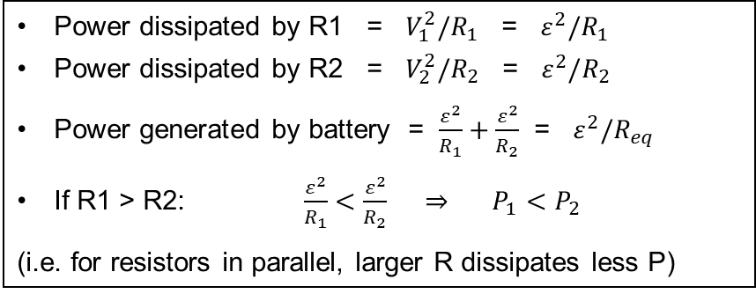


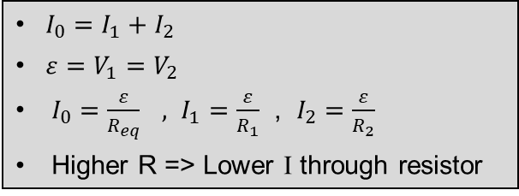







Power: Resistors in Parallel
Power: $P=IV=I^{2}R=V^{2}/R$
$$I_{0}$$
$I_{0}=I_{1}+I_{2}$
$ε=V_{1}=V_{2}$
$I_{0}=\frac{ε}{R_{eq}} , I_{1}=\frac{ε}{R_{1}}$ , $I_{2}=\frac{ε}{R_{2}}$
Higher R => Lower I through resistor
$$ε$$
$$V_{2}$$
$$R_{1}$$
$$R_{2}$$
$$V_{1}$$
$$I_{2}$$
$$I_{1}$$
$$I_{0}$$
Power dissipated by R1 = $V_{1}^{2}/R_{1}$ = $ε^{2}/R_{1}$
Power dissipated by R2 = $V_{2}^{2}/R_{2}$ = $ε^{2}/R_{2}$
Power generated by battery = $\frac{ε^{2}}{R_{1}}+\frac{ε^{2}}{R_{2}}$ = $ε^{2}/R_{eq}$
If R1 > R2: $\frac{ε^{2}}{R_{1}}<\frac{ε^{2}}{R_{2}} ⇒ P_{1}<P_{2}$
(i.e. for resistors in parallel, larger R dissipates less P)

Slide 19






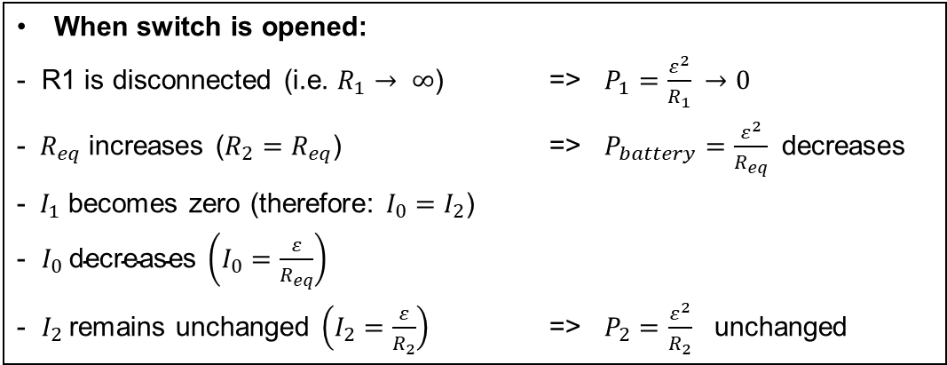
Power: Resistors in Parallel (contd.)
Closed switch
Open switch
$$I_{0}$$
$$I_{1}$$
$$I_{2}$$
$$I_{0}$$
$$I_{2}$$
$$R_{1}$$
$$R_{2}$$
$$R_{1}$$
$$R_{2}$$
$$I_{0}$$
$$I_{0}$$
When switch is opened:
- R1 is disconnected (i.e. $R_{1}→ ∞$) => $P_{1}=\frac{ε^{2}}{R_{1}} →0$
- $R_{eq}$ increases ($R_{2}=R_{eq}$) => $P_{battery}=\frac{ε^{2}}{R_{eq}}$ decreases
- $I_{1}$ becomes zero (therefore: $I_{0}=I_{2}$)
- $I_{0} \text{decreases} \left(I_{0}=\frac{ε}{R_{eq}}\right)$
- $I_{2}$ remains unchanged $\left(I_{2}=\frac{ε}{R_{2}}\right)$ => $P_{2}=\frac{ε^{2}}{R_{2}}$ unchanged

Slide 20
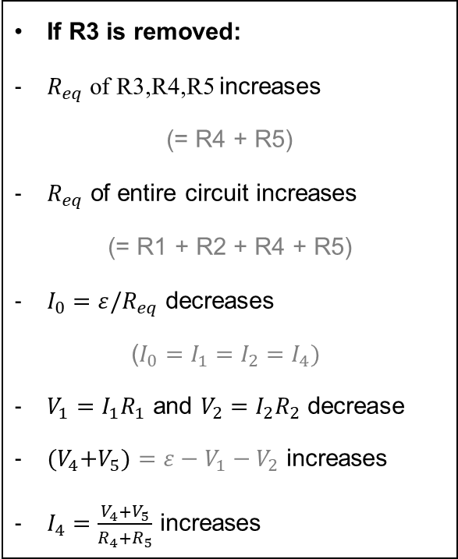
Power: R in Parallel and Series [1]
R4
R5
If R3 is removed:
$R_{eq}$ of R3,R4,R5 increases
(= R4 + R5)
$R_{eq}$ of entire circuit increases
(= R1 + R2 + R4 + R5)
$I_{0}=ε/R_{eq}$ decreases
($I_{0}=I_{1}=I_{2}=I_{4})$
$V_{1}=I_{1}R_{1}$ and $V_{2}=I_{2}R_{2}$ decrease
${(V}_{4}+V_{5})=ε−V_{1}−V_{2}$ increases
$I_{4}=\frac{V_{4}+V_{5}}{R_{4}+R_{5}}$ increases
$$I_{2}$$
$$I_{4}$$
R3
$$I_{1}$$
R2
$$I_{3}$$
R1
ε
$$I_{0}$$
$$R_{eq}=R_{1}+R_{2}+1/\left(\frac{1}{R_{3}}+\frac{1}{R_{4}+R_{5}}\right)$$
$$I_{0}=I_{1} =I_{2} , I_{3}+I_{4}=I_{0}$$
$$I_{0}=ε/R_{eq}$$

Slide 21
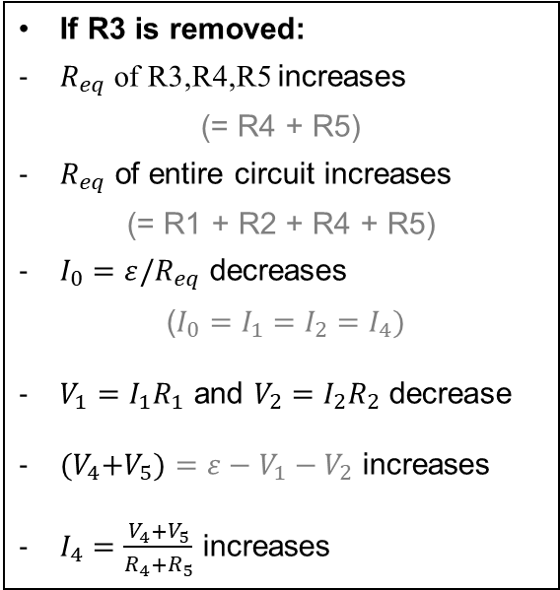
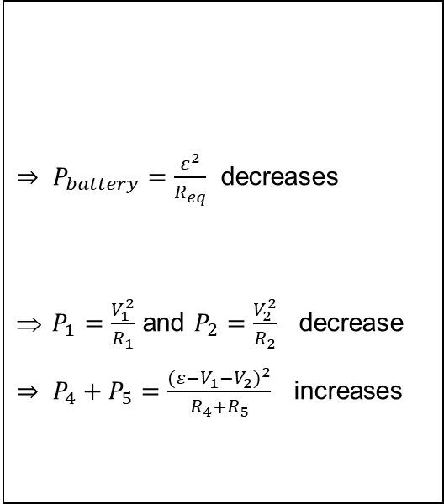
Power: R in Parallel and Series [2]
If R3 is removed:
$R_{eq}$ of R3,R4,R5 increases
(= R4 + R5)
$R_{eq}$ of entire circuit increases
(= R1 + R2 + R4 + R5)
$I_{0}=ε/R_{eq}$ decreases
($I_{0}=I_{1}=I_{2}=I_{4})$
$V_{1}=I_{1}R_{1}$ and $V_{2}=I_{2}R_{2}$ decrease
${(V}_{4}+V_{5})=ε−V_{1}−V_{2}$ increases
$I_{4}=\frac{V_{4}+V_{5}}{R_{4}+R_{5}}$ increases
$⇒ P_{battery}=\frac{ε^{2}}{R_{eq}}$ decreases
$P_{1}=\frac{V_{1}^{2}}{R_{1}}$ and $P_{2}=\frac{V_{2}^{2}}{R_{2}}$ decrease
$⇒ P_{4}+P_{5}=\frac{({ε−V_{1}−V_{2})}^{2}}{R_{4}+R_{5}}$ increases

Slide 22
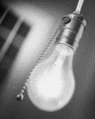
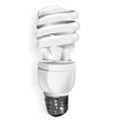

Power Rating
A 60 W rated light bulb and a 75 W rated light bulb are both designed to work when the potential difference across them is 120 V. (i.e. bulbs consume specified power when connected to a voltage source of 120 V). The resistance of the 60 W bulb’s filament is _____ the resistance of the 75 W bulb’s filament
48 Ω lower than
0.4 Ω lower than
equal to
0.4 Ω higher than
48 Ω higher than
Find Resistance of Each Bulb: $P=\frac{V^{2}}{R}$
60 W bulb:
240 Ω
75 W bulb:
192 Ω
For a given type of bulb, higher power means brighter
60 W incandescent and 15 W CFL have the same brightness
http://energystar.custhelp.com/cgi-bin/energystar.cfg/php/enduser/std_adp.php?p_faqid=2563&p_created=1148315013

Slide 23
Conceptual Analysis of Power
(similar to resistors in series)
A certain battery has two (non-ideal) wires connected to it as shown below. Both wires are made of the same material, wire 1 is three times has long as wire 2 but has one third the cross-section. How do the rates at which energy is dissipated from the two wires compare?
current in 1 = current in 2
a. P₁ = P₂ / 3
b. P₁ = 3 P₂
c. P₁ = P₂ / 9
d. P₁ = P₂
e. P₁ = 9 P₂
1
Use this version of power:
P = I² R
+
–
P₁ = I² R₁
P₂ = I² R₂
2
P₂ = I² (R₁ / 9)
= P₁ / 9

Slide 24
Conceptual Analysis with Power
Which of the following resistors will increase its thermal energy at the highest rate?
Resistance
Current
R I
2 R I
R I / 2
R / 2 I
R 2 I
Use

Slide 25
Which is Brighter in Series?
These two bulbs are connected in series, the one with the higher resistance will be …..
Brighter
or Dimmer
In series, current is the same, and
Brighter bulb (higher power) must have higher resistance

Slide 26
Which is Brighter in Parallel?
These two bulbs are connected in parallel, the one with the higher resistance will be …..
Brighter or
Dimmer
In parallel, potential difference is the same, and
Brighter bulb (higher power) must have lower resistance

Slide 27
Comparing Four Identical Bulbs
One set of these bulbs is in series with power supply
One set of these bulbs is in parallel with power supply
Which is which?
Set of brighter bulbs:
Parallel
ΔV_{1 Parallel} = ε
Analysis 1:
ΔV_{1 Series} = ε / 2
Analysis 2:
Ι_{1 Series} = Ι_{1 Parallel} /2

Slide 28
Removing Circuit Elements
If a single bulb is removed, what happens to the other?
Remaining bulb:
Bulbs are connected in series
goes out
Bulbs are connected in parallel
stays on

Slide 29
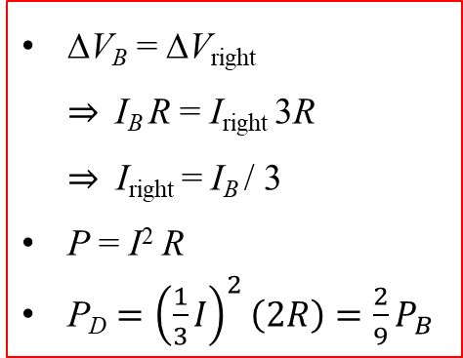
Conceptual Analysis for Power
Rank the power dissipated by these four resistors. A, B, & C are identical; D has twice the resistance of the others.
I_{D} = I_{C}
R_{D} > R_{C}
P = I² R
P_{D} > P_{C}
I_{A} = I_{B} + I_{right}
R_{A} = R_{B}
P = I² R
P_{A} > P_{B}
C
B
ΔV_{B} = ΔV_{right}
$⇒$I_{B} R = I_{right} 3R
$⇒$ I_{right} = I_{B} / 3
P = I² R
P_{D} $={\left(\frac{1}{3}I\right)}^{2}\left(2R\right)=\frac{2}{9}P_{B}$
D
A = B = C = D
A > B > C = D
D > B > C > A
A > B > D > C
A > D > B > C
A
I_{B}
I_{right}
I_{A}

