Slide 1
Cameras
OpenStax Chapter 25.6
Lens Cameras: focus image on film/CCD
Youtube: https://youtu.be/pUVdFQJTclM

Slide 2
Pinhole Camera
A pinhole camera is a box (of paper, cardstock or something else) with a very small hole in it
Works by only allowing some light rays through
These light rays can be projected on a screen:
For a more focused picture, make hole smaller:
But now less light gets through so the picture is fainter

Slide 3
Lens Camera
Uses a lens to form an image
Using the lens, light from object is focused on film or CCD (charge-coupled device) to create an image on it
What type of lens should it be?
We want a real image
So (if it’s a single lens) it must be a converging lens

Slide 4

Focusing a Camera
For a given object, you want the film/CCD to be at the image location
For a given object, you want the film/CCD to be at the image location
blurry image if film is here
or here
F
F
Focus image by:
A – Moving lens
B – Moving film
C – Changing lens
All rays from a specific part of the object come together at the same point on the detector

Slide 5
Using Thin Lens Equation to Analyze a Camera
A camera lens has a focal length of 7.0 mm; the lens is 7.2 mm from the detector when an object produces a clear image. How far is the object from the lens?
Since cameras use converging lenses to form real images, both the focal length and image distance are positive:
s' = +7.2 mm
f = +7.0 mm
=> s = 250 mm = 25 cm = 0.25 m

Slide 6
Using Thin Lens Equation to Analyze a Camera
If the object from the previous slide fills the 9.6 mm tall sensor, how tall is the object itself?
We’ll need to use magnification:
s' = +7.2 mm
f = +7.0 mm
s = 250 mm = 25 cm = 0.25 m
Since the image is inverted we’ll use h' = – 9.6 mm

Slide 7
Exposure Settings
(time)
For a picture to turn out correctly enough light (but not too much) has to hit the detector
One way to do that is to let light hit detector for a long time
One benefit to this is easy to do
Also amount of light hitting detector is directly proportional to the time (twice the time means twice the light)
What’s a downside to having light hit the detector for more time?
Image blur

Slide 8
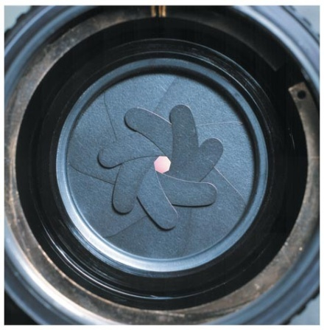
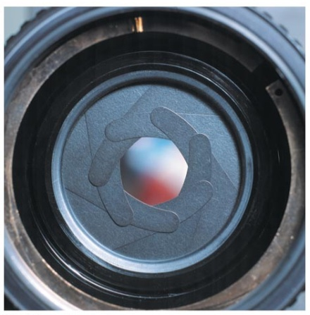
Exposure Settings
(Iris)
If you have a certain time for the camera to be active another way to adjust the exposure is by changing the opening through which light enters
An iris can be used to cover parts of the lens to let more or less light in
© 2010 Pearson Education, Inc.
Amount of light let in is proportional to the area

Slide 9
Exposure Settings
(Focal Length)
For a given lens size, focal length will make a difference in the amount of light focused on the detector
Which one of these would form a brighter image?
Smaller image will be brighter (light concentrated in smaller area)
F
F
Focal Length and opening size are combined in “f-number” of a camera
F
F

Slide 10
Human Eye
OpenStax Chapter 26.1-26.2
Eyesight
  Near point: closest point eyes focus on (ciliary muscles fully contracted)
  Far point: farthest point eyes focus on (ciliary muscles fully relaxed)
Corrective Optics
  Put object at the corrected ____point (near/far point of normal adult)
  Corrective lens puts virtual image at natural _____point (near/far point of patient)
  Myopia / Nearsightedness
    Far point needs correction (it’s too near / small)
    Corrected far point should approach ∞ (very far away)
    Use diverging lens
  Hyperopia / Farsightedness
    Near point needs correction (it’s too far / big)
    Corrected near point can vary, should be about 25 cm
    Use converging lens

Slide 11
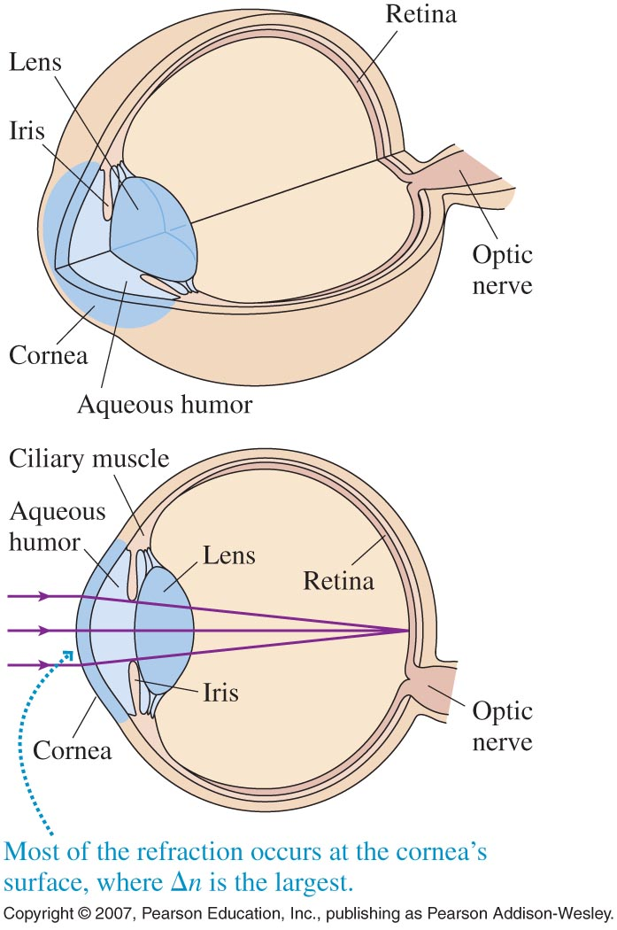
Human Eye
Works by generating a real image on the retina
Works by generating a real image on the retina
Incoming rays are refracted by different parts of the eye
(eye acts like a converging lens)
(eye acts like a converging lens)
Indices of Refraction for Different Parts:
Aqueous humor
1.33
Lens
1.42
Vitreous humor
1.33
From: Intermediate Physics for Medicine and Biology 3rd Edition By R. K. Hobbie (© 1997 Springer-Verlag)
Copyright © 2007, Pearson Education, Inc., publishing as Pearson Addison-Wesley.

Slide 12
Focusing the Eye
To focus, place image at
retina (detector)
Reptiles, Birds, Mammals:
Change lens’ focal length…
Change lens’ focal length
…by changing lens’ shape
Accommodation: ciliary muscles contract / relax
Copyright © 2007, Pearson Education, Inc., publishing as Pearson Addison-Wesley.

Slide 13
Changing Lens’ Shape
For object getting closer and staying in focus
constant
(s' = distance from lens to retina)
Thin lens equation
Has to increase
as well
Increasing
(dividing by smaller number)
This means f gets smaller
Lens shape becomes thinner or thicker?
Zoom in to first surface:
vs.
Ciliary muscles contract to reduce focal length
(“harder” to focus on near than far)

Slide 14
Range of Vision 1
Limit to how much ciliary muscles can change the lens’s shape
For s to be as short as possible and image still be on retina need:
f as short as possible
Lens as thick as possible
Ciliary muscles fully contract
Lens
(Not to scale)
s for this situation is called the Near Point
(cannot focus on objects nearer to eye)
About 25 cm for “normal” adults

Slide 15
Range of Vision 2
Limit to how much ciliary muscles can change the lens’s shape
For s to be as long as possible and image still be on retina need:
f as long as possible
Lens as thin as possible
Ciliary muscles fully relax
Lens
s for this situation is called the Far Point
(cannot focus on objects farther from eye)
Use ∞ for “normal” adults

Slide 16
Near Point and Far Point
There’s a limit to how much the ciliary muscles can change the lens’ shape
Near Point
Far Point
Muscles fully contracted
Muscles fully relaxed
Cannot focus on objects closer to eye
Cannot focus on objects farther from eye
About 25 cm for “normal” adults
Approaches ∞ for “normal” adults

Slide 17
Object Between Near and Far Point
Ciliary muscles contract however much they need to form focused image (of desired object) on retina
f as depends on how contracted the muscles need to be (for image to be on retina)
Can focus on anything in this range
Lens
Focus on this object
Near Point
Far Point
When eye focuses on something, f is set until focus changes
Use Corrective Lenses if
near point is too long or far point is too short
Use Corrective Lenses if
near point is too long or far point is too short
Corrective Lenses put a (C – real; D – virtual) image between eye’s natural near and far points

Slide 18
Myopic (Near Sighted)
At Far Point
Can see things that are near, but not things that are far away
To figure out how to fix, consider a point source:
At Far Point:
Myopic Eye
Eye can focus these rays onto retina
Closer in, the angle between the rays would be larger
Myopic eye is fine when angle between rays is large

Slide 19
Myopic (Near Sighted)
Farther than Far Point
Can see things that are near, but not things that are far away
To figure out how to fix, consider a point source:
Farther than Far Point:
Myopic eye is too long
Myopic Eye
Rays are more parallel (angle between them is smaller)
To fix, use diverging lens to spread rays out
Myopic Eye brings them together before reaching retina

Slide 20
Corrective Lens (c.l.) for Myopia
Put object at corrected far point (∞)
Put object at corrected far point (∞)
Have c. lens put image at natural far point
Have c.l. put image at natural far point (n.f.p.)
Consider if nat. f.p. < 100 m
Strongly consider if nat. f.p. < 10 m
Definitely use if nat. f.p. < 4 m
Consider if nat. f.p. < 100 m
Strongly consider if nat. f.p. < 10 m
Definitely use if nat. f.p. < 4 m
Consider if nat. f.p. < 100 m
Strongly consider if nat. f.p. < 10 m
Definitely use if nat. f.p. < 4 m
Consider if nat. f.p. < 100 m
Strongly consider if nat. f.p. < 10 m
Definitely use if nat. f.p. < 4 m
d
|s'|
s
c
e
c
e
corrected f.p.
c = c.l.’s focal point
e = eye’s focal point
n.f.p.
Image formed by c.l. is the object for the person’s eye
Use thin lens equation to find f of c.l.
Notes:
Powers for listed u.f.p.: Consider -0.01 D; Strongly consider -0.1 D; Definitely use -0.25 D

Slide 21
Hyperopia (Far Sighted)
At Near Point
Can see things that are far away, but not things that are close
To figure out how to fix, consider a point source:
At Near Point of Hyperopic Eye:
Hyperopic Eye
Eye can focus these rays onto retina
Further out the angle between the rays would be smaller
Hyperopic eye is fine when angle between rays is small

Slide 22
Hyperopia (Far Sighted)
Closer than Near Point
Can see things that are far away, but not things that are close
To figure out how to fix, consider a point source:
Closer than Near Point
Hyperopic eye is too short
Hyperopic Eye
Rays have a larger angle between them
To fix, use a converging lens to bring rays closer together
Hyperopic eye brings them together behind retina

Slide 23
Corrective Lens (c.l.) for Hyperopia
Put object at corrected near point (25 cm or whatever desired)
Put object at corrected near point (25 cm or whatever desired)
Have c. lens put image at natural near point
Have c. lens put image at natural near point
Consider if nat. n.p. > 30 cm
Strongly consider if nat. n.p. > 40 cm
Definitely use if nat. n.p. > 50 cm
Consider if nat. n.p. > 30 cm
Strongly consider if nat. n.p. > 40 cm
Definitely use if nat. n.p. > 50 cm
Consider if nat. n.p. > 30 cm
Strongly consider if nat. n.p. > 40 cm
Definitely use if nat. n.p. > 50 cm
Consider if nat. n.p. > 30 cm
Strongly consider if nat. n.p. > 40 cm
Definitely use if nat. n.p. > 50 cm
d
eye n.p.
s
|s'|
c = c.l.’s focal point
e = eye’s focal point
c
e
c
e
corrected n.p.
Image formed by c.l. is the object for the person’s eye
Use thin lens equation to find f of c.l.
Notes:
Powers for listed u.n.p.: Consider +0.67 D; Strongly consider +1.5 D; Definitely use +2 D

Slide 24
Power for Corrective Lenses
Refractive Power of a Lens is defined as:
With focal length in meters, power is measured in diopters (D)
(prescriptions do not include the D)
Sign is carried along
Myopic patients require lenses with negative power
Myopic patients require lenses with negative power
Hyperopic patients require lenses with positive power
Hyperopic patients require lenses with positive power

Slide 25
Basic Steps for Corrective Lenses
Make a sketch
Should C.L. be on the eye or some distance?
Which should be closer to the eye?
the object
the C.L.’s image
Object: where we want patient to be able to see (corrected)
Object: where we want patient to be able to see (corrected)
Image: where patient’s eye wouldn’t need C.L. (natural)
Image: where patient’s eye wouldn’t need C.L. (natural)
Solve with Thin Lens Equation

Slide 26
Sample Question 1
A patient has a far point of 150 m; the same patient’s near point is 75 cm. Which of the following prescriptions in diopters will correct this person’s vision with contact lenses (no distance between eye and lens)?
+2.0 D
–2.0 D
+2.67 D
–2.67 D
No correction needed
Patient is hyperopic: needs a converging lens
(near point is too far; far point is not too close)
Want object at corrected near point:
s = 0.25 m
To put an image at natural near point:
s' = –0.75m (-ve because image is virtual)

Slide 27
Sample Question 2
A patient has a far point of 70 cm; the same patient’s near point is 20 cm. Which of the following prescriptions in diopters will correct this person’s vision with contact lenses (no distance between eye and lens)?
–3.6 D
+3.6 D
+1.4 D
–1.4 D
No correction needed
Patient is myopic: needs a diverging lens
(far point is too close; near point is not too far)
Want object at corrected far point:
s → ∞
To put an image at natural far point:
s' = –0.7m

Slide 28
Sample Question 3
A patient has a far point of 3 m; the same patient’s near point is 40 cm. To correct his vision, bifocals will be prescribed. If the bifocals will be 1.5 cm from his eye, what power in diopters will be used to correct his near vision?
Fixing the hyperopia: need a converging lens
–0.3 D
+1.5 D
+1.7 D
+6.5 D
+6.7 D
image
object
Eye
d = 1.5 cm
c
s
n
|s'|
Want object at corrected near point:
c = 0.25 m
s = c – d = 0.235 m
s = c – d
To put an image at natural near point:
n = 0.40 m
s' = –(n – d) = –0.385 m
s' = –(n – d)

Slide 29
Sample Question 4
A patient has a far point of 3 m; the same patient’s near point is 40 cm. To correct his vision, bifocals will be prescribed. If the bifocals will be 1.5 cm from his eye, what power in diopters will be used to correct his distance vision?
Fixing the myopia: need a diverging lens
–0.3 D
+0.3 D
–2.5 D
+2.5 D
+1.7 D
Eye
image
d = 1.5 cm
n
|s'|
Want object at corrected far point:
c →∞
s = c – d → ∞
To put an image at natural far point:
n = 3 m
s' = –(u – d) = –2.985 m
s' = –(n – d) = –2.985 m ≈ –3 m
s' = –(u – d)

Slide 30
Human Eye in Water
The eye only works because of refraction when light goes from air to the material in the eye (where n ~ 1.4); for a human eye in water, will the eye be myopic, hyperopic or neither?
(Keep in mind: myopia – image forms in front of retina; hyperopia – image forms behind retina)
myopic
hyperopic
Myopic for far objects, hyperopic for close
Myopic for close objects, hyperopic for far
Neither
Since the index of refraction of water is
n = 1.33, there will be much less refraction
Eye
In air
In water
(less refraction)
What about a fish in air?

Slide 31
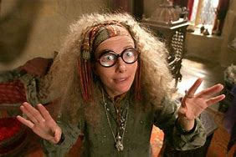
Determining Conditions From Glasses
Consider the following individual:
“Professor Trelawney moved into the firelight, and they saw that she was very thin; her large glasses magnified her eyes to several times their natural size, and she was draped in gauzy, spangled shawl.”
-Harry Potter and the Prisoner of Azkaban
Prof. Trelawney’s glasses create an enlarged image
they must be converging lenses
she must have hyperopia

Slide 32
Magnifying Glass
  Deals with angular size
  Mx is ratio of normal person’s near point (25 cm) to glass’ focal point
Angular Size
  Measure from one side of object to other
  Use right triangle to find
Magnifiers
  Use converging lens
  Put object just inside focal point

Slide 33
Basic Magnifiers
Use a single lens to create a large upright image of the object
What type of lens could be used for that?
Diverging
Converging
With object at inside the focal point, image will be upright and magnified

Slide 34
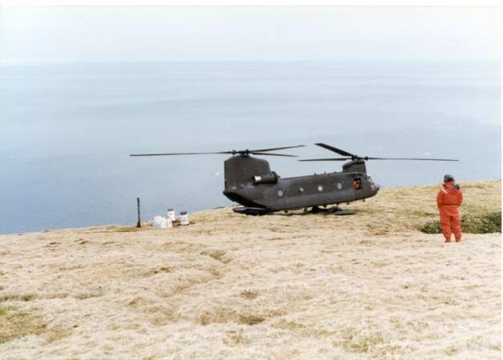
Apparent Size
The more space an image takes on the eye’s retina, the larger the brain interprets the corresponding object to be
Context clues are used to determine whether an object is actually smaller or just farther away
From top of a stadium, people on the field look small (apparent size is little), but you know they are not
Removing context clues can remove ability to determine size
Magnifiers increase apparent size, but how to measure it?
http://en.wikipedia.org/wiki/File:Fairway-Rock-mil-atop.jpg

Slide 35
Apparent Size and Images
Consider this object and find its image
The image is larger than the object, but it is also located farther away
How can we be sure that the apparent size of the image will have increased to an observer, compared to the size of the object?
F
F
Apparent Size is related to Angular Size

Slide 36
Angular Size
Angle between one side of an object/image to the other
Hold your pencil fairly close to your eye
Now move the pencil further away
θ
Eye
Angular Size is θ
Angular Size is now ϕ
ϕ
Eye

Slide 37
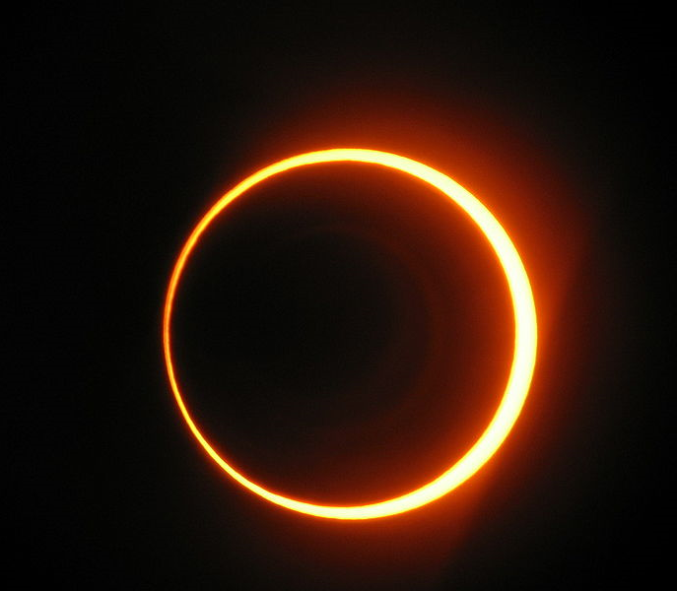
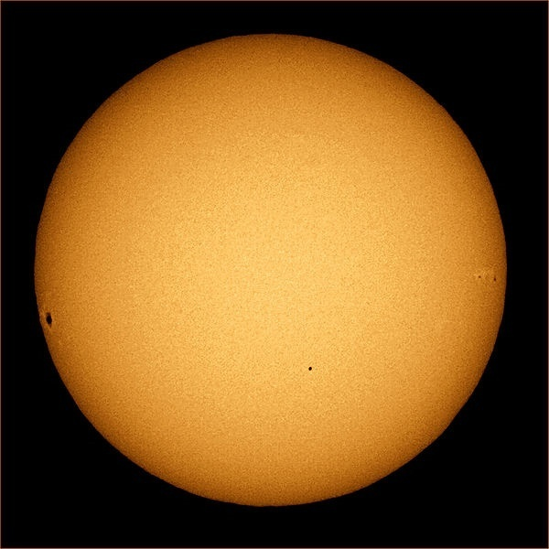
Angular Size and Astronomy
Eclipses vs. Transits
Solar Eclipse (moon in front of sun)
Transit of Mercury (Mercury in front of sun)
Mercury and sun do not
Moon and sun have similar angular sizes (when viewed from Earth)
Mercury
~1.4 times the size of the moon
http://en.wikipedia.org/wiki/File:Ecl-ann.jpg
http://en.wikipedia.org/wiki/File:Mercury_transit_2.jpg

Slide 38
Angular Size and Magnifier
Put object at about the focal point and compare angular size of image to the angular size of the object at a person’s near point
Angular Size of Object
(without lens)
Angular Size of Image
(with lens)
h
θ₀
length to near point ~25 cm
(for object placed at about the focal point)
Angular Magnification:

Slide 39
Microscope (OpenStax 26.4)
To get a larger magnification instead of one lens, microscopes use at least two
Eyepiece (acts like a Magnifier)
Objective
Eye
L
F_{o}
F_{e}
F_{e}
F_{o}
Creates Virtual image with Angular magnification of
Creates Real image magnified by
Overall magnification is product of objective and eyepiece’s

Slide 40
Microscope Limit
All microscopes have a limit to how much magnification they can provide
Comes from the fact that light is not a ray
Depends on wavelength of light
We’ll discuss wave properties of light next time

