Slide 1
Physics in Robotics
Lecture 06
PSCI 1102
09/16/2022

Slide 2
More on Display Systems
Liquid Crystal Display
https://www.youtube.com/watch?v=iPak5PA0AXk

Slide 3
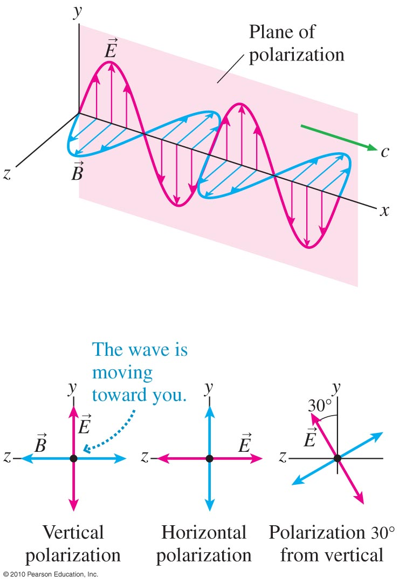
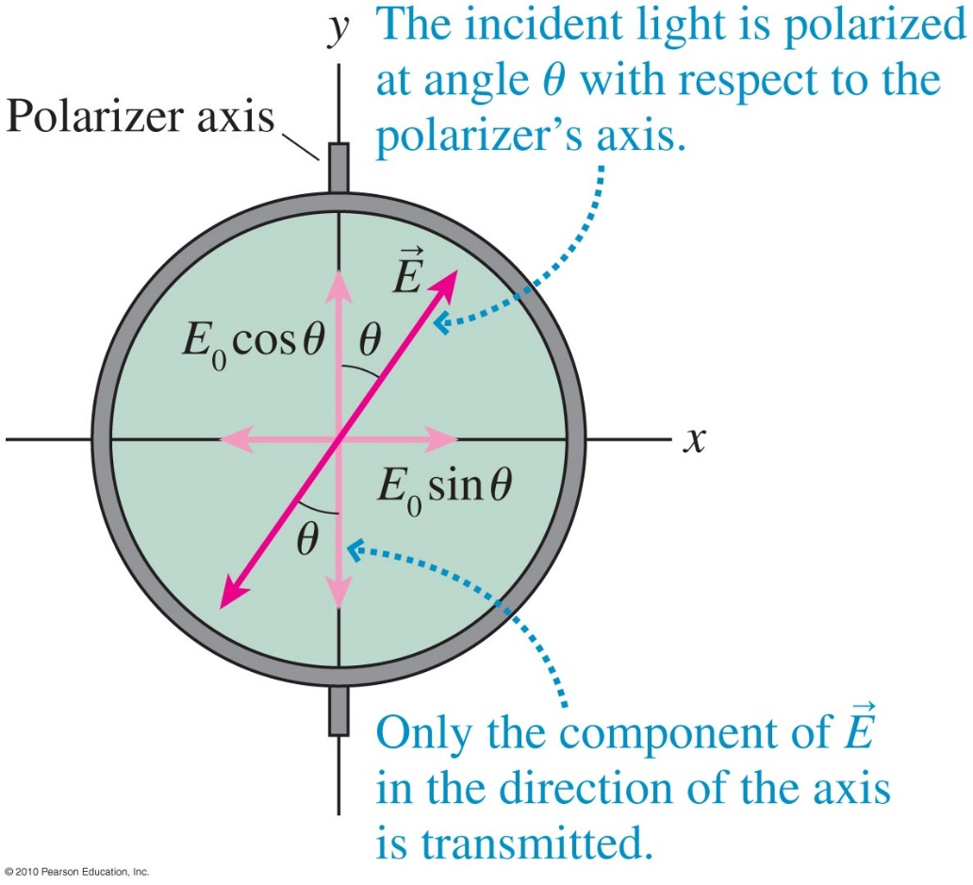
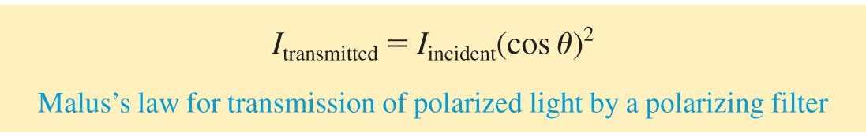
Polarizations (Ch 12.10 in “P”)

Slide 4
Temperature Sensor

Slide 5
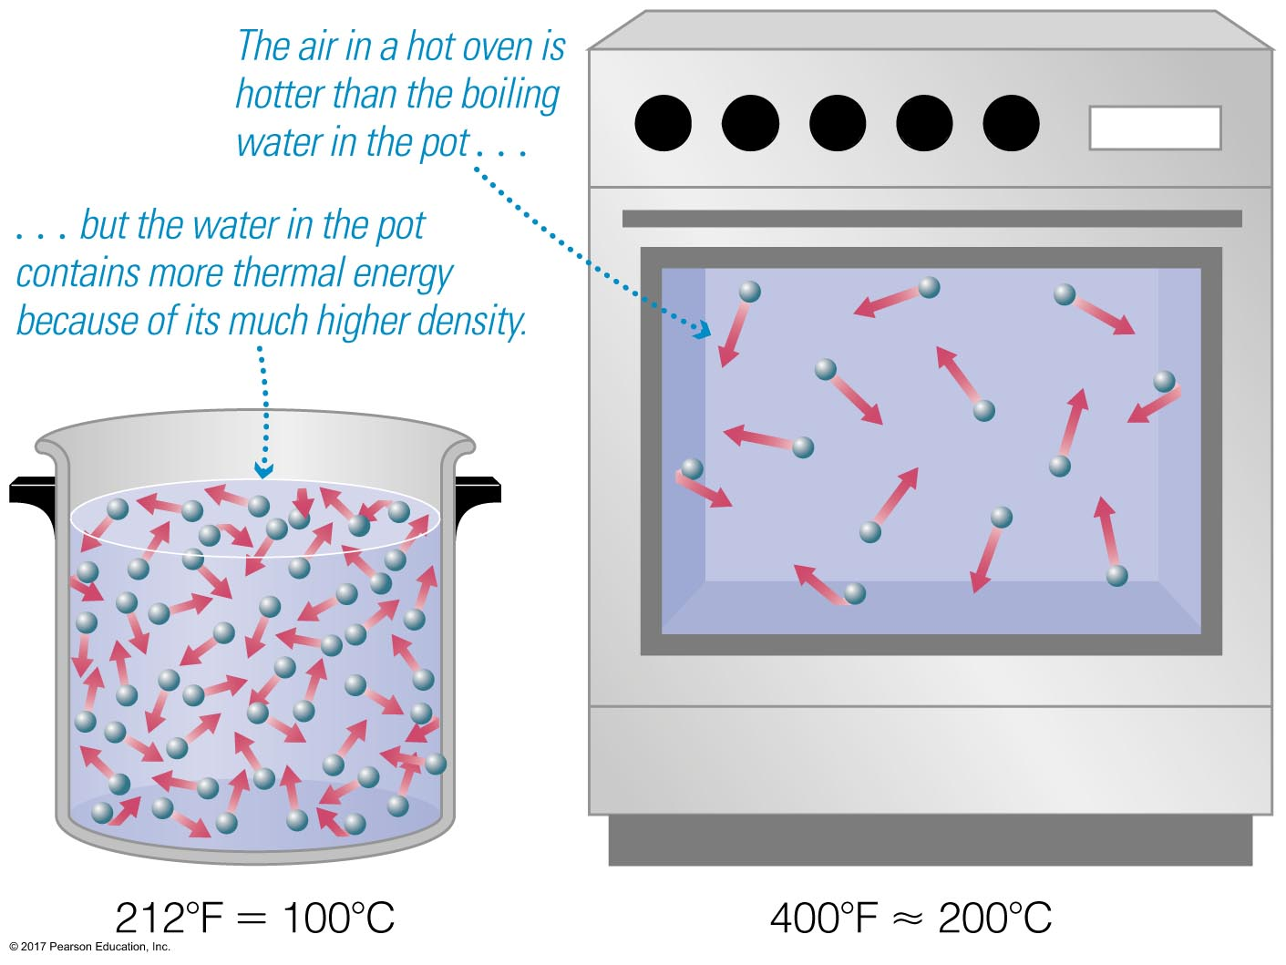
Temperature Scales
Thermal energy is a measure of the total kinetic energy of all the particles in a substance. It therefore depends on both temperature AND density.
  Example:

Slide 6
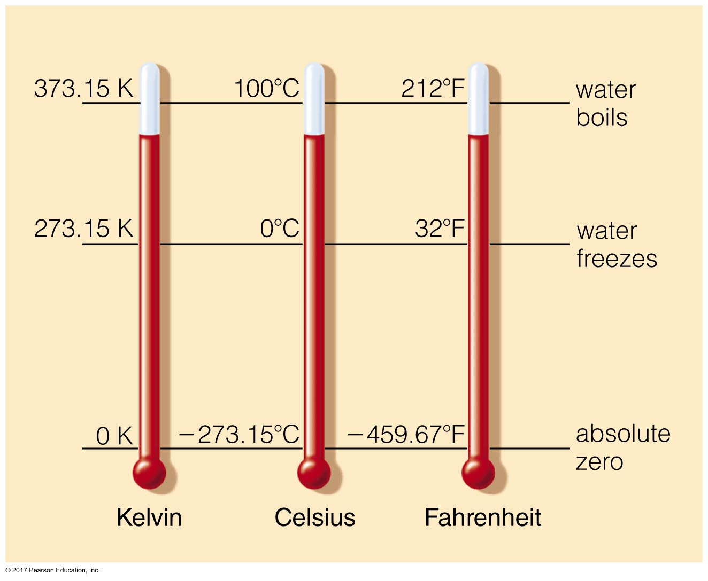

Slide 7
Fº = 1.8 Cº + 32
Cº = (0.56) *(Fº – 32)
K = Cº + 273

Slide 8
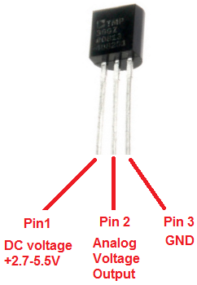
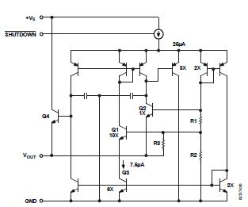
TMP36

Slide 9
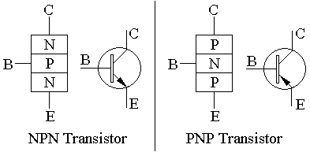
NPN vs. PNP

Slide 10
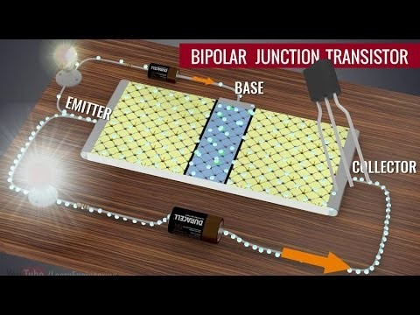

Slide 11
Transistor Documentary
https://www.youtube.com/watch?v=U4XknGqr3Bo

Slide 12
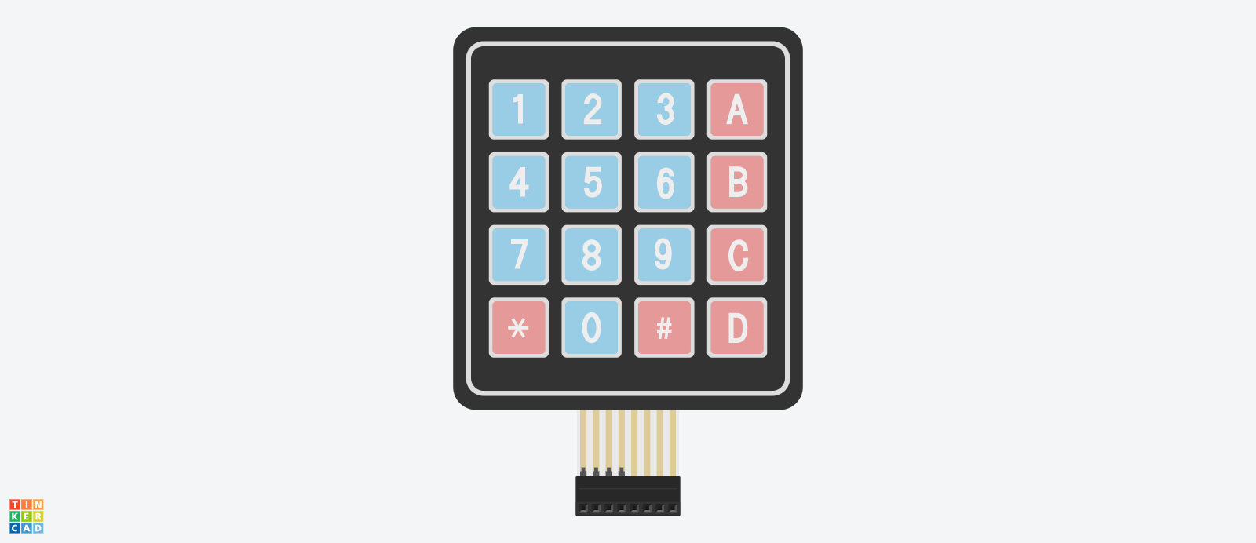
Key Pad

