Slide 1
Light Waves
OpenStax Chapter 27
Wavelength
  Decreases when light travels through a medium other than vacuum
Diffraction
  Waves spread out when they reach an obstacle
  Youtube: https://youtu.be/WGNa5n7Vn1Y

Slide 2
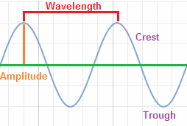
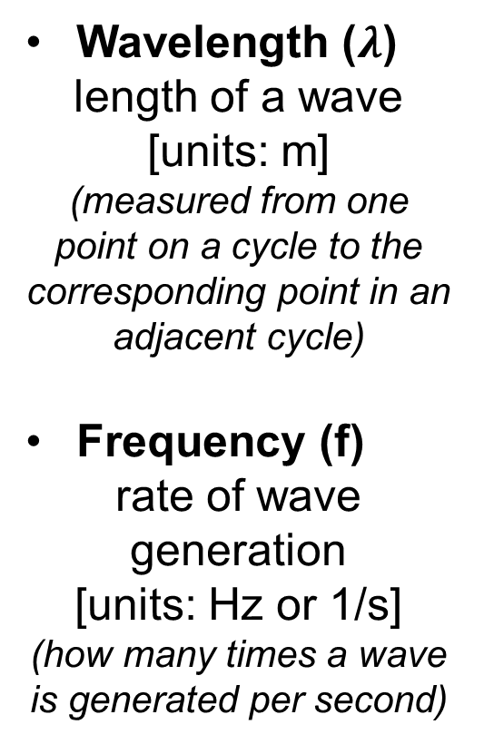
Wave Features
Wavelength ($λ$)
length of a wave [units: m]
(measured from one point on a cycle to the corresponding point in an adjacent cycle)
Frequency (f)
rate of wave generation
[units: Hz or 1/s]
(how many times a wave is generated per second)

Slide 3
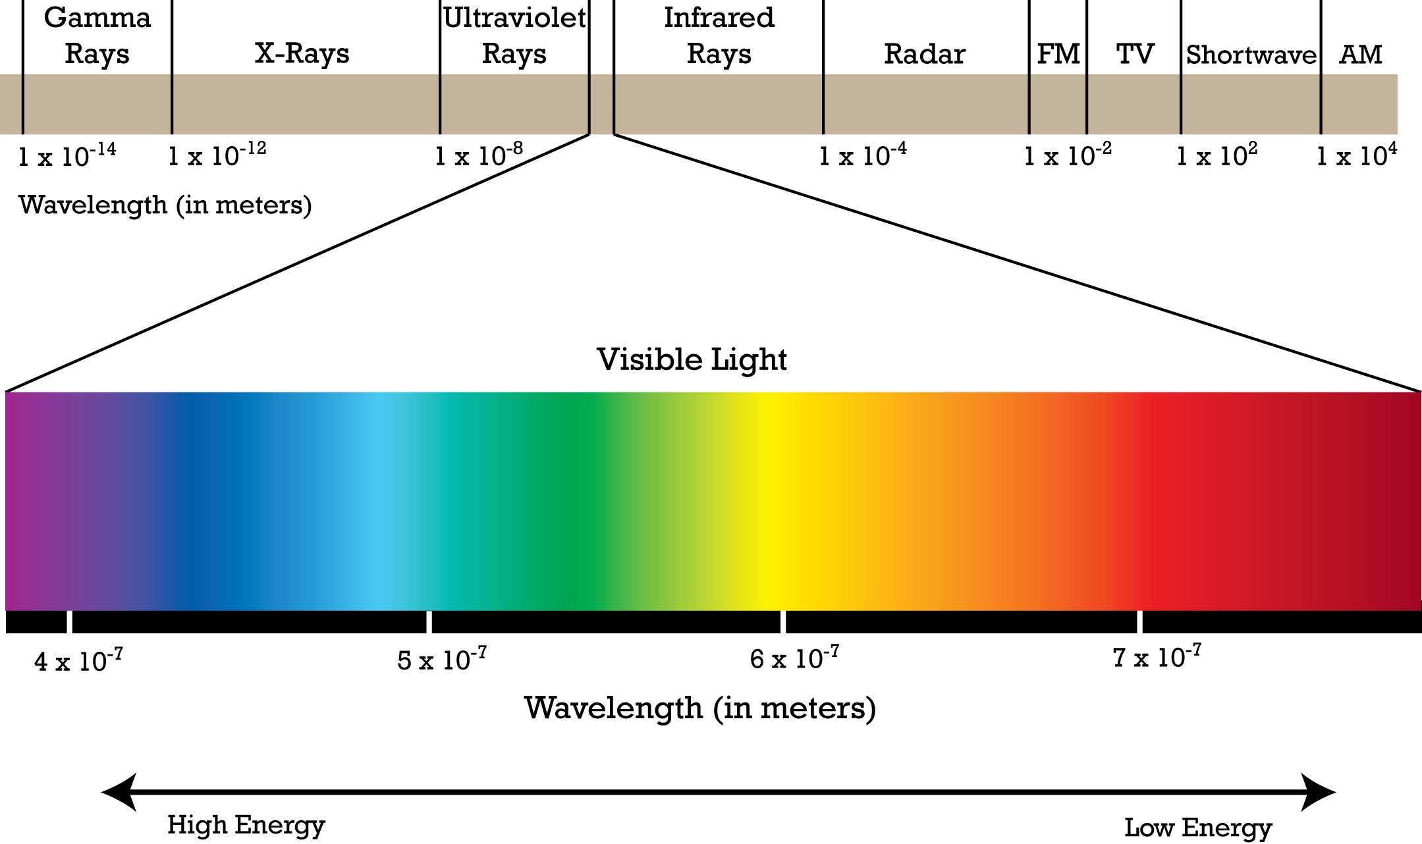
Electromagnetic Spectrum
Light waves belong to the family of waves known as the electromagnetic spectrum
Wavelength and frequency determine wave properties such as color and energy

Slide 4
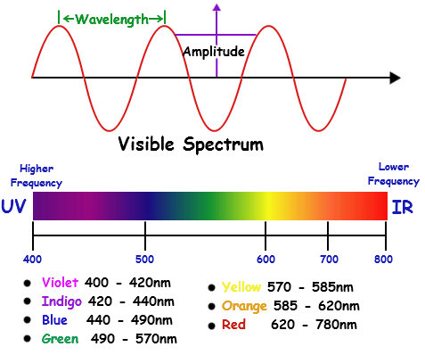
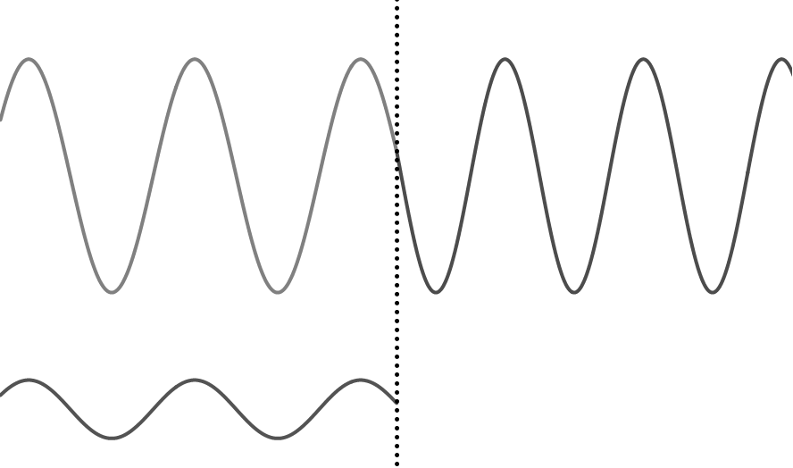
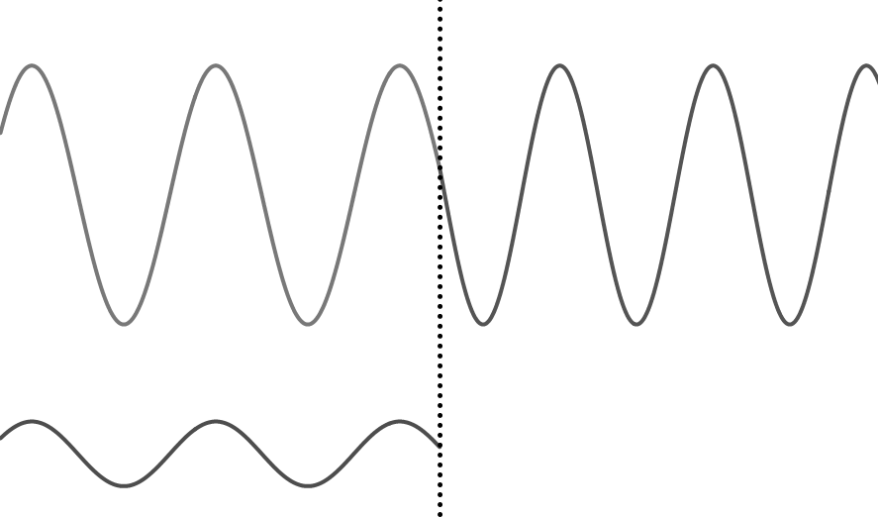
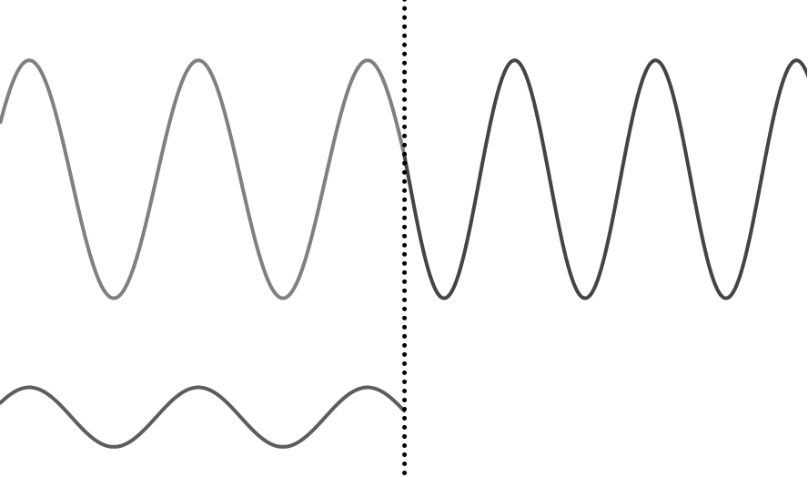
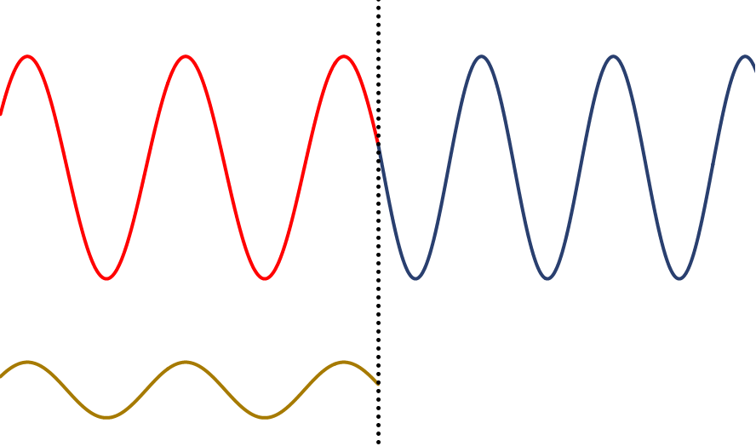
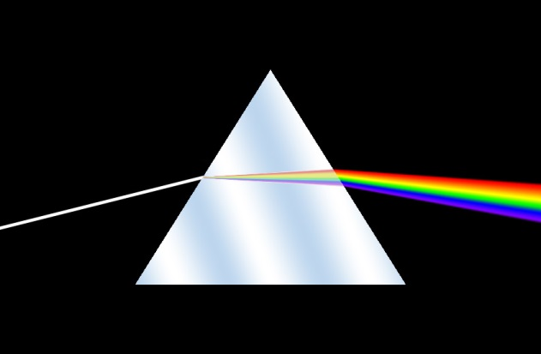
Visible Light Spectrum
White Light:
Combination of waves of all colors in the visible spectrum
white light
White light can be decomposed into lights of other colors
(because waves of different colors refract at different angles [see slide 9])
Visible Light Spectrum
Shortest Wavelength: 400 nm (violet)
Longest Wavelength: 700 nm (red)

Slide 5
Wave
Superposition
When waves try to be in the same place at the same time, at any point, the actual observed wave is found by adding the displacement the point would have from each wave
Notes:
5

Slide 6
Interference
Waves combine as they pass one another
Constructive Interference:
same parts line up
amplitude gets larger
Destructive Interference: opposite parts line up
amplitude gets smaller
Notes:
6

Slide 7
How to Get Constructive Interference
Superposition of in-phase waves (i.e. waves with peak-to-peak and trough-to-trough alignment)
Put identical sources next to each other
Or: Separate sources by the correct distance
Separate sources by nλ
(n = any integer)
Source 1
Source 2
nλ
Notes:
7

Slide 8

How to Get Destructive Interference
Separate the wave sources by an odd, integer number of half wavelengths (i.e. peak-to-trough alignment)
What about two sources that don’t generate parallel waves?
Source 1
Source 2
$\left(n+\frac{1}{2}\right)$λ
Look at “path length difference”
(how far wave travels from each source to point)
Separate sources by (n + 1/2) λ
(n = any integer)
Notes:
8

Slide 9
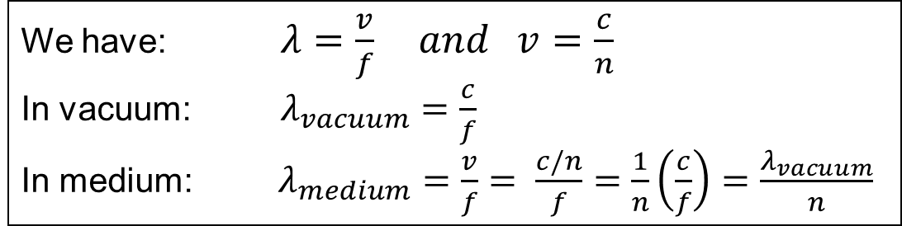
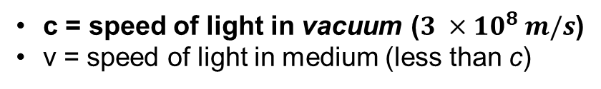
Light Traveling Through Media
Speed of light depends on medium through which it propagates
(which is why light refracts when traveling from one medium to another)
Index of refraction:
c = speed of light in vacuum ($3 ×10^{8} m/s$)
v = speed of light in medium (less than c)
A wave’s speed is related to its frequency and wavelength
Light’s wavelength depends on what medium it travels through
We have: $λ=\frac{v}{f} and v=\frac{c}{n}$
In vacuum: $λ_{vacuum}=\frac{c}{f}$
In medium: $λ_{medium}=\frac{v}{f}= \frac{c/n}{f}=\frac{1}{n}\left(\frac{c}{f}\right)=\frac{λ_{vacuum}}{n}$
Bigger n means smaller λ
λ provided in tables is generally wavelength in vacuum
Frequency (f) does NOT change in medium

Slide 10
Figuring out n from Waveform
In the figure below, a light wave is shown traveling through three different media. What is the correct ranking of index of refraction for these three media?
n₁ > n₂ > n₃
n₂ > n₁ > n₃
n₁ = n₂ = n₃
n₃ > n₁ > n₂
n₂ > n₃ > n₁
n₁
n₂
n₃

Slide 11
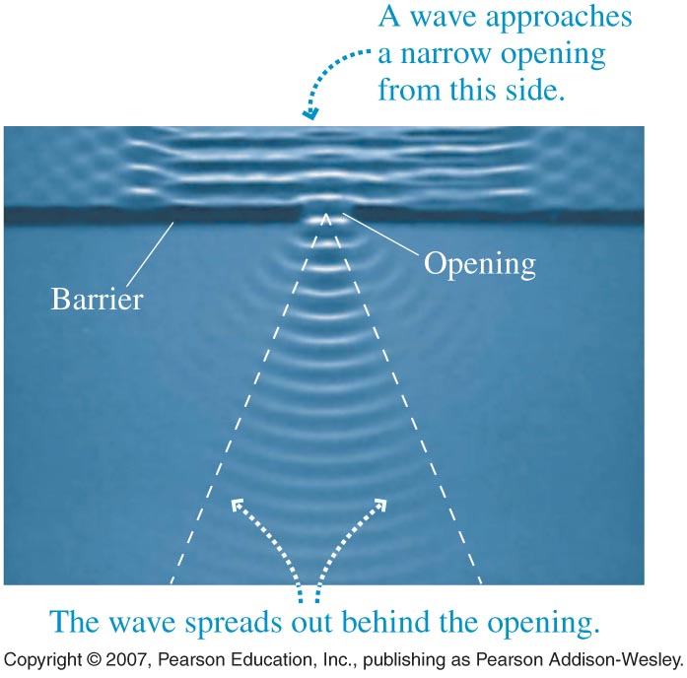
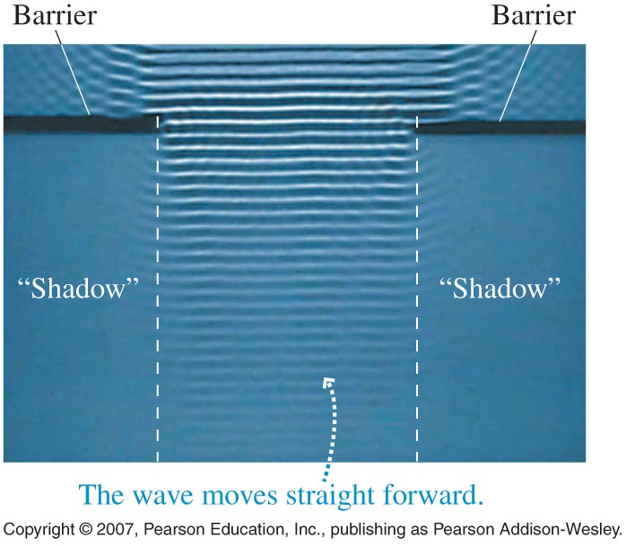
Diffraction (OpenStax 27.2)
When a wave reaches a boundary
the wave spreads out on the far side
Happens anytime there’s a boundary
Corners, objects, etc.
Depends on:
wavelength
size of opening
The smaller the gap in a boundary, the larger the curvature of the wave (esp. when the gap is ~ size of λ)

Slide 12
Sound vs. Light at a corner
Can person A hear person B?
B
Can person A see person B?
Top View
A
Typical wavelengths:
Both light and sound are waves, what is different?
Sound:
meters
Light:
< micrometers (10^{–6} m)
Sound waves from B can diffract at the corner and reach A because sound wavelength is much bigger than size of opening
(light wavelength is much smaller)

Slide 13
Diffraction at a Small Slit
Light (or any other wave) spreads out at slit
These just show wave front there is light everywhere between the fronts
Represented by wave fronts (“topview” of a wave)
sideview
wave front
(i.e. topview)
Progressively bigger arcs
Wave fronts can even interfere with each other

Slide 14
Double-Slit Diffraction
OpenStax Chapter 27.3
Double Slit Interference
  Diffraction at two openings
  Diffracted waves interfere with each other

Slide 15
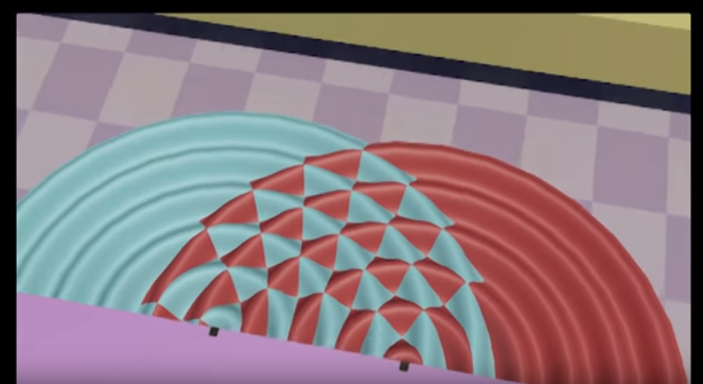
Double-slit Diffraction: https://www.youtube.com/watch?v=Kdi4e76UvO8

Slide 16
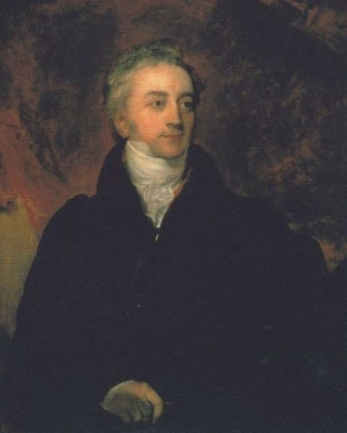
Young’s Double-Slit Experiment
Where red intersects red or blue intersects blue we get constructive interference
(i.e. bright spots)
Red lines are Peaks
Dashed blue lines are troughs (Minima)
Completely destructive interference when red intersects blue
(i.e. dark spots)
http://en.wikipedia.org/wiki/File:Young_Thomas_Lawrence.jpg
Rules of interference (slides 7,8):
Peak + Minimum -> destr
Peak + Peak -> constr
Minimum + Minimum -> constr

Slide 17
What Double Slit Interference Looks Like
(when a screen is placed somewhere in front of the slits)

Slide 18
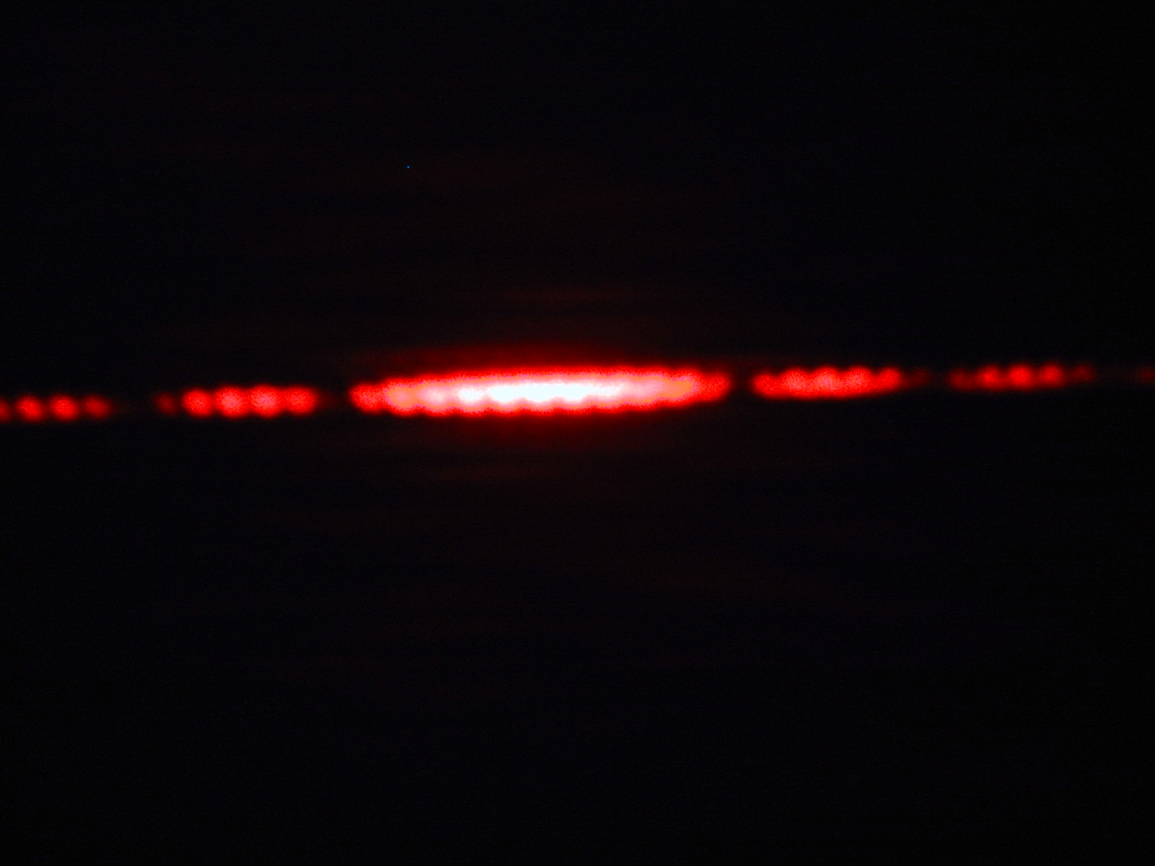
What Double Slit Interference looks like
http://www1.union.edu/newmanj/lasers/Light%20as%20a%20Wave/light_as_a_wave.htm

Slide 19
Schematic of Double Slit Interference
L = length from slits to screen
Can measure θ_{m} /θ'_{m} and y_{m} /y'_{m} from center to either side
θ_{m} = angle from center to m^{th} bright patch
θ '_{m} = angle from center to m^{th} dark patch
m = 3 (bright)
m = 2 (dark)
m = 2 (bright)
m = 1 (dark)
m = 1 (bright)
θ₃
θ₂
θ₁
m = 0 (dark)
d = distance between slits
m = 0 (bright)
θ '₀
m = 0 (dark)
θ '₂
θ '₁
m = 1 (bright)
m = 1 (dark)
m = 2 (bright)
m = 2 (dark)
m = 3 (bright)
y_{m} = distance along screen from center to m^{th} bright patch
…
y'_{m} = distance along screen from center to m^{th} dark patch
m (bright)
m (dark)
m+1 (bright)

Slide 20
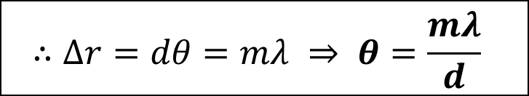
Analysis of Young’s Double Slit
Finding Bright Spots
screen
Since L >> d these lines are almost parallel
θ
y_{m}
d
L = length to viewing screen
For a bright spot the path length difference (Δr) must be a whole number of wavelengths:
θ
If θ is small (and measured in radians)
d
θ
$$∴Δr=dθ=mλ ⇒ θ=\frac{mλ}{d}$$

Slide 21
Location of Bright and Dark Spots
Maxima
(Maximum for m = 0 is very center of pattern)
This is where the center of each bright fringe is
θ and θ ' must be measured in radians for these equations
Minima
This is where the center of each dark fringe is

Slide 22

Double Slit Interference
A pair of slits 0.20 mm apart are cut into a piece of paper. Light shining on the slits creates an interference pattern on a screen 1.2 m away. One bright fringe is located at a 10 mm mark (not measured from the center of the interference pattern); another bright fringe is located at a 13.6 mm mark. If there are no bright fringes between these two what is the light’s wavelength?
If fringes are n^{th} and (n +1)^{th}, how far apart are they?
400 nm
500 nm
600 nm
700 nm
e. Cannot tell without knowing fringe number
previous slide:$y_{n}=\frac{nλL}{d}$
Distance between two consecutive fringes is:

Slide 23
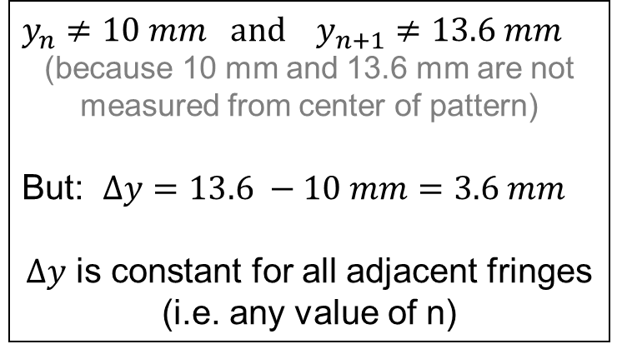
Double Slit Interference
A pair of slits 0.20 mm apart are cut into a piece of paper. Light shining on the slits creates an interference pattern on a screen 1.2 m away. One bright fringe is located at a 10 mm mark (not measured from the center of the interference pattern); another bright fringe is located at a 13.6 mm mark. If there are no bright fringes between these two what is the light’s wavelength?
(n+1)^{th} bright fringe
$$y_{n}≠10 mm and y_{n+1}≠13.6 mm$$
(because 10 mm and 13.6 mm are not measured from center of pattern)
But: $Δy=13.6 −10 mm=3.6 mm$
$Δy$ is constant for all adjacent fringes
(i.e. any value of n)
n^{th} bright fringe
y_{n+1}
y_{n}
…
Center of Pattern

Slide 24
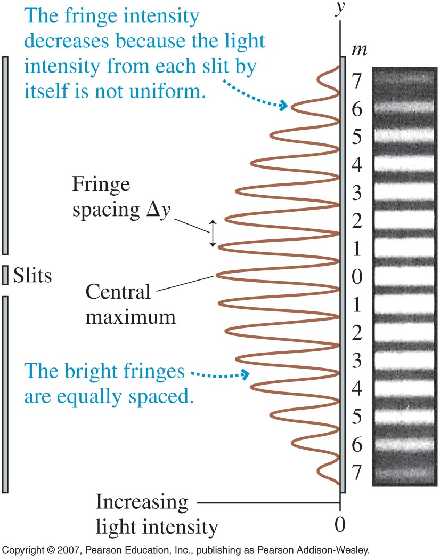
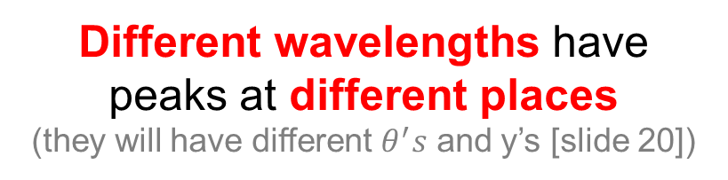
Intensity for Double Slit Interference
Location of fringes is measured from center of the fringe
If we measure the intensity it looks something like this:
What would happen if instead of monochromatic light you had multiple colors present?
Different wavelengths have peaks at different places
(they will have different $θ^{′}s$ and y’s [slide 20])
With just two slits, these peaks could run together

Slide 25
Diffraction Grating
OpenStax Chapter 27.4
Diffraction Gratings
  Peaks are narrow and bright
  Can be used for spectroscopy

Slide 26
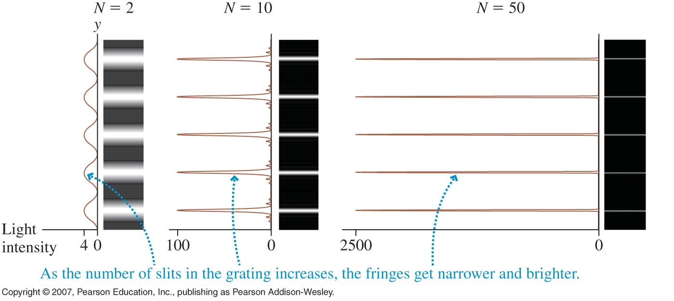
Diffraction Grating
Make thousands of slits: the peaks will be narrower
(they also get brighter)
Slits are closer to each other,
so: d gets smaller
and: θ gets larger
d sin(θ_{m}) = mλ
m = 0,1, 2, 3, …
d = distance between two neighboring slits (not a lot bigger than λ)
All other parameters defined the same as for double slit
y_{m} = L tan(θ_{m}) note: θ is NOT small in diffraction grating

Slide 27
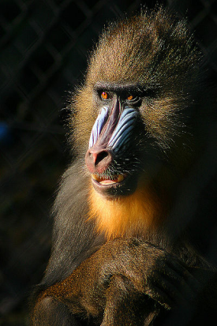
Examples and Uses of Diffraction
Examples
Lab Use
Anything with lots of periodic openings or structures (sometimes in different layers)
Separate light into components
Different wavelengths diffract to different locations
Commercial gratings
Peacock feathers (in part)
Spectroscopy
Mandrill faces
Substances emit and absorb unique sets of wavelengths (spectra)
CDs / DVDs
Identify material based on spectrum
Security holograms

Slide 28
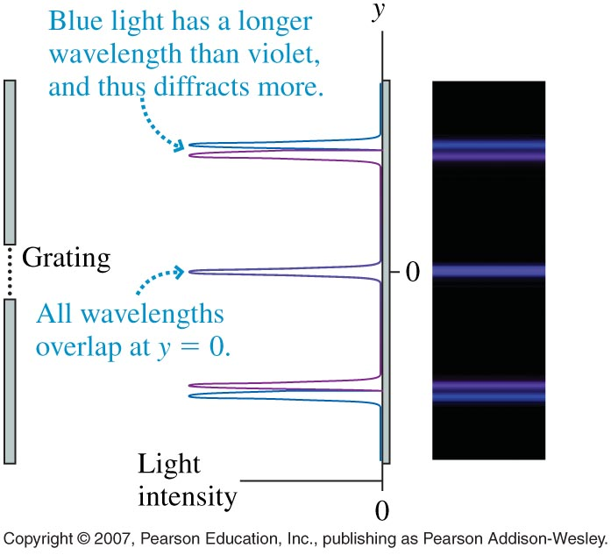
Spectroscopy
Takes advantage of the fact that different wavelengths of light diffract at different angles
Well defined peaks can then be used to find the light’s wavelength
Substances emit unique light in certain conditions
Pattern formed with grating can then be used to identify unknown materials

Slide 29
Diffraction Grating
Light composed of red (λ = 700 nm) and blue-green light (λ = 500 nm) is incident on a diffraction grating. If the grating has a separation of 750 slits per millimeter, what will be the diffraction angles for the first (non-centered) peak for each color?
1. Red: 31.7°; BG: 22.0°
2. Red: 22.0°; BG: 31.7°
3. Red: 0.553°; BG: 0.384°
4. Red: 0.384°; BG: 0.553°
5. Red: 45.0°; BG: 45.0°
Which groups are possible?
A. θ_{r} > θ_{b}
B. θ_{r} < θ_{b}
C. θ_{r} = θ_{b}
Longer wavelengths will always diffract more
d = (1 / 750) mm

Slide 30
Single Slit
OpenStax Chapter 27.5
Single Slit Diffraction
  Huygen’s Principle explains motion of waves
  Wavelets interfere with each other
  Equations only describe location of dark fringes

Slide 31

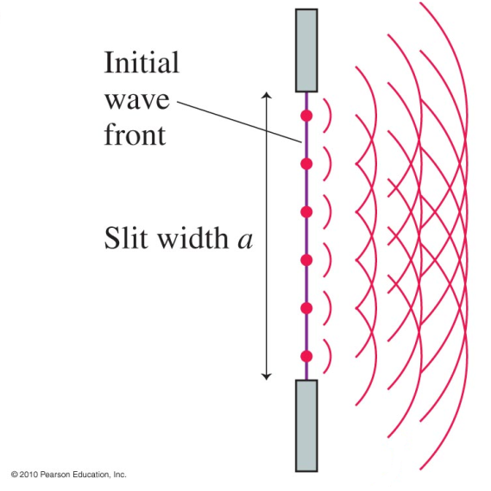
Huygen’s Principle
Geometric principle describing wave travel
At any time, each point on a wave is the source for a spherical “wavelet”
Wave front is whatever shape is tangent to all wavelets
http://en.wikipedia.org/wiki/File:Christiaan_Huygens-painting.jpeg
When wavelets interfere, single slit diffraction patterns are seen
© 2010 Pearson Education, Inc.

Slide 32
Analysis of Single Slit Diffraction
Wavelets interfere with one another causing a diffraction pattern even if there is only one slit
Bright patches will occur when as many wavelets as possible constructively interfere
Bright patches will occur when as many wavelets as possible constructively interfere
Dark fringes will occur when all wavelets destructively interfere
Dark fringes will occur when all wavelets destructively interfere
We’ll find the first dark fringe and extend from there
For the first dark fringe, what pathlength difference should we look for?
λ / 2

Slide 33
Finding First Dark Fringe
For the angle θ of the fringe, we can pair up sources of wavelets like this:
Look at any two wavelet sources that are half the slit away from each other
a
θ₁
a/2
θ₁
The screen is very far away so the rays are almost parallel
For Destructive Interference

Slide 34
Finding First Dark Fringe
For the angle θ of the fringe, we can pair up sources of wavelets like this:
Each wavelet source in the top half exactly cancels out one wavelet source in the bottom half
a
θ₁
a/2
θ₁

Slide 35
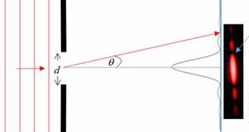


Location of Dark Patches
Starting with this:
For small angles and a screen that is L away from the slit:
$$w$$
$$y_{1}$$
Dark fringes are located at:
Width of central maximum (from first dark fringe on one side to the first dark fringe on the other side) is

Slide 36
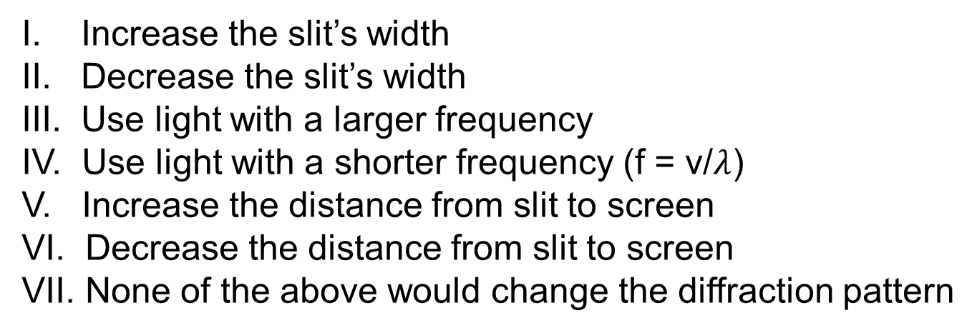
Conceptual Problem
Which of the following actions (independent of the others) would increase the width of the central maximum of a diffraction pattern (more than one answer possible)?
I. Increase the slit’s width
II. Decrease the slit’s width
III. Use light with a larger frequency
IV. Use light with a shorter frequency (f = v/$λ$)
V. Increase the distance from slit to screen
VI. Decrease the distance from slit to screen
VII. None of the above would change the diffraction pattern

Slide 37
Circular Aperture
OpenStax Chapter 27.6
Circular Aperture Diffraction
  Diffraction pattern is circular
    Bright central disk (Airy disk)
    Dark ring and then bright ring … in pattern around it
  We’ll only deal with location of first dark fringe

Slide 38
Diffraction Without Slit
Diffraction also occurs through openings that are shapes other than rectangles
Wave spreads out as appropriate to the shape of the opening
What do you expect the diffraction pattern from a circular opening to look like?
circular
By analogy to diffraction pattern from a slit
Bright center with dark fringe around it followed by another bright ring then another dark ring…

Slide 39
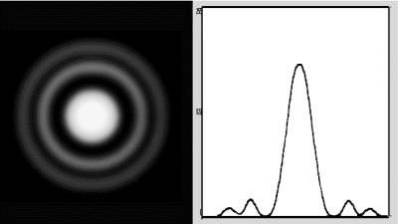
Circular Aperture
Diffraction pattern looks like this:
Central bright spot is called “Airy disk”
http://www.astro.ljmu.ac.uk/courses/phys134/scopes.html
(Derivation is pretty involved)
Angular size of first dark ring (in radians) is given by:
D is the diameter of the aperture

Slide 40
Resolution
OpenStax Chapter 27.6
Circular aperture diffraction
  Bright central disk (Airy disk)
  Dark ring and then bright ring … in pattern around it
Resolution is limited by diffraction

Slide 41
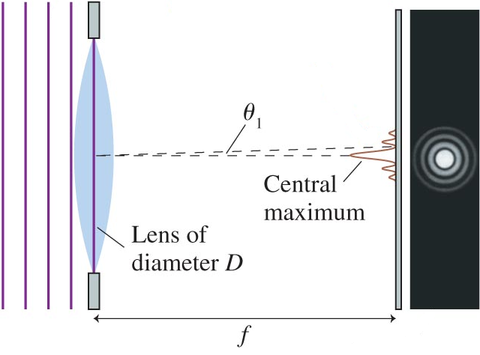
Resolution of Optical Instruments
Diffraction is directly involved in the ability to determine whether or an image is formed by one object or two
Converging Lenses:
1. focus light
2. act like apertures (since only light passing through a lens will be focused by it)
© 2010 Pearson Education, Inc.
You will always get a diffraction pattern when trying to focus on an image
Even a point object will result in a finite image

Slide 42
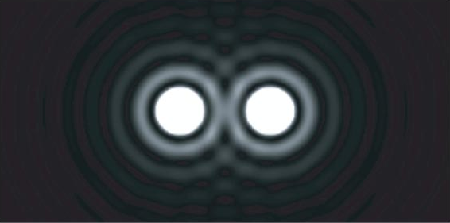
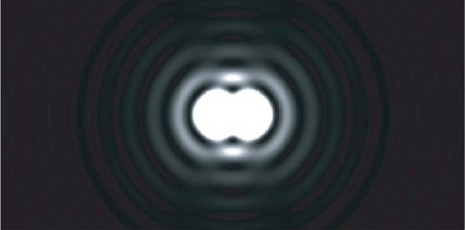
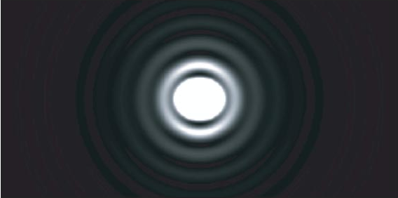
Determining if Two Objects are Separate
Images of stars with a telescope
Farther away
Even farther
© 2010 Pearson Education, Inc.
Can barely tell they’re different objects
Can no longer tell they’re different objects
Definitely different objects

Slide 43
Resolution for Human Eye
Retina
θ₁
Pupil
Diff. Patterns

Slide 44
Thin Film Interference
OpenStax Chapter 27.7
Light behavior at boundaries
  Going to lower index of refraction no phase change for reflected wave
  Going to higher index of refraction phase change for reflected wave of half a wavelength
Thin film interference
  Reflected wave from first and second boundaries can interfere with each other

Slide 45
Light behavior at Boundary
With the ray model of light, we looked at reflection at boundaries
If n₁ ≠ n₂, reflected ray will always be present
Reflected ray’s properties depend on the indices of refraction for the two materials
Reflect (stays in original medium)

Slide 46
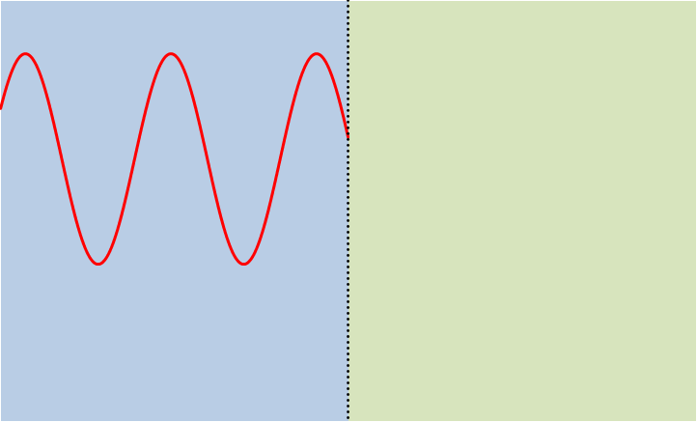
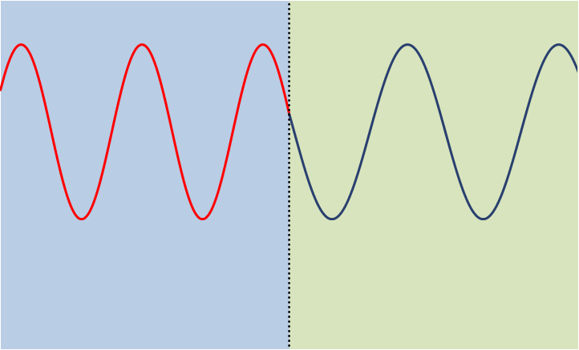
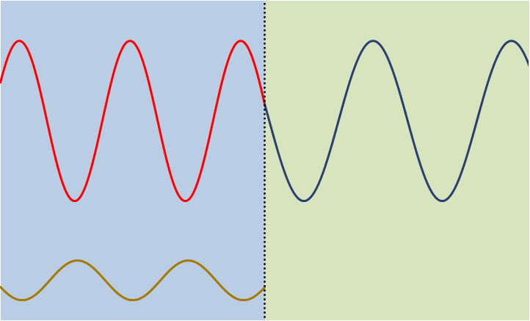
Reflected Light
When light moves into a medium with a lower index of refraction
n₁
n₂ < n₁
Reflected wave looks like mirror image of transmitted
Transmitted wave has longer wavelength
Said to have “no phase change”

Slide 47
No Phase Shift

Slide 48
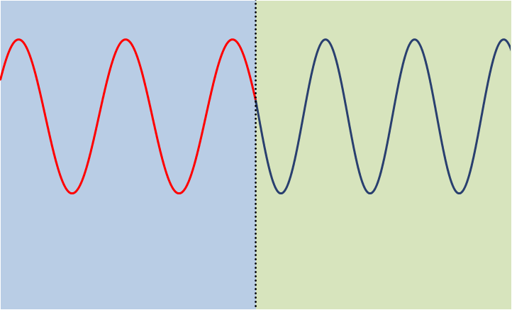
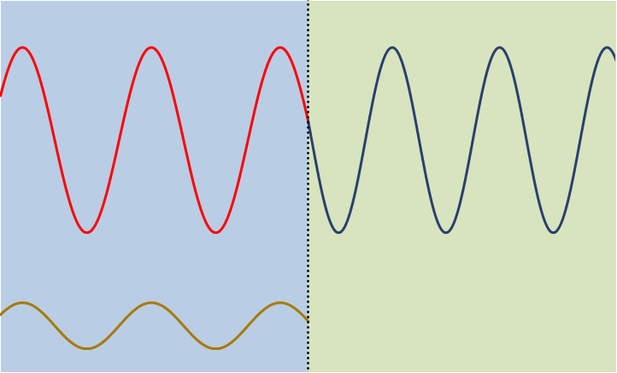
Reflected Light
When light moves into a medium with a higher index of refraction
n₁
n₂ > n₁
Reflected wave looks like a shifted mirror image of transmitted
Transmitted wave has shorter wavelength
Has a “phase change” of λ₁ / 2
(i.e. phase shift changes the path difference by half-wavelength)

Slide 49
Phase Shift

Slide 50






Light behavior with Multiple Boundaries
Light can reflect and refract off of each boundary
Let’s consider three materials:
$$i$$
$$T_{1}$$
$$r_{1}$$
$$T_{2}$$
$$r_{2}$$
$$r_{3}$$
Reflected waves can interfere with each other

Slide 51
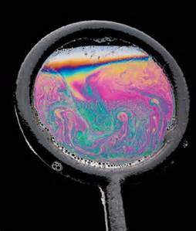
Thin Films - Examples
Soap bubbles
Fingerprints
Oil drops on water

Slide 52
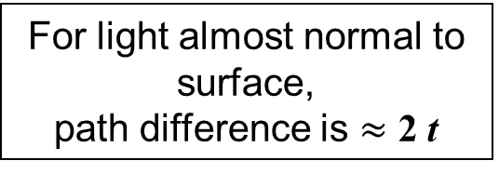


Thin Film Interference
Path Difference
If the middle material is a film of thickness (t) on the order of the light’s wavelength
t
Path difference between the light rays reflected from the left and right side of the thin film is highlighted part
This path difference can produce constructive or destructive interference between the reflected rays
$$i$$
$$T_{2}$$
$$r_{1}$$
$$r_{3}$$
For light almost normal to surface,
path difference is $≈$ 2 t
n₁
n₂
n₃

Slide 53
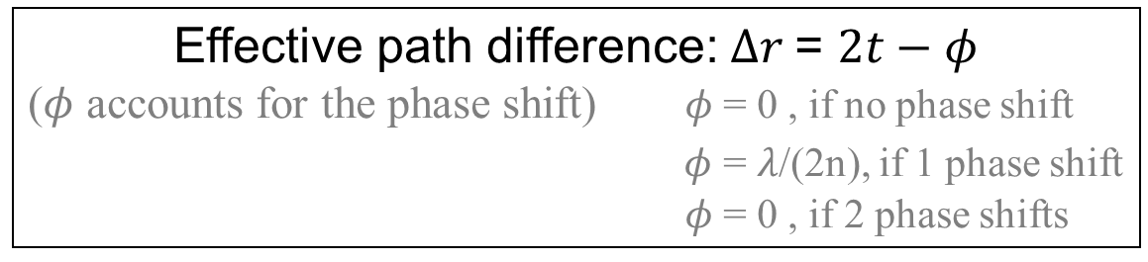
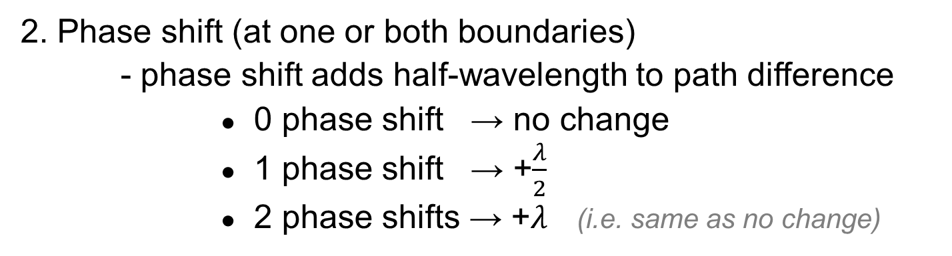

Thin Film Interference
Interference depends on 3 factors:
1. Path difference ($=2t$)
2. Phase shift (at one or both boundaries)
- phase shift adds half-wavelength to path difference
● 0 phase shift → no change
● 1 phase shift → +$\frac{λ}{2}$
● 2 phase shifts → +$λ$ (i.e. same as no change)
3. Refractive index of film (n)
Effective path difference: $Δr$= $2t−φ$
($φ$ accounts for the phase shift) $φ$ = 0 , if no phase shift
$φ$ = $λ$/(2n), if 1 phase shift
$φ$ = 0 , if 2 phase shifts

Slide 54
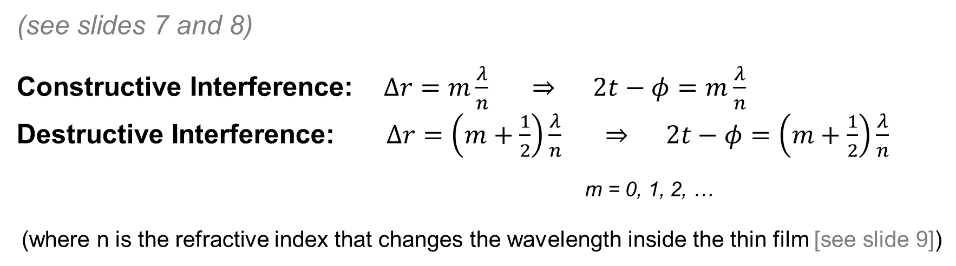

Thin Film Interference
Constructive or Destructive Interference
Effective path difference: $Δr$= $2t−φ$
($φ$ accounts for the phase shift) $φ$ = 0 , if no phase shift
$φ$ = $λ$/(2n), if 1 phase shift
$φ$ = 0 , if 2 phase shifts
(see slides 7 and 8)
Constructive Interference: $Δr=m\frac{λ}{n} ⇒ 2t−φ=m\frac{λ}{n}$
Destructive Interference: $Δr=\left(m+\frac{1}{2}\right)\frac{λ}{n} ⇒ 2t−φ=\left(m+\frac{1}{2}\right)\frac{λ}{n}$
m = 0, 1, 2, …
(where n is the refractive index that changes the wavelength inside the thin film [see slide 9])

Slide 55



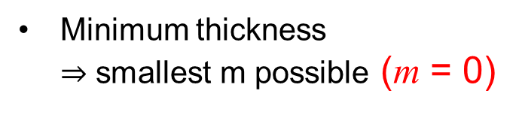
One Use of Thin Film
(anti-reflection coating)
A coating is going to be added to a sheet of glass (n = 1.50) to eliminate the reflection of red light (λ_{air} = 700 nm). If the coating’s index of refraction is 1.30, what is the minimum thickness it can have?
AIR
THIN FILM
GLASS
Air $→$ Thin Film: 1 phase change
Thin Film $→$ Glass: 1 phase change
Total of Two phase shifts
$(φ$ = 0)
n₁=1.0
n₂=1.3
n₃=1.5
we want Destructive Interference: $2t−φ=\left(m+\frac{1}{2}\right)\frac{λ}{n_{2}}$
Minimum thickness
$⇒$ smallest m possible (m = 0)
Would it make a difference if the AIR and GLASS are switched?

