Slide 1
Physics in Robotics
Lecture 03
PSCI 1102
08/26/2022

Slide 2
TinkerCAD Circuit Hands on lecture

Slide 3
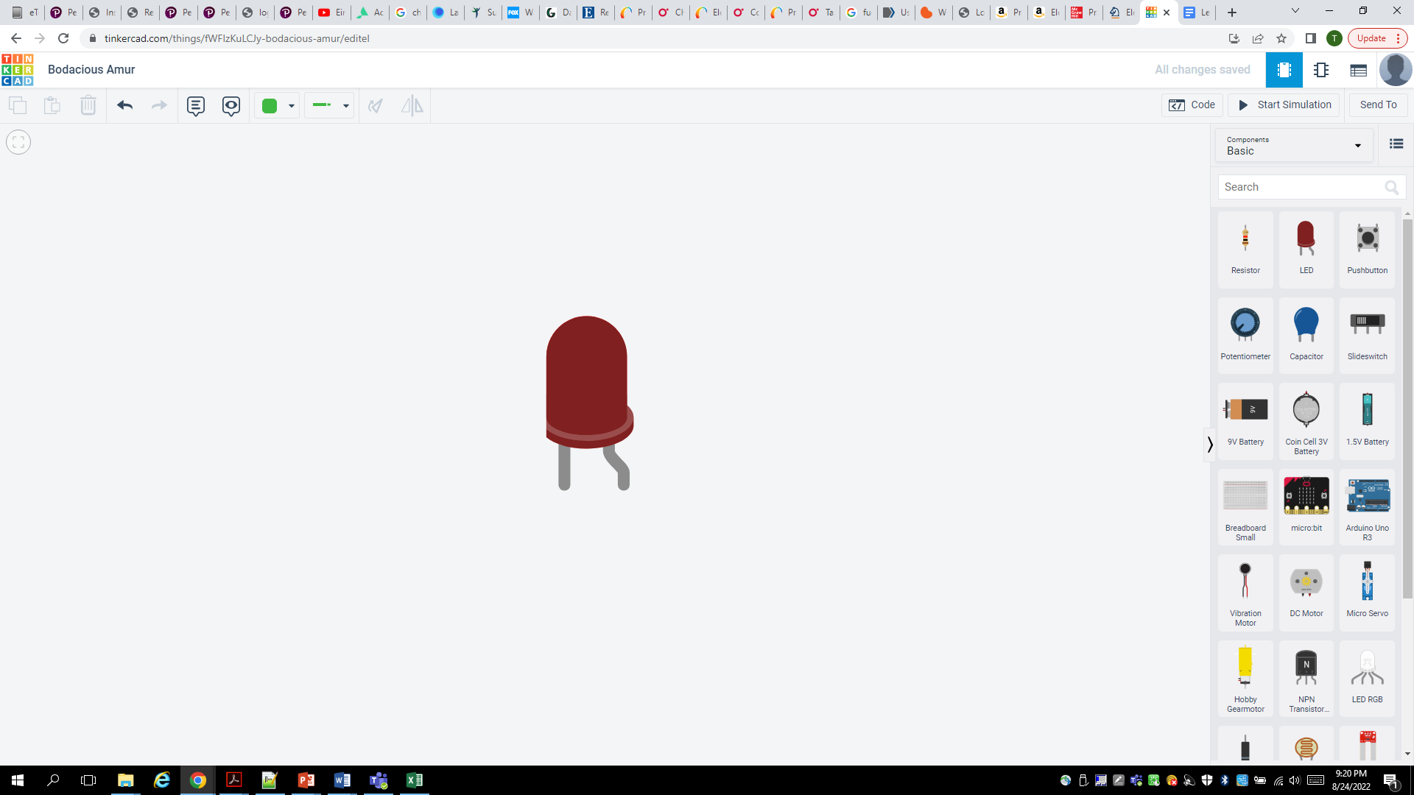

Slide 4
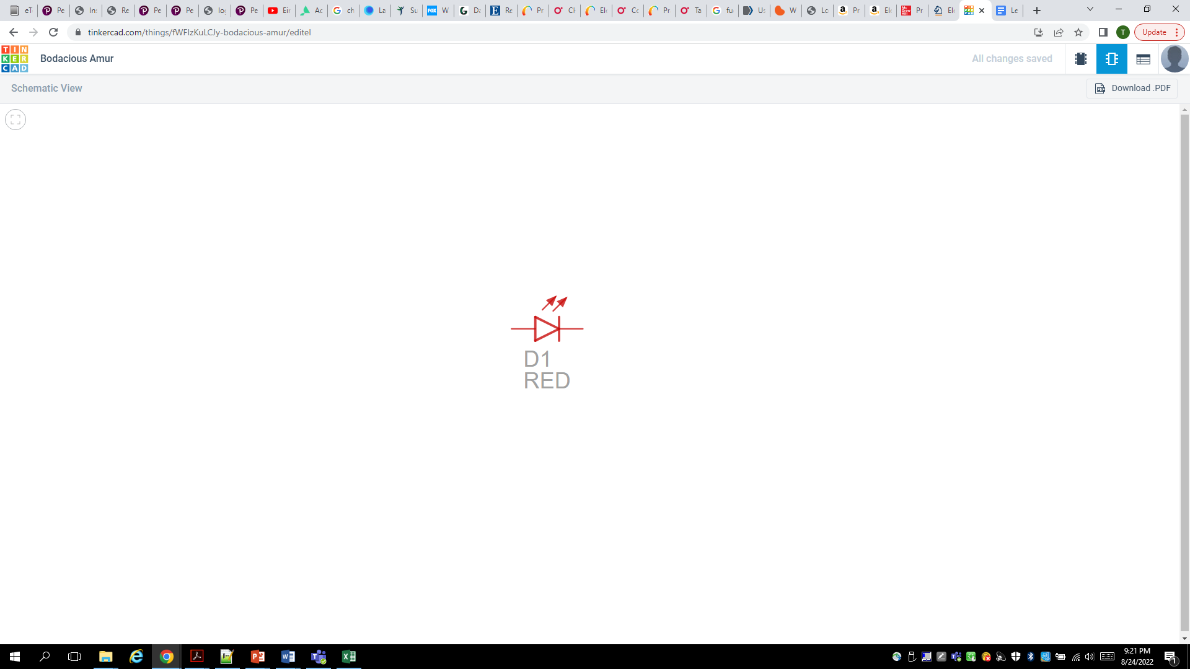

Slide 5
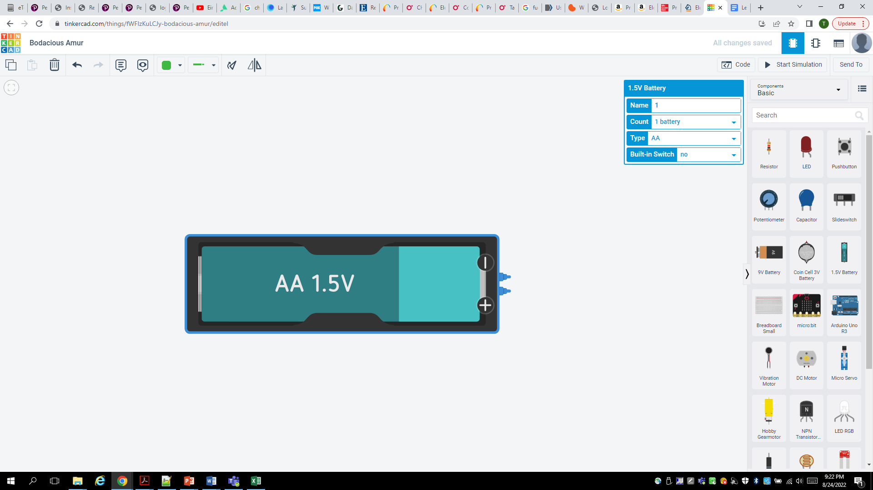

Slide 6
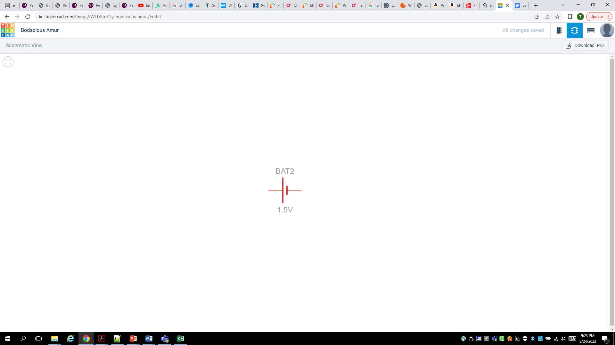

Slide 7
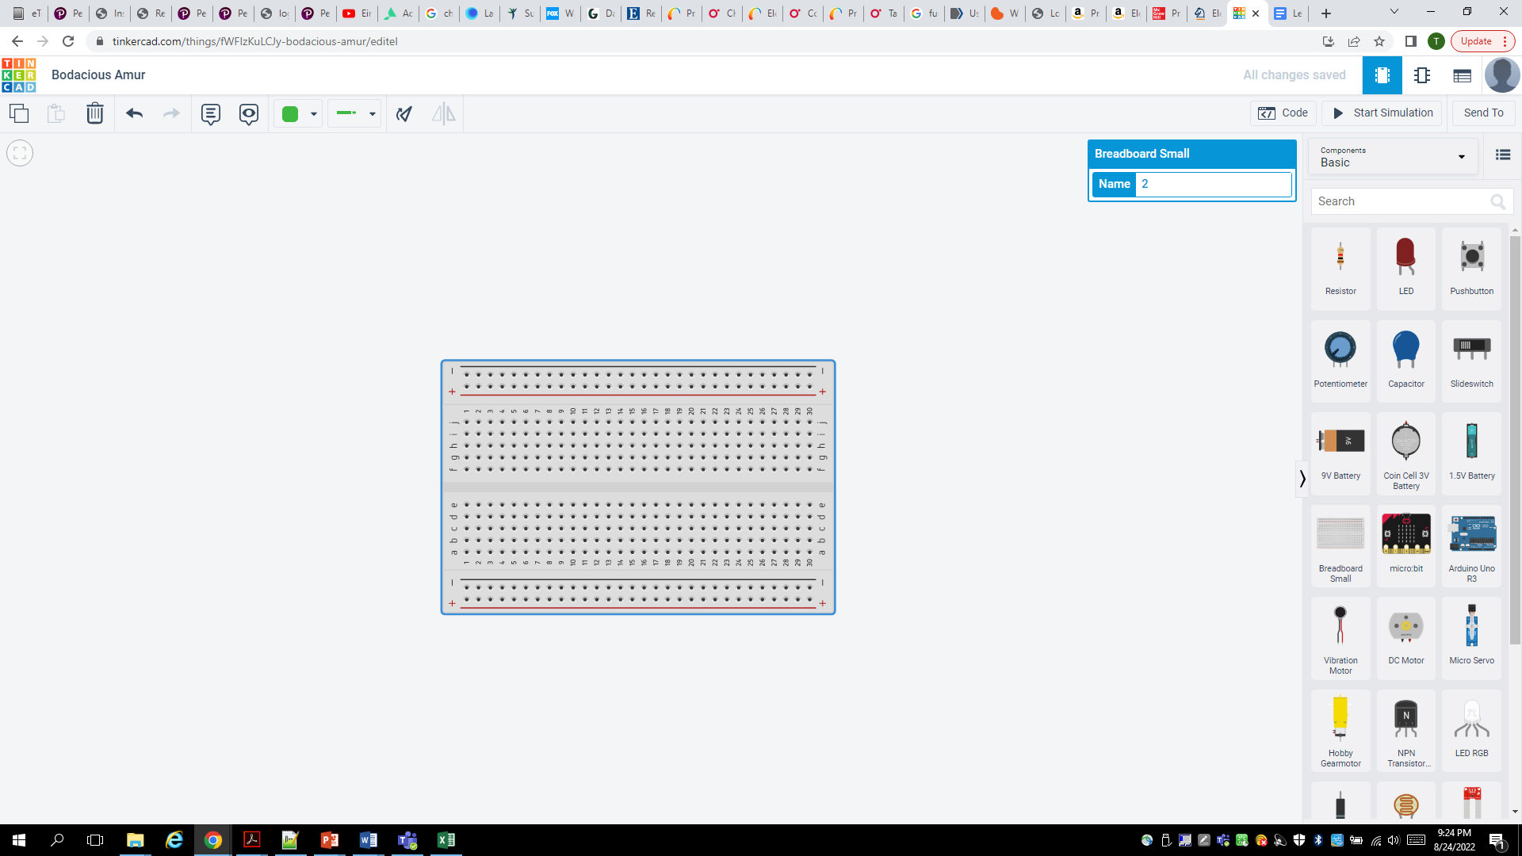

Slide 8
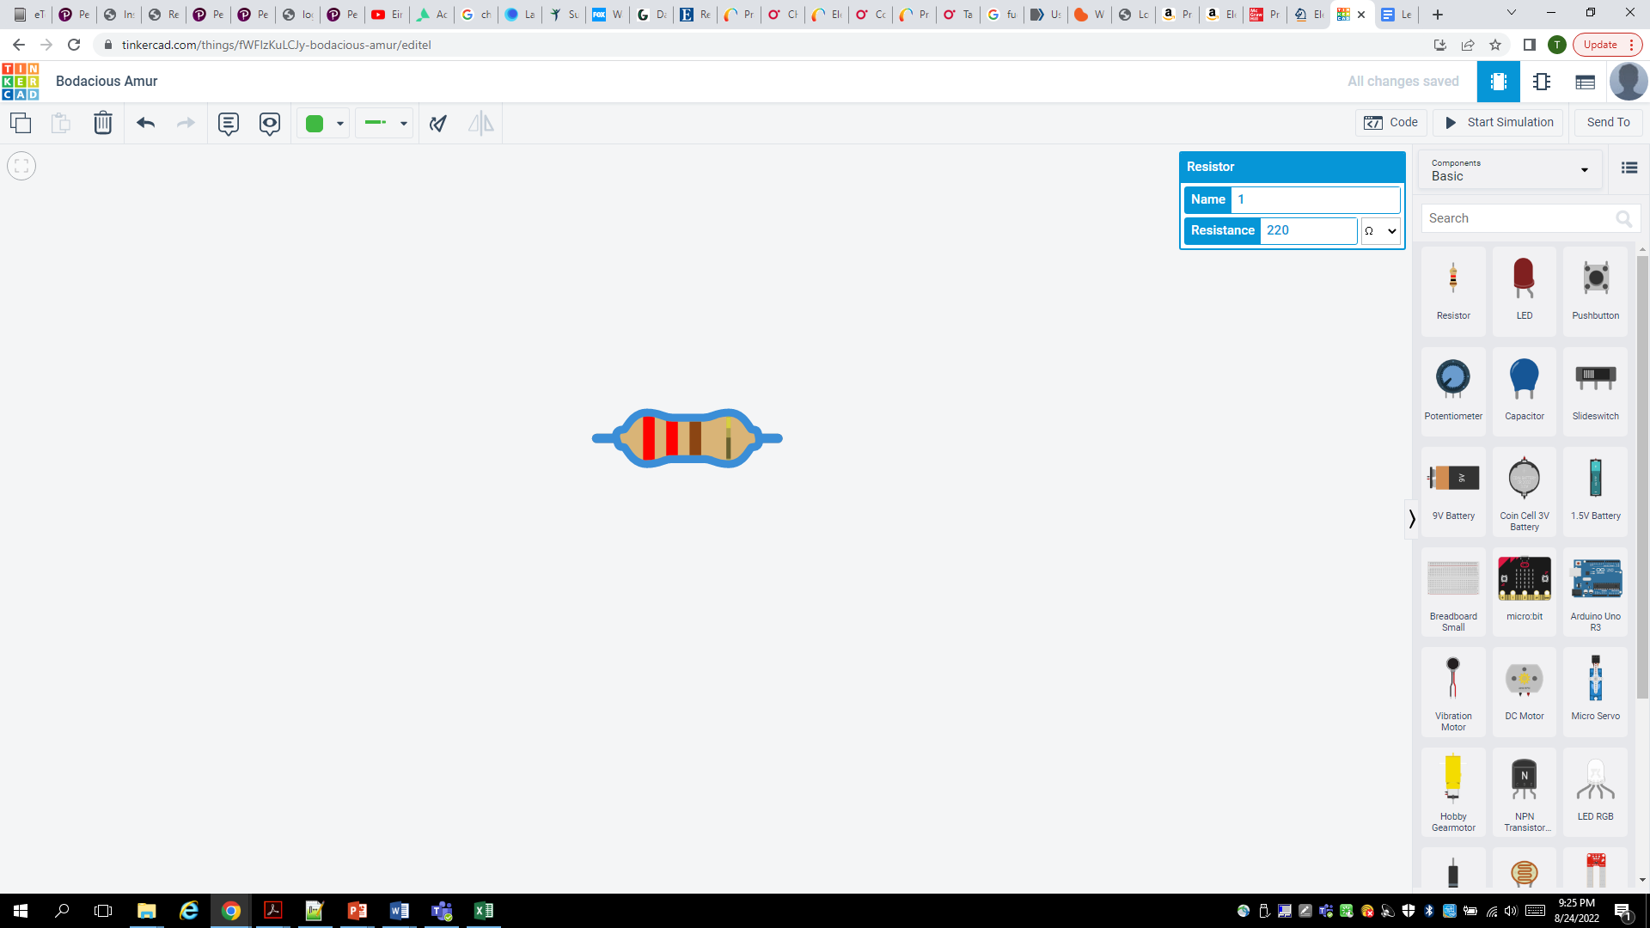

Slide 9
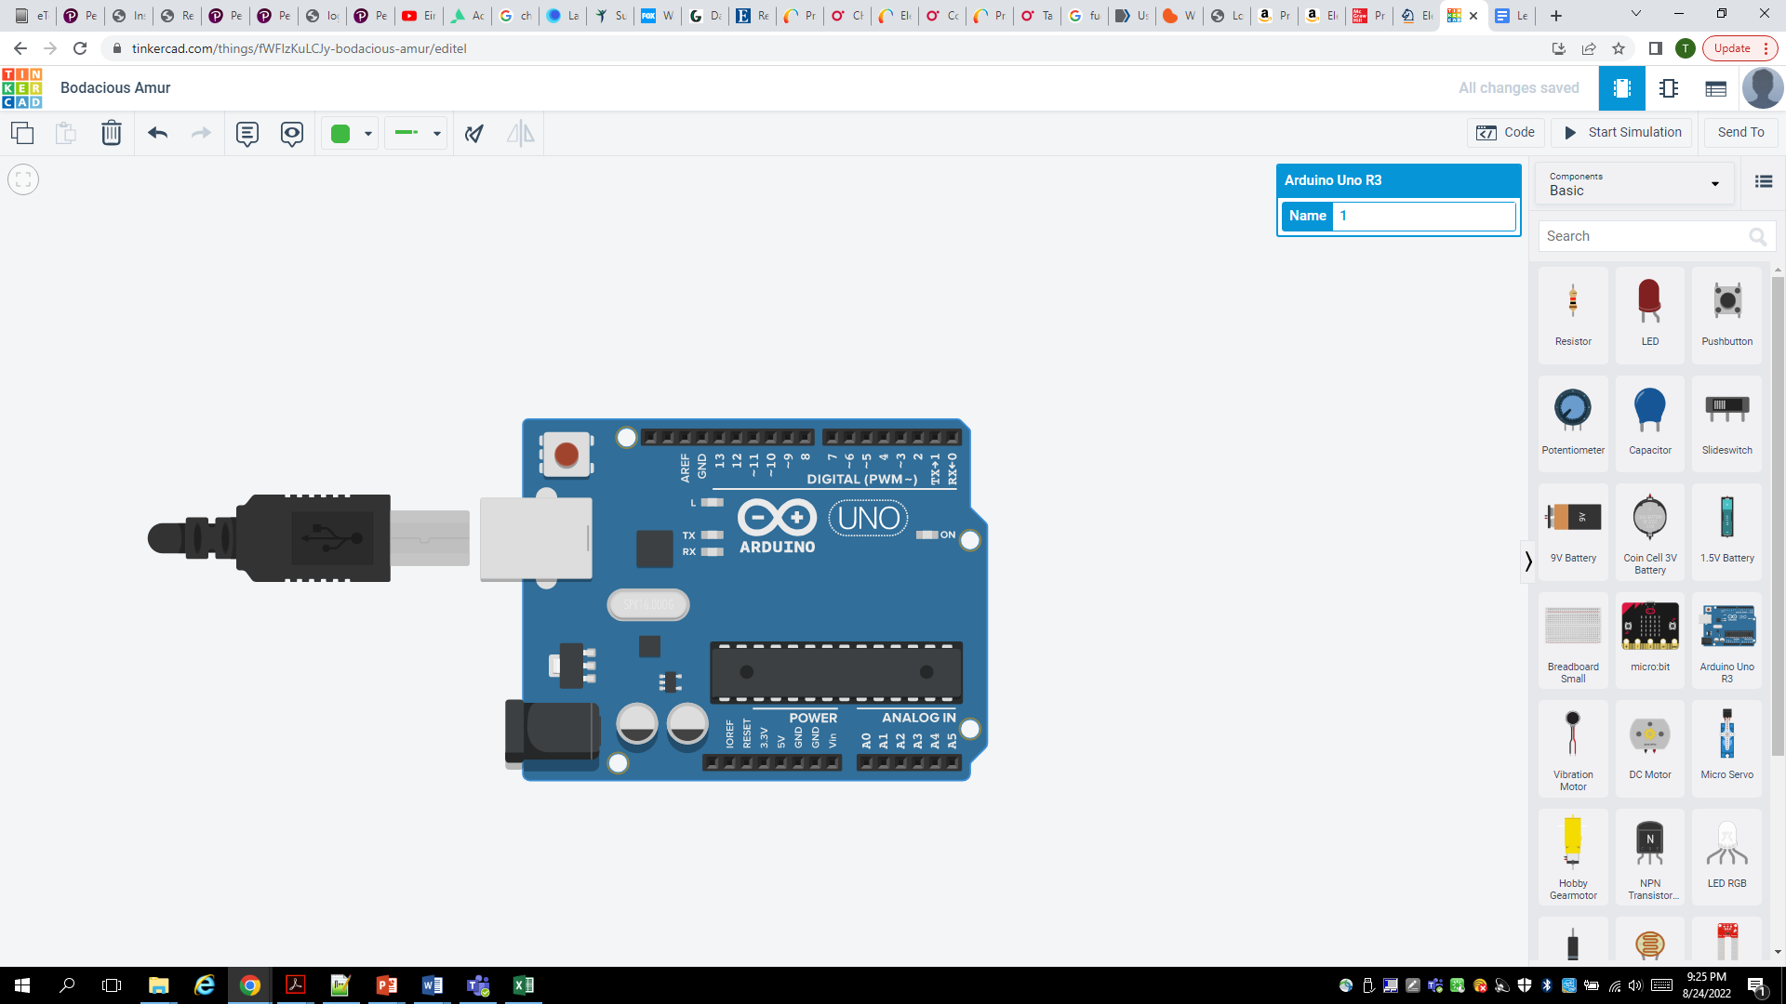

Slide 10
