Slide 1
Electric Potential
OpenStax Chapter 19
Electric Potential Energy
  Based on separation of charges, their signs, and their magnitudes
  Equation doesn’t have absolute value!
  Include ONE potential energy term for each pair of particles
  Youtube: https://youtu.be/MfVgfsJ1paY

Slide 2
One More Way to Look at Electric Fields
(and shade of things to come)
Charges Create:
Electric Field
Charges Interact with Other Charges:
Potential Energy
Force
Force points towards lower Potential Energy

Slide 3
Reminders About Energy
Describes what system currently looks like:
Motion: Kinetic Energy
Position: Potential Energy
Objects released from rest move to lower potential energy

Slide 4
Electrical Potential Energy
Associated with how near charged objects are
Imagine having a large positive object held in place
++++++++++++++++++++++++++++++++++++++++++++++++++++++++++++++++++++++++++++++++++++++++++++++++++++++++++++++++++++++++++++++++++++++++++++
U_{elec} depends on relative sign of charges
Try to hold a proton here:
(need to apply F_{app} to hold it in place)
+
F_{app}
Try to hold an electron here:
(need to apply F_{app} in opposite direction)
F_{app}
–
Proton wants to leave
Electron is happy here
(has high potential energy)
(has low potential energy)

Slide 5
Potential Energy of Two Like Point Charges
Move other charge closer
Charge fixed in place
+
+
+
+
+
Larger force needed to move same distance (because repulsion is stronger)
Small force needed (because repulsion is weaker
Force
Force
Potential energy gets higher as the charges get closer together because of repulsion
(more positive)

Slide 6
Potential Energy of Two UnLike Point Charges
Move other charge farther
Charge fixed in place
+
-
-
-
-
Larger force needed to move same distance
Small force needed
Potential energy gets lower as the charges get closer together because of attraction
(more negative)

Slide 7
Electric Energy and Charges
Imagine having two charges fairly near each other
Types of Charges
Favored/ Disfavored
Potential Energy
2 Positive
Disfavored
High
U_{elec} will be very positive
2 Negative
Disfavored
High
Positive and Negative
Favored
Low
U_{elec} will be very negative
Imagine charges far from each other:
Potential energy should have high magnitude or low?

Slide 8
Potential Energy of Two Point Charges
Like charges:
Higher Potential Energy as they get closer
Unlike charges:
Lower Potential Energy as they get closer
In conservation of energy, include one of these terms for each pair of particles
Requires U_{elec} to be zero when the particles are infinitely far apart

Slide 9
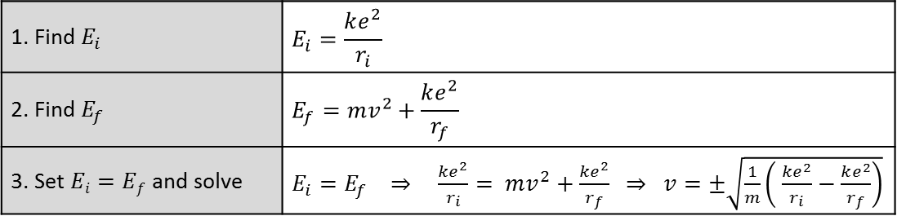
Applying Conservation of Energy (E_{i} = E_{f})
Two electrons are initially held at rest 20.0 nm apart from each other are both released. How fast is each one moving when they are 40.0 nm apart from each other?
1.12 × 10⁵ m/s
1.59 × 10⁵ m/s
7.95 × 10⁴ m/s
1.38 × 10⁵ m/s
1.95 × 10⁵ m/s
1. Find $E_{i}$ | $$E_{i}=\frac{ke^{2}}{r_{i}}$$
2. Find $E_{f}$ | $$E_{f}=mv^{2}+\frac{ke^{2}}{r_{f}}$$
3. Set $Ei=Ef$and solve | $E_{i}=E_{f} ⇒ \frac{ke^{2}}{r_{i}}= mv^{2}+\frac{ke^{2}}{r_{f}}$ $⇒ v=±\sqrt{\frac{1}{m}\left( \frac{ke^{2}}{r_{i}}−\frac{ke^{2}}{r_{f}}\right)}$
1. Which is the correct expression for the system’s initial energy?
2. Which is the correct expression for the system’s final energy (kinetic + electric potential)?

Slide 10
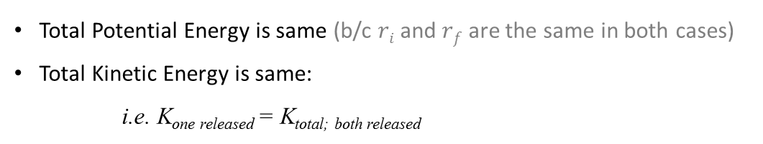
Applying Conservation of Energy
Two electrons are initially held at rest 20.0 nm apart from each other are both released. How fast is each one moving when they are 40.0 nm apart from each other?
c. 7.95 × 10⁴ m/s
If only one electron is released, how fast will it be when it is 40 nm from the stationary one?
7.95 × 10⁴ m/s = v_{both}
1.12 × 10⁵ m/s = √(2)v_{both}
1.59 × 10⁵ m/s = 2 v_{both}
2.25 × 10⁵ m/s = 2^{3/2}v_{both}
3.18 × 10⁵ m/s = 4v_{both}
v_{both} = speed found when both are released (=7.95 × 10⁴ m/s)
Total Potential Energy is same (b/c $ri$ and $rf$ are the same in both cases)
Total Kinetic Energy is same:
i.e. K_{one released} = K_{total; both released}
= 2K_{each; both released}

Slide 11
Potential Energy of Groups of Charges
- Find total energy by summing energy of every pair
Ca²⁺
p⁺
e–
a
a
e– and p⁺
(r = 2a)
e– and Ca²⁺
p⁺ and Ca²⁺
Replace calcium ion with oxygen ion:
O^{2–}
p⁺
e–
a
a
e– and O^{2–}
p⁺ and O^{2–}
Contribution from electron and proton don’t change form
(although the charge in between them is changing)

Slide 12
Electric Potential
OpenStax Chapter 19.2
Electric Potential
  Energy of system can depend on studied particle in other charges electric potential
Electric Potential
  Measure of some charges’ contribution to electric potential energy
  “Measure” of how happy/unhappy particles would be
    Where V is positive, negative particles are happy
    Where V is negative, positive particles are happy

Slide 13
Electric Potential
A charge’s electric potential energy depends on the charge itself and what source charged objects are nearby
Define electric potential to describe what contribution the source charged objects make to the potential energy
Electric potential thanks to source charged objects
Electric Potential Energy
(of system with q in it)
(Similar to the gh in
Charge of a probe particle being studied
SI Unit: Volt (V) = J / C
Scalar quantity (no direction)

Slide 14
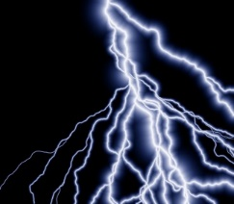
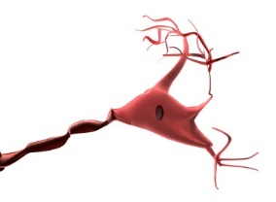

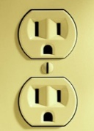
Where Potential Shows Up
Nature
Technology
Lightning
10⁺⁸ V
Starting charges moving
Nerve Cells
Batteries
Resting Potential:
AAA, AA, C, D: 1.5 V
7 × 10^{–2} V = 70 mV
Car: 12 V
Action Potential:
5.5 × 10^{–2} V = 55 mV
Household Outlets
Electric Eels
US: 120 V
600 V
PRC: 220 V
Muscle Depolarization
Europe: 230 V
EKGs

Slide 15
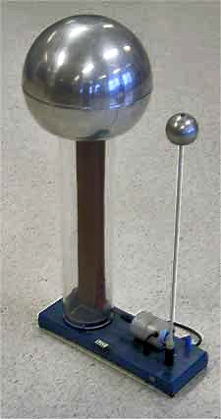
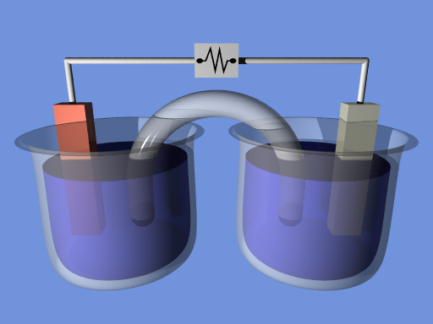
How to Create Potential?
Separate charges from each other
Mechanically:
Van de Graaff generators
Chemically:
batteries
cells
http://en.wikipedia.org/wiki/File:Van_de_graaff_generator_sm.jpg
http://en.wikipedia.org/wiki/File:ElectrochemCell.png
By virtue of being non-neutral, charges create potential
(just like they create electrical fields)

Slide 16
Electric Potential, Energy, and Charges
Starting with:
Potential Energy (U_{elec})is positive when charge and potential have same sign
Sign of Charge (q)
Sign of Potential (V)
Favored/ Disfavored
Positive
Disfavored (+ve U_{elec})
Positive
Negative
Favored (-ve U_{elec})
Positive
Favored (-ve U_{elec})
Negative
Negative
Disfavored (+ve U_{elec})
Therefore: +ve charges tend to move to more –ve potentials,
and –ve charges tend to move to more +ve potentials

Slide 17
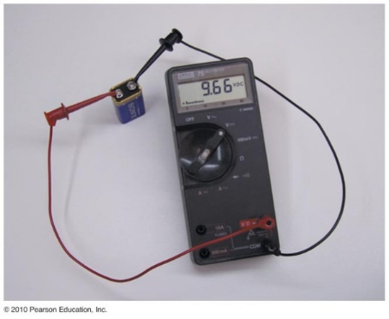
Measuring Electric Potential
Voltmeters measure relative voltage at two different places
(i.e. the difference in potential between two points)
Book’s Notation:
© 2010 Pearson Education, Inc.
Reading is (Probe 1 – Probe 2)
Reverse the probes and you reverse the reading’s sign
Because a voltmeter measures potential difference, zero potential can be set anywhere without affecting reading

Slide 18
Potential Caused by Point Charge
Start with potential energy from two point charges and definition of potential:
Electric potential thanks to q
Charge of a q'
Requires V to be zero when the particle is infinitely far away

Slide 19
Potential from Multiple Sources
(see slide 11)
Find the potential from each individual source as if it was alone
2. Add all of these together
Remember: Electric potential is a scalar
It can be found through simple addition
(no need to find components, as in vector addition)

Slide 20
Electric Potential with Two Charges
If these charges are 3 mm, apart, what is the electric potential directly between them?
Distance for both is 1.5mm
–5 nC
+5 nC
Over here potential is negative
Over here potential is positive
Positive particles would be favored
Negative particles would be favored
V = 0 V

Slide 21
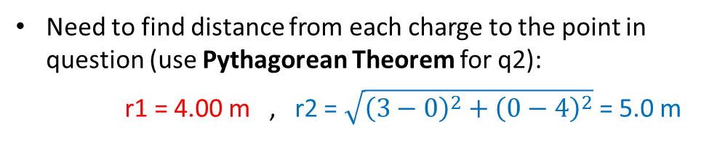

Extra Problem with Two Particles
Two –5.00 μC particles are held fixed: q1 at (0.00, 0.00)m and q2 (3.00, 0.00)m. What is the electric potential at (0.00, 4.00)m?
(Hint: draw a diagram)
Need to find distance from each charge to the point in question (use Pythagorean Theorem for q2):
r1 = 4.00 m , r2 = $\sqrt{{\left(3−0\right)}^{2}+{\left(0−4\right)}^{2}}$= 5.0 m
y
(0,4)
V_{q1} = $\frac{k q_{1}}{r_{1}} = \frac{\left(8.99 ×{10}^{9}\right)\left(−5×{10}^{−6}\right)}{4}$ V = –11.3 kV
r1
r2
q₁
q₂
V_{q2} = $\frac{k q_{2}}{r_{2}}$ = –9 kV
x
V_{combined} = V_{q1} + V_{q2} = $−$11.3 – 9 kV = –20.3 kV
Negative sign shows positive particle would be fairly favored here
(negative particle would be disfavored)

Slide 22
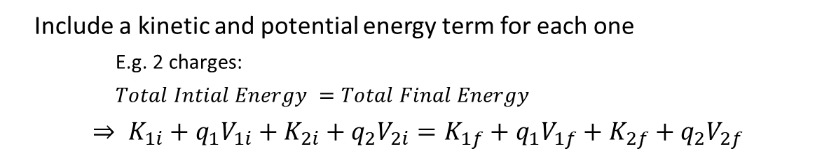
Conservation of Energy
Reminder: Total work done on an object gives its change in kinetic energy
If you only have one charge (that is free to move):
If there are multiple moving charges:
Include a kinetic and potential energy term for each one
E.g. 2 charges:
$Total Intial Energy =Total Final Energy$
$$⇒ K_{1i}+q_{1}V_{1i}+K_{2i}+q_{2}V_{2i}=K_{1f}+q_{1}V_{1f}+K_{2f}+q_{2}V_{2f}$$
Note: Particles want to move towards lower potential energy (more negative or less positive the better)

Slide 23
Set Up with Conservation of Energy:
A proton and electron are released from rest at the dot in the figure. What describes their motion after their release?
20 V
30 V
40 V
Both move left
Both move right
p+ moves left, e- moves right
p+ moves right, e- moves left
Neither moves
Both will move with increasing speed

Slide 24
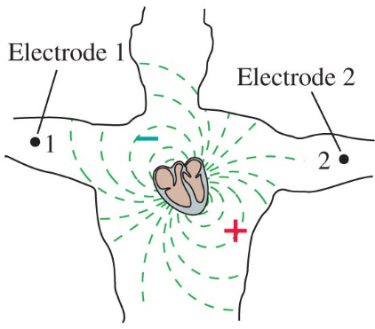
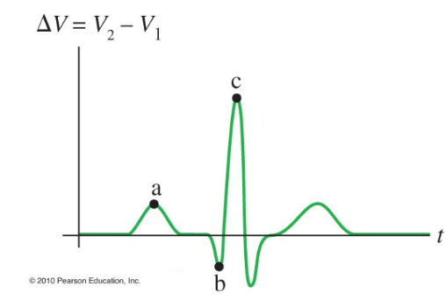

EKG Measurement
EKGs measure potential difference between at different parts of body as heart beats. (They also measure electric field.) The leads shown here are attached on either side of the torso. If point c is a potential difference of 4.5 mV, and an electron was released from rest at electrode 1 , how fast would it be moving when it gets to electrode 2 (assuming the potential difference was constant)?
40,000 m/s
7.5 × 10^{–6} m/s
9.9 × 10¹³ m/s
$→$ typical e– speed in wires
If a proton had been released from Electrode 1, how fast would it be when it gets to Electrode 2?
© 2010 Pearson Education, Inc.
What is the kinetic energy of the electron at 2?
Slower
Faster
Same speed
None of the above
It wouldn’t reach electrode 2
7.22 × 10^{–22} J
+ve particles want to move towards lower potential

Slide 25
EKG Measurement (equations)
If an electron was released from rest at Electrode 1 , how fast would it be moving when it gets to Electrode 2 (assuming the potential difference was constant)?
40,000 m/s
7.5 × 10^{–6} m/s
9.9 × 10¹³ m/s
U_{i} + K_{i} = U_{f} + K_{f}
Since:
If a proton had been released from Electrode 1, how fast would it be when it gets to Electrode 2?
ΔU = U_{f} – U_{i}
= qV_{f} – qV_{i}
= q(V_{f} – V_{i})
=q ΔV
Slower
Faster
Same speed
None of the above
It wouldn’t reach electrode 2
+ve particles want to move towards lower potential

Slide 26
Electron Volts (eV)
Unit of Energy (despite the name)
Values may be reported in eV, but do all calculations in J
Defined as energy associated with a proton or electron going through a potential difference of one volt
(i.e. 1 e x 1 V = 1 eV)
1 eV = 1.60 × 10^{–19} J
In previous problem (slide 24), K_{f} can be found in eV by:
Or since ΔV was +4.5 mV, energy change was 4.5 meV

Slide 27
Electric Fields and Potentials
Electric Potential and Electric Field
  Field is perpendicular to equipotentials
  Field points towards lower potential
  Closer equipotentials means stronger field

Slide 28
Equipotential Lines
One way to visualize potential
Draw (dashed) line through all points that have the same electric potential
5V
10V
15V
20V
Like a contour map of elevations

Slide 29

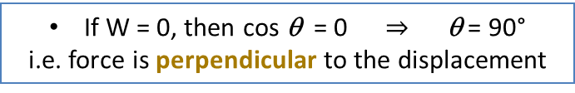
Motion on Equipotential
Does an object moving on an equipotential line change its potential energy?
No (because ΔU_{elec} = q ΔV = 0)
Remember that potential energy is related to work done (W)
If there is no change in electric potential energy,
the electric field must not be doing any work (W = 0)
(where $θ$ is the angle between F and d)
If W = 0, then cos θ = 0 $⇒ \text{q}\text{ = 90°}$
i.e. force is perpendicular to the displacement
Electric force (and field) must be perpendicular to equipotential
0V
1V
2V

Slide 30
Direction of E-Field
Which way would the electric force on a positive charge?
Towards lower potential (see slide 16)
Which way would the electric force on a negative charge?
Towards higher potential (see slide 16)
Which way does the electric field point?
Reminder (lecture 11-13):
For +ve charge, field and force point in the same direction
For -ve charge, field and force point in opposite directions
From high to low potential
+
F
–
F
(Makes sense since high potentials are created by +ve charges, which repels +ve charges and attracts –ve charges)
0V
1V
2V

Slide 31
Relationship between E and V
V_{i}
Change in electric potential between equipotentials
V_{f}
+
d
Electric Field in a region
Perpendicular Distance between equipotentials
Notes:
Above eqn. is true if E = constant (else: only use it in a small region)
Field is strongest when equipotentials are closest
If E = 0 N/C, then V = constant (not necessarily 0 V)
(Alternative unit for E is V / m = N / C)

Slide 32
Using Relation Between E and V
Conceptual
Considering these protons, which will have the largest magnitude acceleration, and what will be the direction of the acceleration?
0 V
– 2 V
B
– 4 V
C
A
– 6 V
Equipotentials are closest for A so it accelerates fastest
Electric field is perpendicular to Equipotentials and towards Lower Potential
(Arrows not to scale)

Slide 33
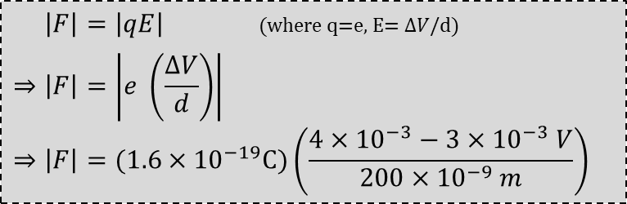
Using Relation Between E and V
Numerical
The equipotentials shown below are 200 nm apart. What is the force on the electron?
0V
2mV
4mV
Which way does the electric FIELD point?
Right
Left
e–
(field points from high to low potential)
Which way does the electric FORCE exerted on the electron point?
Right
Left
1mV
3mV
(for –ve charge, field & force are opposite
8.0 × 10^{–16} N, right
8.0 × 10^{–16} N, left
2.4 × 10^{–15} N, right
2.4 × 10^{–16} N, left
$\left|F\right|=\left|qE\right|$ (where q=e, E= $ΔV$/d)
$$⇒\left|F\right|=\left|e \left(\frac{ΔV}{d}\right)\right|$$
$$⇒\left|F\right|=(1.6×{10}^{−19}C)\left(\frac{4×{10}^{−3}−3×{10}^{−3} V}{200×{10}^{−9} m}\right)$$

Slide 34
One Way to Look at Potential
Field is Force per Charge
“Source” charges create field AND potential (see lecture 11-13 slide 39)
Field and Potential affect other charges (the ones we’d study)
+ + + + + + + + + +
V_{high}
A
+1C
–1C
+2C
B
+1C
V_{mid}
C
+1C
V_{low}
Would have same potential energy
Field is Source’s Contribution to Force
Would have lower potential energy than A and B
Would have highest potential energy
Potential is Source’s Contribution to Energy
Potential is Energy per Charge:

Slide 35
Summary of Electric Field and Potential
Field is strongest when equipotentials are closest
Electric Field is a vector points from high potential to low potential
Electric Potential is a scalar it has no direction
Electric Field is Perpendicular to Equipotentials
d in equation is part of distance that’s perpendicular to Equipotentials too
(that E-field does work along)

Slide 36
A Final Look at Field and Potential
Now With Equations
Single charge:
Electric Field
Potential
Field points towards lower Potential
When multiple charges interact:
Potential Energy
Force
Force points towards lower Potential Energy
(note: potential energy depends on both q and E)

Slide 37
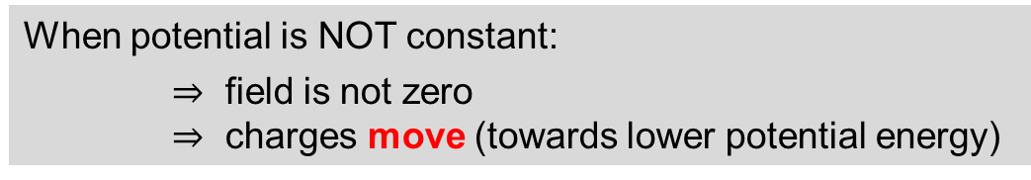
Conductor in Equilibrium
Electric field is zero inside conductor in equilibrium
(may be non-zero on the surface of conductor)
(see lecture 11-13 slide 45)
What does that mean about the potential?
It is CONSTANT (not necessarily zero)
When potential is NOT constant:
$⇒$ field is not zero
$⇒$ charges move (towards lower potential energy)

