Slide 1
Optics
(behavior of light)
OpenStax Chapter 25
Youtube: https://youtu.be/lkm5XY_If6w

Slide 2
Describing Light
There are several different ways to “look” at light:
Light is
a wave
a particle
with some velocity
Light can be treated like a ray
this is an approximation but it’s where we’ll start

Slide 3
OpenStax Chapter 25.1
Ray model of light
  Light travels in a straight line unless if it interacts with a surface / changes media

Slide 4

Ray Model
What do we mean by that?
Rays of light are the geometric kind of ray
Reminder about rays:
Start at point
Point outward as straight line

Slide 5
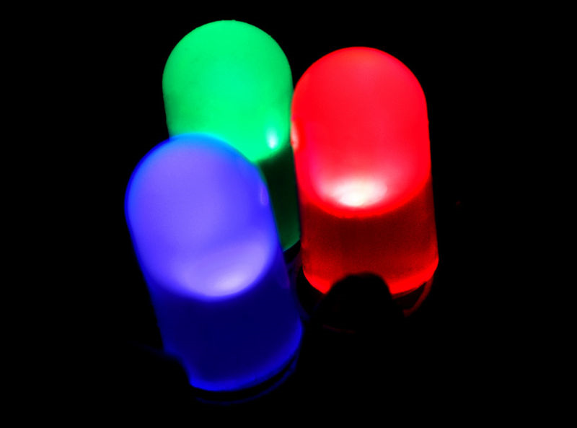
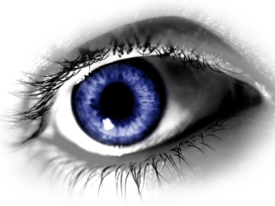
Basic Ideas of Ray Model
Light is represented as a collection of rays
Light source produces an infinite number of rays (one in each direction)
Object is detected when an observer “collects” the rays
(for example rays enter the observer’s eye)
Rays travel in straight line unless they interact with matter
http://en.wikipedia.org/wiki/File:RBG-LED.jpg

Slide 6
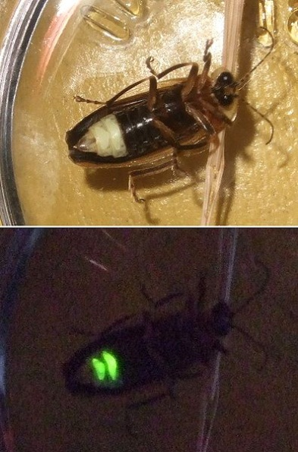
Light Sources
(Light Production)
Self-Luminous Objects (generate light)
Reflective Objects
(just reflect rays)
Fire, electric lights, stars, some animals, etc.
Just about everything else
1. Light bulbs in this room produce light rays
2. These rays bounce off this screen
3. The reflected rays enter the eye or other detector
http://en.wikipedia.org/wiki/File:Firefly_composite.jpg

Slide 7
Rays and Objects
Each object emits rays in all directions
Object 1: know location, trace rays
Object 2: What if you know rays’ trajectories but not object’s location?
Rays can be traced back to find object’s location
When looking for images, trace rays back to find where they intersect

Slide 8
Rays and Matter
When reaching a border between mediums (for example air to water), rays can
Within a medium, light can
Scatter (change direction)
Be Absorbed (light’s energy changes matter and ray ends)
Reflect (stays in original medium)
Refract (travel in new direction into new medium)

Slide 9
Reflection (OpenStax 25.2)
Ray reaches surface at “angle of incidence” θ_{i}
Angle between ray and a normal (perpendicular) line from surface
Ray “bounces” away from surface at “angle of reflection” θ_{r}
normal
Laws of Reflection:
1. Rays and normal are in same plane
2. Those angles are equal: θ_{i} = θ_{r}
θ_{i}
θ_{r}
(Stripes like this generally mean that second material is opaque)

Slide 10
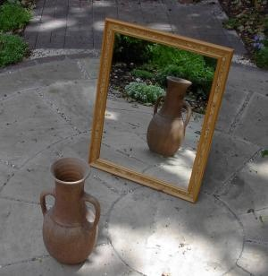
Plane Mirrors
Flat, shiny surface
Light rays that impact on surface reflect off
Observer can detect these rays
http://en.wikipedia.org/wiki/File:Mirror.jpg
Interpret the reflected rays as coming from the “image”
Image location: where it looks like the reflected rays come from

Slide 11
Ray Diagram to Find Image
Draw rays from light source
Rays are straight unless if they encounter mirror
Rays follow Law of Reflection at Mirror (i.e. θ_{i} = θ_{r})
Draw (dashed) line back from the reflected ray
Image is located where the reflected rays trace back to intersect each other
Mirror
Object
Image
Use dot for one point on object
Reflected rays look like they came from image
θ_{i}
θ_{r}
θ_{i}
These are not the only rays that are emitted
θ_{r}
You need at least two rays in any ray diagram
Use three to help check your diagram

Slide 12
Where is the Image for a Plane Mirror?
What we mean by image location:
Place where it looks like all the reflected rays come from
Brain interprets the rays by saying an appropriately sized thing is located there
Image forms behind the mirror
On normal line which passes through the object
What do we mean by “behind the mirror”?

Slide 13
How far back is the image?
Does knowing where the object is tell us where the image is?
Look at a single set of rays and include its normal line
Law of Reflection says these are equal:
The red and green triangles are congruent
(i.e. same shape and size)
Object
θ_{i}
θ_{r}
90°−θ_{i}
90°−θ_{i}
θ_{r}
Image is as far behind the mirror as the object is in front of it
These two are equal
(they’re vertical angles)
Image

Slide 14
Distance Terminology for Optics
Object Distance: s this is distance from the mirror / surfaces / lens to the object in question
Image Distance: s' this is distance from the mirror / surfaces / lens to the object’s image
Measured along a line perpendicular to the mirror/surface/lens (the “optical axis” will be more important when we deal with lenses and curved mirrors)
s
s'

Slide 15
Checking on Object and Image Locations
Which is s?
Which is the following is the image for the object?
A
A
B
C
D
normal
B
“Extension” of mirror
E: None of them are s
C
D
E: None of them are the image location
(because they do not lie on the normal)

Slide 16
Types of Images Terminology
Virtual image: one that is formed by the appearance that light rays originated there
(i.e. formed by intersection of projected (dashed) rays)
e.g. plane mirrors form virtual images
Real image: one that is formed where light rays actually converge
(i.e. formed by intersection of actual rays – see section on lenses)
Virtual Image
Light actually is present at location of real image
but
no rays are actually present at location of a virtual image (for a mirror)

Slide 17
Mirror Image with Ray Diagram
Why don’t mirrors flip up and down?
Side View
For this non-point object:
Rays come from each point of the object (and hit different parts of the mirror)
This could have been an overhead view
Image doesn’t shift up or down (no flip up and down)
There’s also no left-right flip
Each point on the image is in same place w.r.t. mirror as corresponding point on object
(Think about what you would say if there were no context clues)

Slide 18
What if Object isn’t Directly in Front of Mirror?
Someone standing here can see image
no image formed if Bob stands here (on the opaque side)
Can an image still form?
YES
1. Does Bob have to be in front of mirror (to the left in this figure)?
YES
NO
2. Can Bob see his image here?
To create an image, an object must be located in front of the shiny side of the mirror
(not on the opaque side)
s
s'
Bob’s Image
Bob
“Extension” of mirror

Slide 19
Who can see an Image ?
We haven’t worried about the location of an observer so far
Whether or not someone sees an image depends on two main things (measured with respect to the mirror):
Where the object is
For the observer to see an image, reflected rays must reach the observer
Where the observer is
Next, we’ll consider a small object in the middle of a mirror

Slide 20
Who can see an Image ?
Ray Diagram
Stand between reflections of extreme rays to see image
Someone standing near the object should see image
Reflections of “extreme” rays give limits of where observer can be and still see image

Slide 21
Who can see an Image ?
Ray Diagram
Stand between reflections of extreme rays to see image
Someone standing directly behind the object should be able to see it’s image
So should someone standing near the object
Limit for being able to see the image is that the observer is detecting “extreme” rays that just hit the mirror

Slide 22
Finding Last Person to See an Image
In the figure, the mirror is 2 m long, and the object is 1 m away from its left edge. The dashed line is 0.5 m away from the mirror. How far to the right of edge of the mirror can someone standing on the line be and still see an image of the object?
x₁
Law of Reflection says these are equal:
y₁
x₂
y₂
θ_{i}
θ_{r}
So these are similar triangles
(all angles equal)
i.e. x₁/x₂ = y₁/y₂
A. 2 m B. 0.5 m
C. 0.25 m D. 4 m
E. 1 m

Slide 23
What if You Have More than One Mirror?
Method 1: Ray diagram
Send at least two rays to each mirror
Try to have at least two rays reflect off both mirrors

Slide 24
What if You Have More than One Mirror?
Method 1: Ray diagram
Send at least two rays to each mirror
Try to have at least two rays reflect off both mirrors
e.g. two rays that hit horizontal then vertical mirror and vice versa
Keep following this process until rays “escape”

Slide 25
What if You Have More than One Mirror?
Method 2: Image Location
Find image from object and one mirror
I From object and vertical mirror
s_{v} = 4 boxes for object and vertical mirror
s_{v}'
s_{v}
s_{h} = 6 boxes for object and horizontal mirror
s_{h}
For “first generation” images
s_{v}' = 4 boxes for vertical mirror
s_{h}' = 6 boxes for horizontal mirror
s_{h}'
Use each image as an object with the other mirror
II From object and horizontal mirror

Slide 26
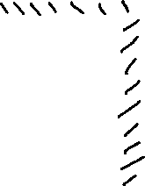
What if You Have More than One Mirror?
Method 2: Image Location
Using I (formed by object and vertical m.) and horizontal mirror
I
s_{I} = 6 boxes (to extension)
s_{I}' = 6 boxes for III
s_{I}
Using II (formed by object and horizontal m.) and vertical mirror
s_{II} = 4 boxes (to extension)
s_{II}' = 4 boxes for III (same position)
s_{I}'
III is an image that does form, but …
III
II
Since III is behind both mirrors (i.e. facing the opaque sides) it won’t create a fourth image
s_{II}'
s_{II}

Slide 27
Two Mirrors Making Multiple Images
Another Image
How do we deal with a situation with two (or more mirrors)?
Yet Another Image
Ray Diagram
One Image
Draw rays which follow the Law of Reflection
Trace them back to find image(s)
(There will also be images down here)

Slide 28

Two Mirrors Making Multiple Images
For object and Upper Mirror:
s = d
How do we deal with a situation with two (or more mirrors)?
so |s'| = d
Upper Mirror
Image Location
d
Find the object’s image in one mirror
d
Lower Mirror
Use this as the object for the next mirror

Slide 29
Two Mirrors Making Multiple Images
For this image and Mirror 2:
s = 3 d
How do we deal with a situation with two (or more mirrors)?
so |s'| = 3 d
d
Image Location
d
Find the object’s image in one mirror
d
Lower Mirror
So far we have two images, we can keep going to get more

Slide 30
Two Mirrors Making Multiple Images
These are the images we found so far
d
Upper Mirror
We could have also started with an image formed by the object and Lower Mirror
d
d
Lower Mirror
Then use this image and Upper Mirror
For the object and Lower Mirror:
s = d
so |s'| = d
(More practice in recitation)

Slide 31
Geometry Techniques for Ray Optics
Some come from Laws
Finding Angles
Use trigonometry for others (make a triangle first)
Similar Triangles
Side ratios are same
Same shape, different size
If a = 2.4, α = 3.6, b = 3.6, then
= 5.4
b
β
To identify
If two angles match, triangles are similar
a
α
Line through center is normal to circle when it reaches the edge
Dealing with Circles

Slide 32
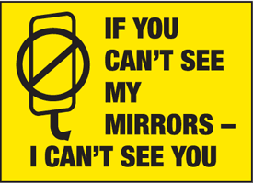
Why do Trucks Have Signs Like This?
Light rays are reversible
If Ray A follows some path
Ray α could follow the opposite path
If rays get from me to you,
then rays get from you to me
http://static.seton.com/media/catalog/product/Truck-Safety-Signs-7258A-001-ba.gif

Slide 33
Curved Mirrors:
Convex and Concave
OpenStax Chapter 25.7
Convex Mirror
  Focal length is negative
  Image is virtual, upright, and reduced
Concave Mirror
  Focal length is positive
  Image is either
    real and inverted
    virtual, upright, and enlarged

Slide 34
Spherical Mirrors Terminology
Instead of a flat surface, mirrored surface is either the outside or inside of a (hollow) sphere
We’ll look at mirrors which are only a portion of the sphere
(fairly flat disks instead of balls)
Radius of Curvature: radius of the sphere which was used to make a mirror
Convex Mirror
Concave Mirror
Reflective side is on outside of sphere
Reflective side is on inside of sphere (looks like a “cave”)
(ray diagrams become a bit more complicated)

Slide 35
Curved Surface
What would happen if we had a curved surface instead of a flat one?
How to define an angle of incidence?
First find the normal line
Perpendicular at the point where the light ray in question reaches the surface
θ_{i}
θ_{r}
Then use law of reflection: θ_{i} = θ_{r} (slide 9)
What about a ray parallel to the first but hitting someplace else?
The reflected ray travels in a different direction

Slide 36
Optical Axis and Focal Point
Optical Axis (OA): line passing through middle of mirror and “center of curvature”
(i.e. similar to extending the radius)
(For plane mirrors f → ∞)
Center of Curvature: center of sphere used to make mirror (C)
f
F
C
Focal Length: measures from focal point to mirror (f)
Focal Point: involved with reflection of rays parallel to optical axis (F)
For fairly flat mirrors (stay near optical axis) focal length is related to radius of curvature (R) by: f = R / 2

Slide 37
Convex Mirrors: Ray Diagram
Use three “Special Rays” to find images
Each one obeys Law of Reflection
1st Ray
Ray which starts parallel to OA
(i.e. optical axis)
normal
Note: with non-plane mirrors, must look at extended object (not single point)
F
C
projected rays pass through F
Reflected ray looks like it came from F

Slide 38
Convex Mirrors: Ray Diagram
2nd Ray
Ray which starts aimed at F (focal point)
image extends from optical axis
F
C
Reflected ray is parallel to the OA
Note: This ray is the reverse of the first special ray (previous slide)

Slide 39
Convex Mirrors: Ray Diagram
3rd Ray
Ray which hits the mirror’s center
θ_{i}
OA is the normal for this ray
θ_{r}
F
C
Reflected ray makes same angle with OA as the incident ray

